Slide 1
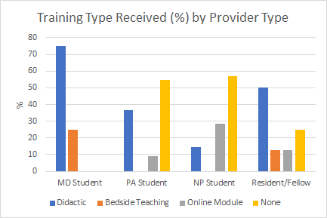
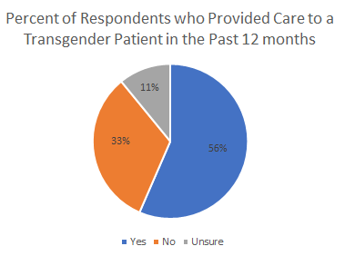
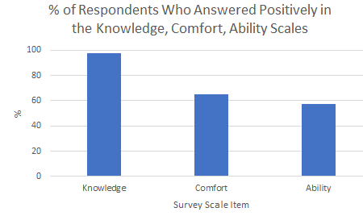
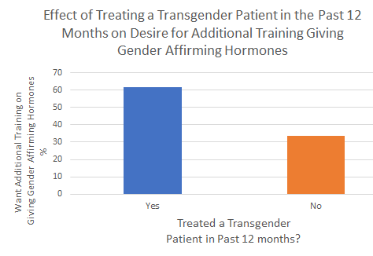
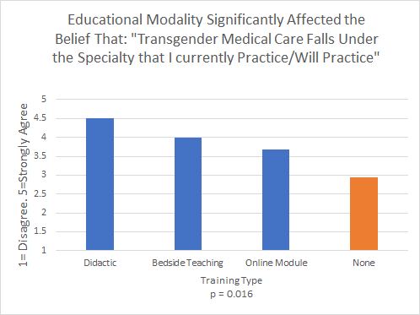
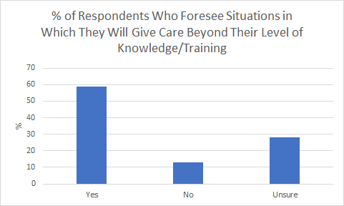
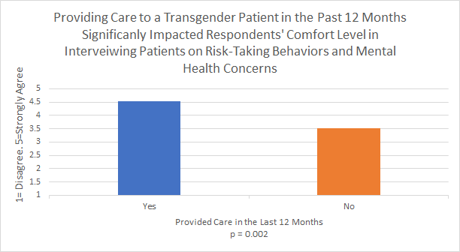
Survey of Healthcare Provider Perceptions of Knowledge, Comfort and Abilities in Care of Transgender Patients at the University of Kentucky
Joshua Borkosky, PA-S, Tiara Cochran, PA-S, Lindsay Kenyon, PA-S, Katya Lundberg, PA-S, Genna Petrey, PA-S, Mandakini Sadhir, MD , Somu Chatterjee, MD
PURPOSE OF STUDY
RESULTS
DISCUSSION and CONCLUSION
The purpose of this study was to assess healthcare providers’ perceptions of comfort, ability and knowledge in the care of transgender patients.
Goal: to identify gaps in providers’ perceived knowledge and proficiency in this patient population to help inform future curricula surrounding transgender patient care with the eventual goal of decreasing barriers to care.
Provider Self-Perceptions and Gaps
The majority of respondents stated they feel they will treat beyond their knowledge or training, reflecting a previous study indicating provider knowledge to be a barrier to patient healthcare.
The lowest scores on the comfort scale indicate that including education on transgender-specific topics such as both counseling patients on medical and surgical transition as well as providing hormonal transition medications and making plans to address psychological needs of patients and families should be considered.
Most education currently in place covers LGBTQ care as a whole, our findings suggest a transgender specific portion is necessary.
Comfort level and perceptions of ability scored lower than self- perceived knowledge. Combined with the high scores that Bedside Teaching and Didactic Curriculum had on all domains of self-perception and on the objective knowledge assessment, exposure to transgender patients through videos within lectures or clinical experience may be a useful supplement to slide-based lecture.
Training and Experience
Providing care within the past 12 months significantly related to self-rankings in comfort in taking risk histories and mental health histories. This leads to further questions – would a standardized patient scenario assist in this process?
A higher percent of those with patient experience and of respondents with didactic training had interest in further training in hormone administration. Integration of a patient simulation in a didactic module could be explored to reduce the provider hesitancy barrier and increase number of providers willing and able to give transgender affirming hormones.
Any training modality in transgender care yielded a higher likelihood that respondents believed primary care is a good venue for hormone therapy. Expanding the role to primary care providers to include the provision of hormonal transition can reduce patient wait times.
Providing training to advanced practice providers (APPs) highlights an opportunity to expand care to transgender patients, as APPs represent a growing proportion of the healthcare system.
Limitations
Convenience sampling and response bias.
Lack variety of providers. Low sample size and low response rate (8%) makes conclusions difficult. Ineffective objective knowledge assessment with low score variability.
Practicing APPs who may get training post-graduation were not included.
Further Study
Qualitative evaluation of online modules and content comparisons of didactic curricula.
Development of a validated and thorough transgender clinical care knowledge assessment for use in further survey research of providers.
INTRODUCTION
A 2016 study showed ~1.4 million adults in the US and ~18,000 adults in Kentucky identified as transgender.
“Transgender” is defined as any individual whose sense of personal identity and gender expression does not correspond with their assigned sex at birth.
Transgender patients face disparities in mental health care, preventive care, and access to care.
Transgender patients have a higher prevalence of HIV, anxiety, depression, substance abuse, and traumatic events.
Transgender patients are less likely to seek care due to discrimination, socioeconomic barriers, long referral wait times, and lack of provider knowledge.
Physicians, medical students, and residents report gaps in their trans-related education, competencies, and knowledge.
This study was designed to identify areas in which healthcare providers lack comfort or knowledge in caring for a transgender patient to inform future continuing medical education curricula and address specifics gaps in transgender care.
METHODS
The study used a web-based exploratory survey of PA, MD and NP students in clinical portions of their curriculum as well as IM-Pediatric residents and fellows in the University of Kentucky healthcare system.
Survey measures: self-perceived ability, comfort in providing care, perceived knowledge of transgender patients, and an objective knowledge assessment.
Provider opinion: regarding which medical specialty is best suited to provide transgender care, opinion on primary care responsibilities for hormonal therapy and the respondent's desire to receive more training in providing care to transgender patients.
The survey was an original creation of the authors and not previously validated. Descriptive statistics and ANOVAs were conducted using SPSS.
REFERENCES
Flores AR, Herman JL, Gates GJ, Brown TNT. How many adults identify as transgender in the United States? Williams Institute. https://williamsinstitute.law.ucla.edu/publications/trans-adults-united-states/. Published April 27, 2020.
Abeln B, Love R. Considerations for the care of transgender individuals. Nursing Clinics of North America. 2019;54(4):551-559. doi:10.1016/j.cnur.2019.07.005
Herbst JH, Jacobs ED, Finlayson TJ, McKleroy VS, Neumann MS, Crepaz N. Estimating HIV prevalence and risk behaviors of transgender persons in the United States: a systematic review. AIDS and Behavior. 2007;12(1):1-17. doi:10.1007/s10461-007-9299-3
Coutin A, Wright S, Li C, Fung R. Missed opportunities: are residents prepared to care for transgender patients? A study of family medicine, psychiatry, endocrinology, and urology residents. Canadian Medical Education Journal. 2018;9(3). doi:10.36834/cmej.42906
Korpaisarn S, Safer JD. Gaps in transgender medical education among healthcare providers: A major barrier to care for transgender persons. Reviews in Endocrine and Metabolic Disorders. 2018;19(3):271-275. doi:10.1007/s11154-018-9452-5
Obedin-Maliver J, Goldsmith ES, Stewart L, White W, Tran E, Brenman S, Wells M, Fetterman DM, Garcia G, Lunn MR. Lesbian, gay, bisexual, and transgender-related content in undergraduate medical education. JAMA. 2011;306(9):971-977. doi:10.1001/jama.2011.1255
Snelgrove JW, Jasudavisius AM, Rowe BW, Head EM, Bauer GR. “Completely out-at-sea” with “two-gender medicine”: A qualitative analysis of physician-side barriers to providing healthcare for transgender patients. BMC Health Services Research. 2012;12(1). doi:10.1186/1472-6963-12-110

