Slide 1
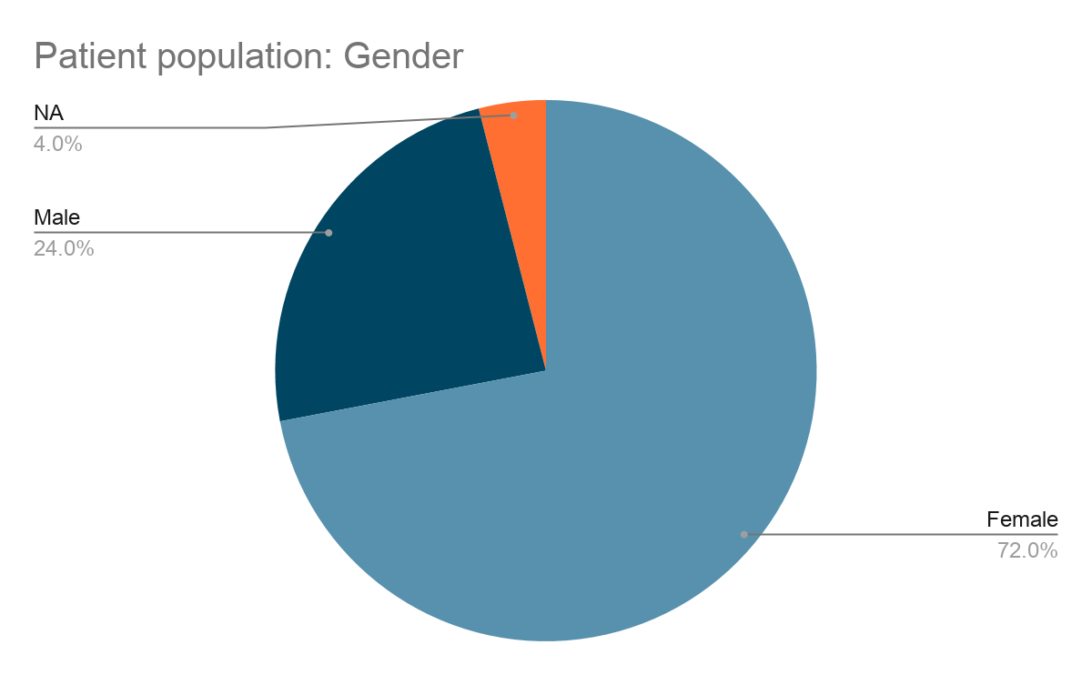
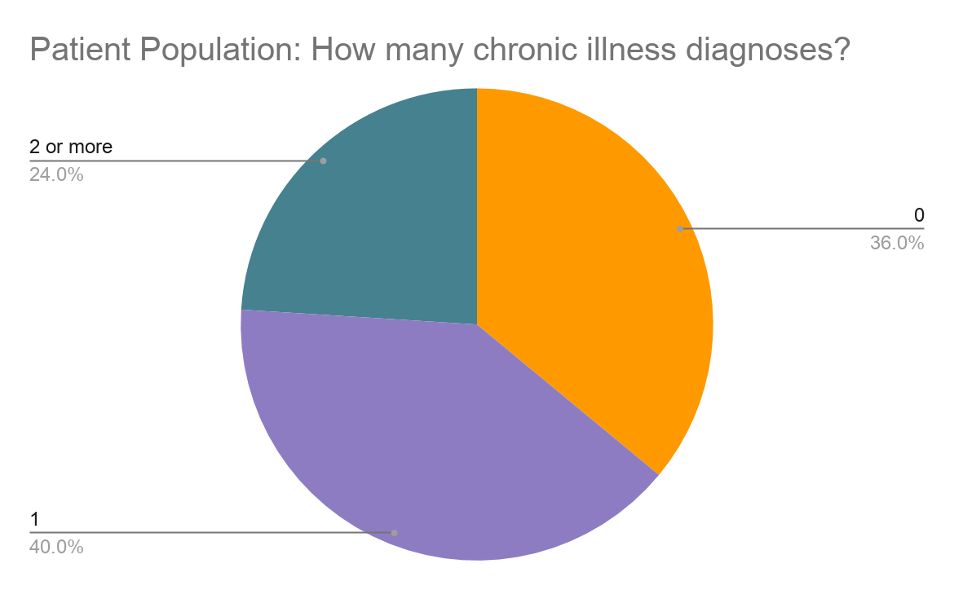
Mindfulness and Depression in Rural Kentucky
K. Bush, S. Combs, A. Howard, A. Marchyn, B. Mckinney, D. Lewis, S. Irving PA-C
Purpose
RESULTS
DISCUSSION
The purpose of this study is to investigate if mindfulness engagement decreases depression severity in rural KY adults (18+) when using a Patient Health Questionnaire-9 (PHQ-9), a validated and self-administered depression presence and screening tool.
Mindfulness was described as praying, meditating, taking time for yourself, deep breathing and spending time in nature.
The results indicated there was not a statically significant relationship between mindfulness practices quantified by time, and decreased PHQ-9 scores.
Additionally, a correlation study to analyze PHQ-9 scores in relation to gender and chronic illnesses, specifically increasing numbers of chronic illnesses were not statistically significant either.
The next step in the research is another study concerning the influence of mindfulness practices to lower the severity of depression in rural patient populations. Improvements to the research design are threefold.
Including an explicit definition of mindfulness and outline specific mindfulness examples
Asking participants if they are prescribed and actively taking an antidepressant as pharmacotherapy or participating in a therapy program
A survey format inclusive of telehealth patient visits
Correlations
 |  | PHQ-9 total score
Mindfulness total time (minutes) | Pearson Correlation | -0.170
 | Sig. (2-tailed) | 0.416
 | N | 25
INTRODUCTION & BACKGROUND
A recent study found that 50 percent of primary care patients with depression are undiagnosed or underdiagnosed (Barrett, Kathleen, and Yu-Ping Chang)^{[1]}. Primary care centers around prevention, so it’s alarming that many patients are undiagnosed. More research needs to be conducted around this topic and is the main reason the research team chose to study a primary care setting versus a mental health facility.
Rural Kentucky is known for being geographically isolated which directly impacts its residents’ access to care. Research shows evidence that incorporating mindfulness into treatment plans decreases depression and leads to better patient outcomes (Lei F)^{[3]}. Mindfulness is an alternative treatment option for depression that could be practiced at home by patients in rural communities. Although there has been abundant research regarding mindfulness and depression, an astonishing lack of exploration has been conducted focusing on rural areas. This study aims to fill those gaps.
Table 1.
CONCLUSION
In conclusion, the study lacks statistical evidence in support of mindfulness engagement causing a decrease in depression in adults from rural KY that were given a Patient Health Questionnaire-9 (PHQ-9). Limitations of the study shed light on recommendations for future research such as using a larger population and adding a specific question to the PHQ-9 that address if the patient is officially diagnosed with depression. Also, the study recommends having a backup research administration plan for telehealth visits. Even though the study did not show significant results, it laid the groundwork for future research to be conducted from. Research is lacking in mindfulness engagement and its impact on depression in rural health populations. Furthermore, the study that was conducted helps create a starting point to fill in the gap in the medical literature.
METHODS
Figure 1a. Figure 1b.
This was an observational, cross-sectional study using a survey that included a PHQ-9 questionnaire and set of additional questions to capture demographic and past medical history information regarding prevalent health conditions in rural Kentucky that seeks to observe the correlation between mindfulness and depression. The research team recruited patients from the St. Claire Family Medicine clinic at the CHER building location in Morehead, Kentucky.
Using IBM SPSS Statistics Version 26, a correlation was run to find the relationship between PHQ-9 scores and total time performing mindfulness activities, in addition to PHQ-9’s correlation to gender, heart disease diagnosis, diabetes diagnosis, cancer diagnosis, and depression diagnosis.
Reliability estimates for the two subscales (PHQ-9 and Mindfulness) were calculated via Cronbach’s alpha and further examined through inter-item correlation means.
SUMMARY OF RESULTS
When the mindfulness and PHQ-9 data collected from patients in a rural Kentucky primary care clinic was analyzed using correlation, the results were not statistically significant (r(24)=- .170, p= .416). An additional correlation also analyzed PHQ-9 total score with gender and other chronic illnesses. No statistically significant relationship was observed.
Cronbach’s alpha demonstrated reliability with acceptable levels of internal consistency (PHQ-9 α = 0.904; Mindfulness α = 0.646); furthermore, inter-item correlation means were within acceptable levels (PHQ-9 x̅ = 0.904; Mindfulness x̅ = 0.646).
REFERENCES
[1] Barrett, Kathleen, and Yu-Ping Chang. “Behavioral Interventions Targeting Chronic Pain,
Depression, and Substance Use Disorder in Primary Care.” Journal of Nursing Scholarship, vol. 48, no. 4, 2016, pp. 345–353. PubMed, doi:10.1111/jnu.12213.
[2] Kroenke, Kurt. “Depression Screening and Management in Primary Care.” Family Practice, vol. 35, no. 1, 2017, pp. 1–3. PubMed, doi:10.1093/fampra/cmx129.
[3] Lei F. Influence of Depression on Treatment and Survival: A Population-based Study in Patients with Breast Cancer in Kentucky. 2018.
Acknowledgements: Dr. Woltenberg

