Slide 1
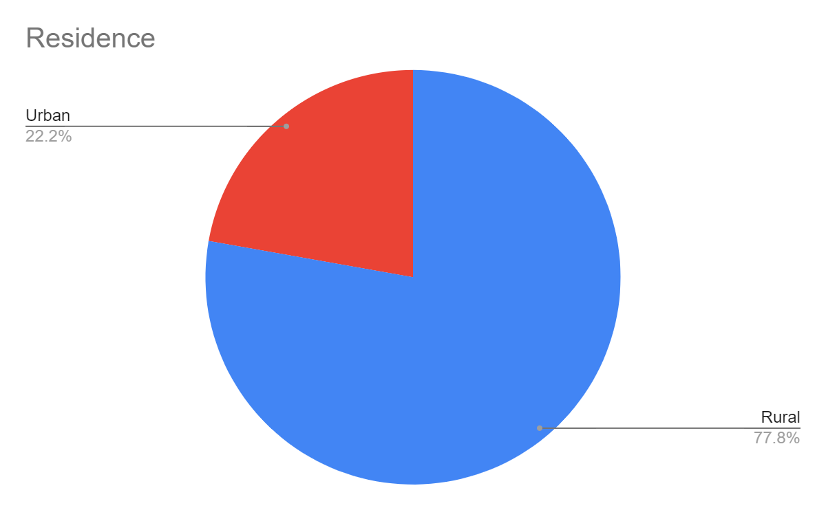
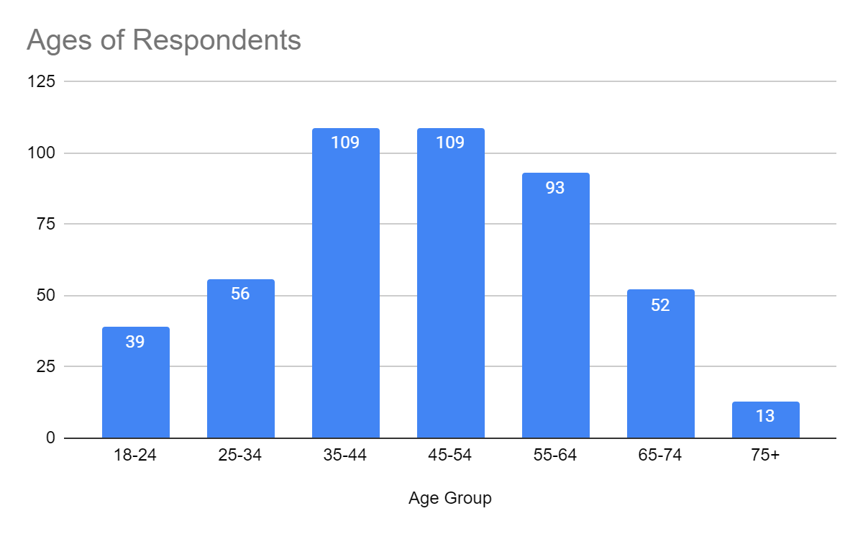
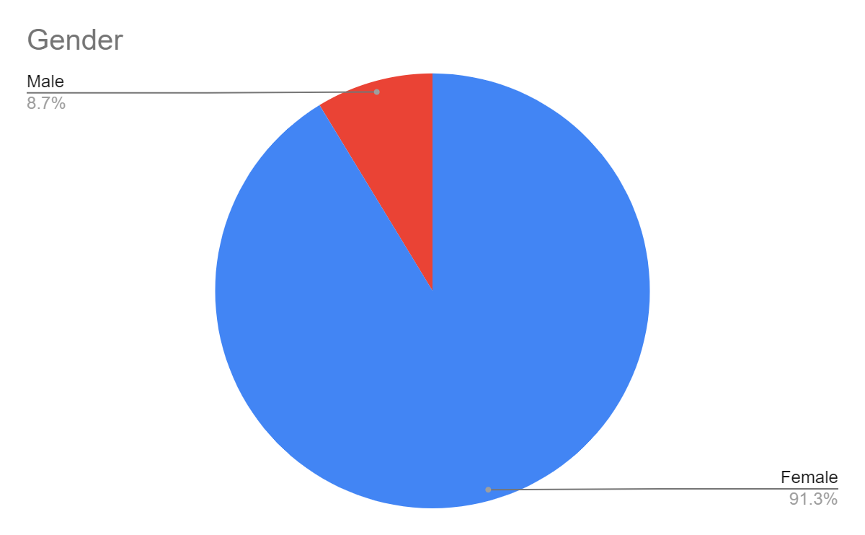
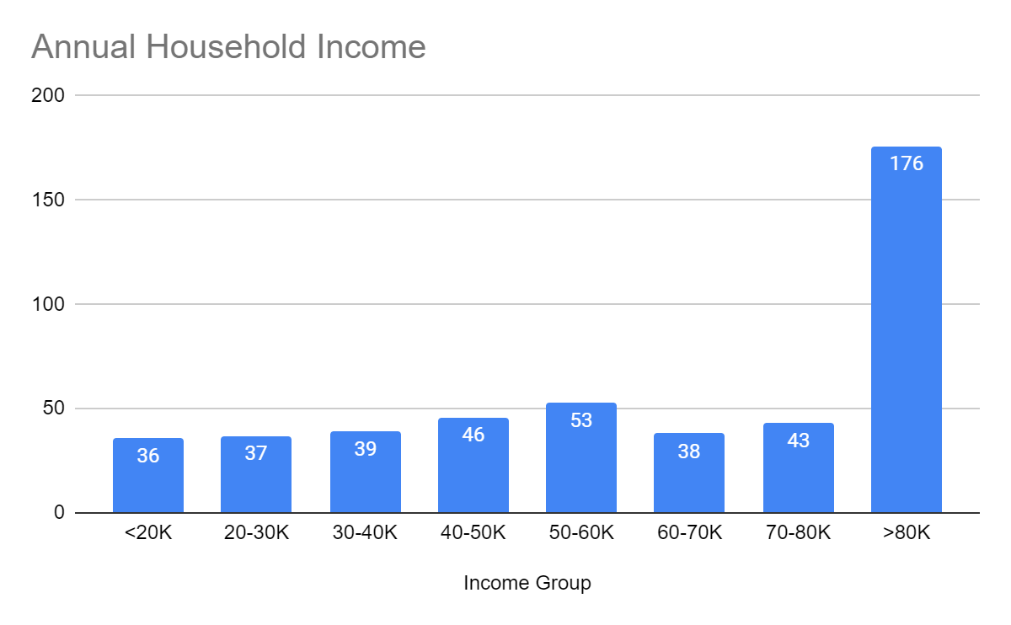
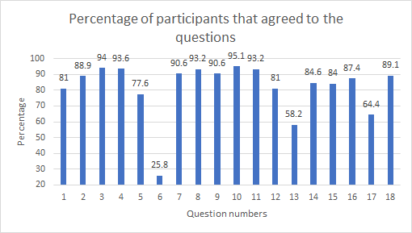
Patient Perception of Their Role
in Team Based Care
Elizabeth Ison, Elizabeth Moss, Nicholas Noble, Cory Ramsey, Onieta Stewart, and Joshua Burkhart, MSPAS, PA-C
INTRODUCTION
RESULTS
SUMMARY OF RESULTS
Historically, physician(s) have been the ones responsible for the healthcare of a patient and have been the ones to make decisions about patient care, not taking the patient’s opinions into consideration.⁶ Research is now discovering that healthcare is becoming more patient centered.⁴ Approaching healthcare in this way allows patients to play a more active role and help control the course of their care.⁶ Although the switch has been recognized, little research has been performed investigating a patient's perspective of their role within team based care. The way a patient views their role within the team could have an impact on their healthcare adherence and overall experience. It is known that healthcare is improved when a patient is directly involved in the decision-making process and when a team-based model is used for healthcare.^{1, 2, 3, 4, 5} Many of the benefits of patient involvement in their care have been explored, but it is less understood the extent to which it is practiced in rural Kentucky or how these rural patients perceive their own role in modern medicine.
There was a significant difference between respondents level of education and whether they agreed that they had looked up information about their condition and treatment (p<0.0001, r=0.164), with 95.9% of respondents with an associates degree or greater reported that they have looked up information regarding their healthcare.
Few statistically significant differences were noted between the urban and rural populations; a significant difference was noted for the total number of diagnoses (urban having more) and the level of agreement for items 3, 4, and 10.
35% of participants agreed that they had a final say in their treatment while disagreeing that “the doctor knows best and I should just do what they say.”
78.4% of respondents agreed to both “I want to have an active role in my healthcare” and “My provider asked what I thought and listened to what I had to say.”
Participants who responded that they want to take an active role were found to agree with action items related to participating in their care (items 7, 10, 11, 14, & 17) with statistically significant differences and varying degrees of weak correlation (see figures)
PURPOSE OF STUDY
Table 1: Survey Items with Descriptive Stats and Agreement
The objective of this study is to better understand how adult patients in rural Kentucky who have at least one chronic medical condition perceive their role in team-based care. The research group hopes to discover whether patients understand their influence on the treatment plan and the importance of their role as a member of their healthcare team, whether they have an active or passive role in the management of their care, and whether or not they feel comfortable discussing their opinions with their provider.
Question | Mean | Median | Mode | Standard deviation | Percent Agreeing
1. I am an important member of my healthcare team | 4.18 | 4 | 5 | 1.01 | 81.0%
2. My opinion matters when planning my treatment with my provider | 4.31 | 4 | 5 | 0.86 | 88.9%
3. I am responsible for my own health | 4.47 | 5 | 5 | 0.79 | 94.0%
4. I want to take an active role in my healthcare | 4.52 | 5 | 5 | 0.79 | 93.6%
5. I am able to disagree with my provider | 2.82 | 3 | 3 | 1.00 | 77.6%
6. The doctor knows best and I should just do what they say | 4.29 | 4 | 4 | 0.75 | 25.8%
7. My opinion matters when discussing medications | 4.43 | 5 | 5 | 0.70 | 90.6%
8. I understand my medications and why I am taking them | 4.31 | 4 | 4 | 0.77 | 93.2%
9. The provider explained my treatment plan using words I understood | 4.48 | 5 | 5 | 0.71 | 90.6%
10. I am comfortable asking my provider questions about my care | 4.45 | 5 | 5 | 0.72 | 95.1%
11. I have looked up information about my condition and treatment | 4.13 | 4 | 4 | 0.89 | 93.2%
12. My provider asked what I thought and listened to what I had to say | 3.60 | 4 | 4 | 1.09 | 81.0%
13. My provider asked whether I agreed or disagreed with the plan | 4.15 | 4 | 4 | 0.82 | 58.2%
14. I can ask for a treatment or test | 4.16 | 4 | 4 | 0.83 | 84.6%
15. My provider makes an effort to include me in decisions about my care | 4.24 | 4 | 4 | 0.82 | 84.0%
16. I have final say in my treatment | 3.64 | 4 | 4 | 1.22 | 87.4%
17. I use my patient portal to monitor my healthcare | 4.21 | 4 | 4 | 0.75 | 64.4%
18. I am satisfied with the healthcare that I receive | 2.77 | 3 | 3 | 0.73 | 89.1%
DISCUSSION & CONCLUSION
The study group concluded that, based on this survey, patients believe they take an active role in their health care. Patients participate in the discussion and voice their opinions with healthcare providers about their health. It can also be concluded that the more informed a patient is, the more likely they will take an active role in their healthcare. Implications from this study can be incorporated into daily practice to help patients be a more active participant on their healthcare team.
Table 2: Comparing Intention with Action Items.
METHODS
“I want to take an active role in my healthcare” Compared to: | Percentage Agreeing to both items | P value | R value
My opinion matters when discussing medications | 87% | <0.0001 | 0.292
I am comfortable asking my provider questions about my care | 91% | <0.0001 | 0.378
I have looked up information about my condition and treatment | 89.9% | <0.0001 | 0.273
I can ask for a treatment or test | 81.6% | <0.0001 | 0.264
I use my patient portal to monitor my healthcare | 62.3% | <0.0001 | 0.174
The survey Patient’s Perceptions of Team Based Care is an 18 question Likert scale survey. It was administered to a convenience sample of patients in H2 Health (a small rural physical therapy clinic in Richmond KY) and at Primary Plus clinics in Maysville, Vanceburg, Augusta, Flemingsburg, Ashland, Tollesboro, and Grayson Kentucky. Additionally, the survey was released as a clickable link on a social media platform such as facebook to allow for a broader range of participants. The survey was designed around a 6th grade reading level with voluntary response and open between January 15 to February 20, 2021. A total of 1,045 surveys were completed. After raw data was cleaned and exclusions were removed a total of 469 surveys were analyzed.
REFERENCES
Crawford MJ. Systematic review of involving patients in the planning and development of health care. Bmj. 2002;325(7375):1263-1263. doi:10.1136/bmj.325.7375.1263
Burton D, Blundell N, Jones M, et al. Shared decision-making in cardiology: Do patients want it and do doctors provide it? Patient Educ. Couns. 2010; 80: 173-179.
Sanford K, Rivers A. Treatment adherence perception questionnaire: Assessing patient perceptions regarding their adherence to medical treatment plans. APA. 2020; 32(3):227-238.
Szafran O, Kennett SL, Bell NR, Green L. Patients' perceptions of team-based care in family practice: access, benefits and team roles. J Prim Health Care. 2018;10(3):248-257. doi:10.1071/HC18018
Brady TJ. The patient's role in rheumatology care. Curr Opin Rheumatol. 1998;10(2):146-151. doi:10.1097/00002281-199803000-00011
Epstien R, and Street R. The values and value of patient-centered care. Ann Fam Med. 2011:9:100-103. doi:10.1370/afm.1239
A P value is statistically significant when <0.05. An R value is defined as weak (r = 0.20-0.29); moderate (r = 0.30-0.49); strong (r = 0.5-1.0)
Notes:
SPEAKING:
Jayde: intro Cory: results
Elizabeth: results
Onieta: methods
Nik: discussion/conclusion

