Slide 1
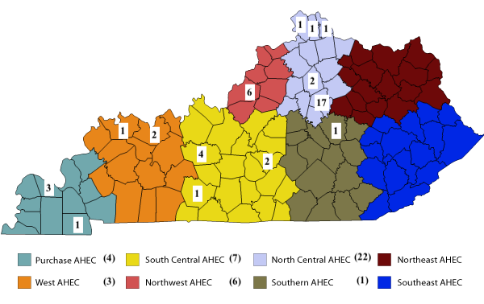
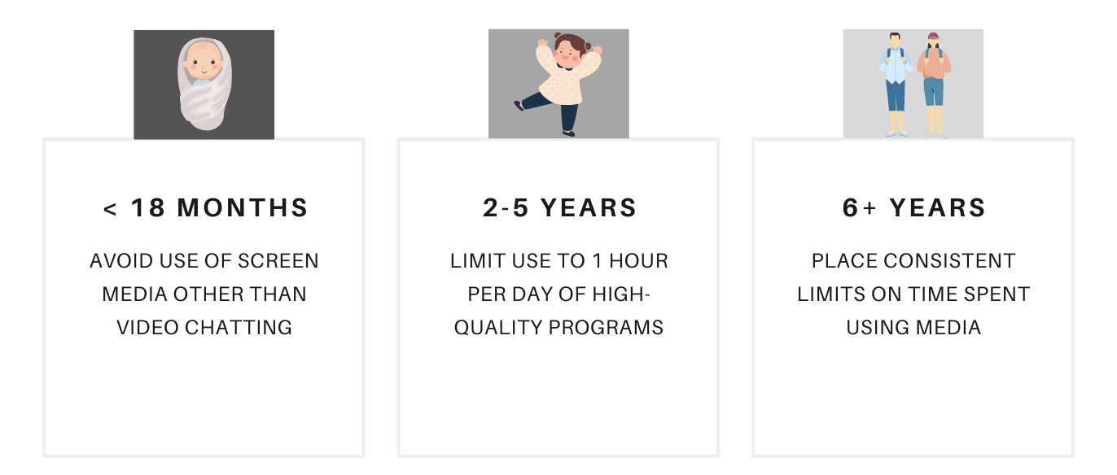
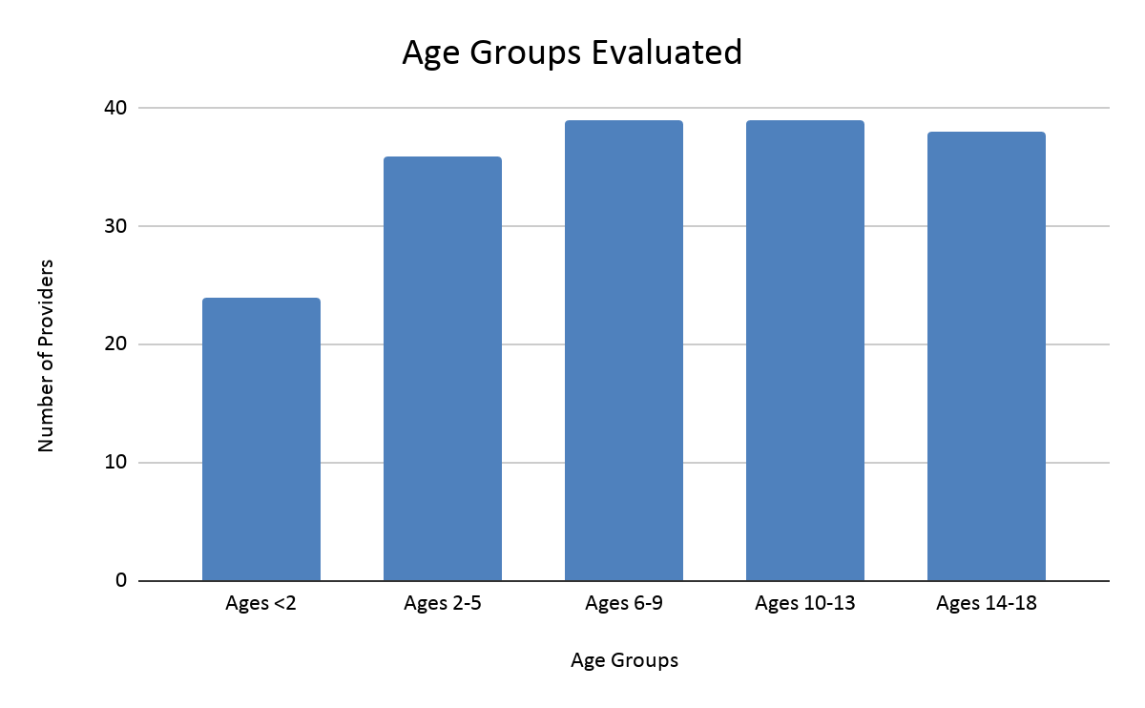
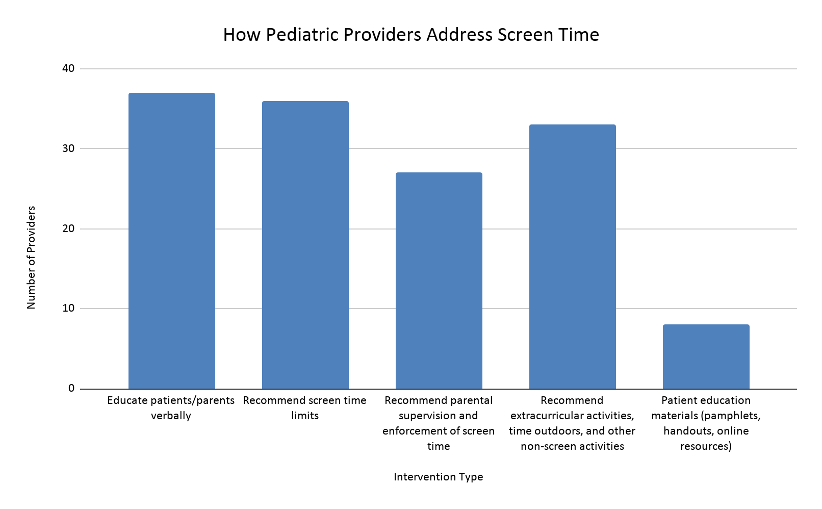
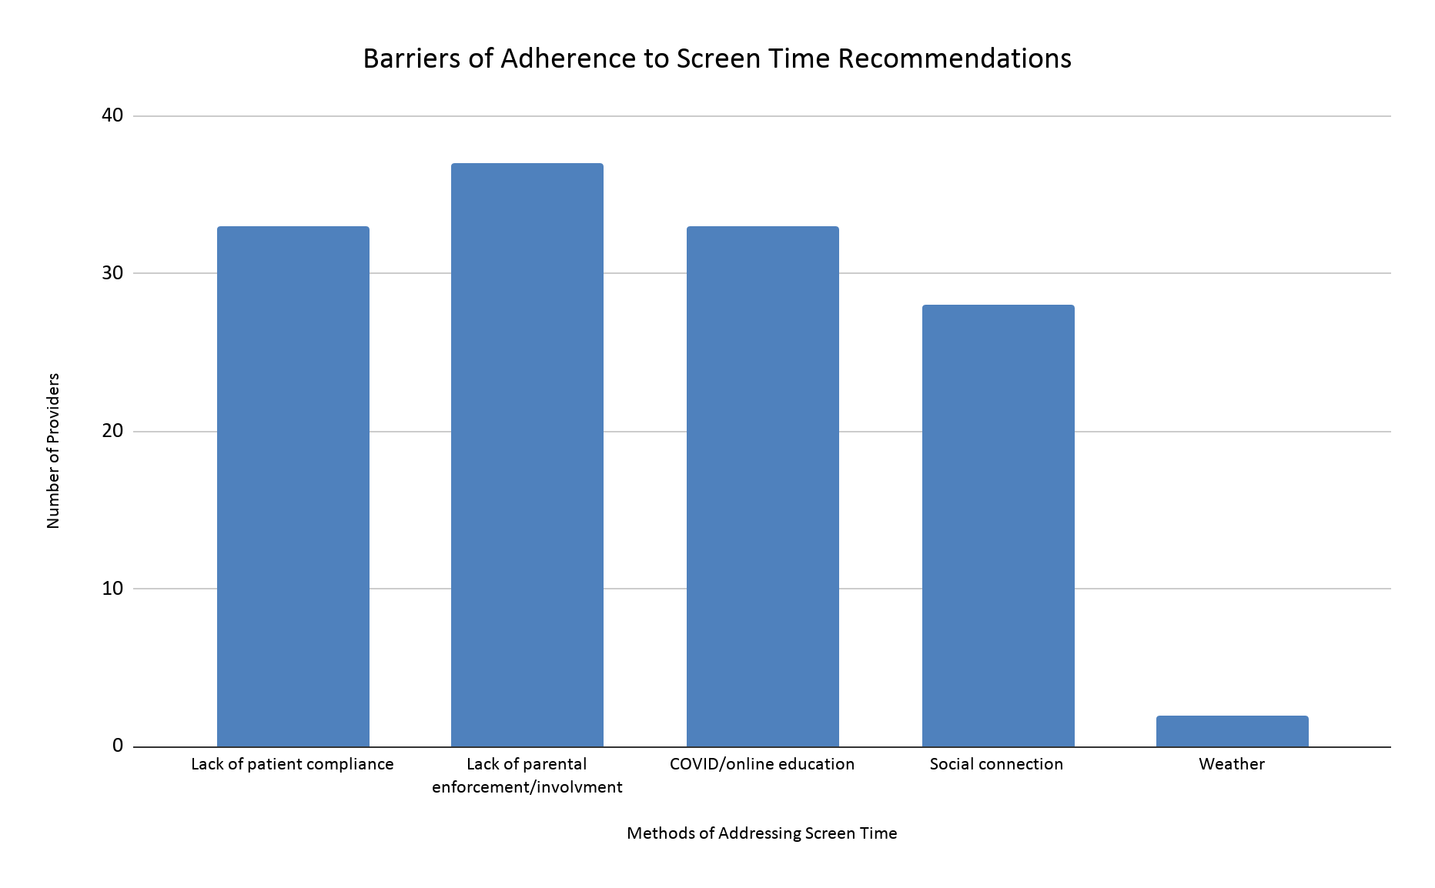
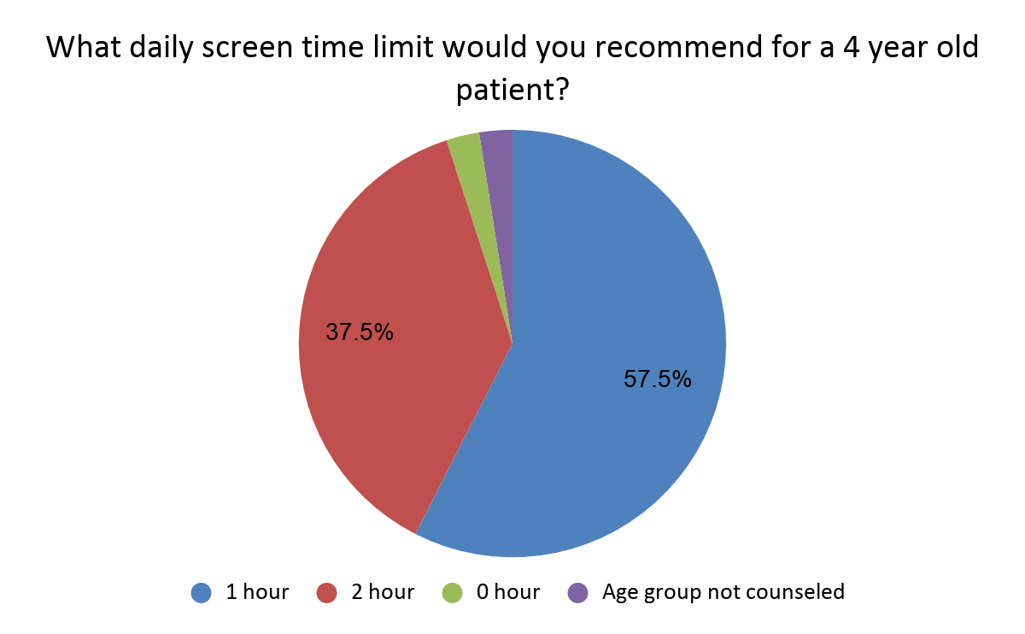
Pediatric Screen Time in the Digital Age
Emily Bertram, Amelia Elling, Lindsey Kraft, Marissa McDowell, Brooke Simmons, MaKayla Wheatley
Faculty Mentor: Leslie Woltenberg, PhD
INTRODUCTION
RESULTS
DISCUSSION
While much evidence exists surrounding the consequences of excessive screen time on pediatric health, proportionate research regarding what pediatric providers are currently doing in clinical practice to combat this does not exist. This existing gap in medical literature presents an opportunity to explore pediatric provider screen time clinical practices. The purpose of this study was to evaluate the methods Kentucky pediatric providers utilize to evaluate and address screen time usage in pediatric populations and collect provider perceptions regarding screen time practices.
kk
The survey yielded 43 responses (n=43). 93% of pediatric providers reported that they evaluated and addressed screen time. Figure 1 displays the distribution of responses throughout Kentucky.
Providers most commonly evaluated screen time during Well Child Checks (98%) and Physicals (58%). Additionally, all providers reported that they directly asked the patient or parent about screen time usage.
In assessing if and how pediatric providers evaluate and address screen time, multiple variables were examined via an electronic survey. Interestingly, there was no correlation between provider type or years of practice and likelihood to evaluate screen time. This demonstrates that a provider’s screen time practices are likely not due to their medical training or years in practice. Assuming these results are representative of Kentucky pediatric providers, this suggests that a vast majority are evaluating screen time in their patient populations, demonstrating that pediatric providers recognize the importance of screen time limits and the health consequences.
Within the survey, a knowledge check question was included to assess how closely pediatric providers follow the AAP screen time guidelines in practice. Nearly half of the study participants answered the question incorrectly. However, there was no statistically significant correlation between correctly answering the knowledge check question and provider type, AHEC region, or years in practice. This lack of adherence to the AAP guidelines highlights a potential educational gap and provides an opportunity for further emphasis on training regarding clinical practice surrounding digital use.
Providers most commonly reported evaluating screen time in patient age groups: 2-5, 6-9, 10-13, and 13-18. However, evaluation of screen time in patients <2 years old was significantly lower, with only 24 out of 40 providers reporting that they evaluate screen time in this patient population. This is worrisome because of the tremendous amount of brain development that happens in the first few years of life.
The most common strategies for addressing screen time reported by respondents included educating both patients and/or their parents verbally and recommending parental supervision, extracurricular activities, and screen time limits. Surprisingly, few providers reported using patient education materials including pamphlets, handouts, or online resources as a method to address screen time usage. Without much existing literature on existing screen time evaluation strategies, future research exploring which methods are the most effective could be useful to guide future practice.
Overall, the majority of providers identified three key barriers that impact patient adherence to screen time recommendations: lack of parental enforcement/involvement, lack of patient compliance, and the impacts of COVID/online education. This demonstrates that providers know and agree upon the most common barriers to adherence, and supports evidence from the background research for this study regarding parental involvement.
Finally, the survey inquired about the impact of COVID-19 on provider practices. Four common themes were identified: leniency with recommendations, excluding online school when making recommendations, not changing recommendations despite the pandemic, and recommending non-screen time extracurricular activities. This finding highlights the fact that there is a difference between how providers are or are not altering their screen time practices in light of COVID-19.
SCREEN TIME GUIDELINES
Figure 1: Survey Respondents by AHEC Region
For the purpose of this study, screen time was defined as the following: television, movies, computers, video games, and social media. This excluded media used for educational purposes (ex. online school).
METHODS
Figure 2: Age groups providers assessed for screen time. Notably, pediatric providers were less likely to evaluate children less than 2 years of age.
Figure 3:Methods pediatric providers use to address screen time.
This study explored the question: how do pediatric providers in Kentucky evaluate and address screen time? In order to collect information for the research question, this study utilized an anonymous electronic survey, titled “Pediatric Screen Time in the Digital Age.” This survey primarily focused on gathering data around providers’ clinical practices and perceptions. The study population for this study was composed of Kentucky pediatric providers. Inclusion criteria was based on the type of provider, including physicians, physician assistants (PA), and nurse practitioners (NP). Subjects were recruited through the publicly available Kentucky Board of Medical Licensure (KBML) database, a list of University of Kentucky pediatric providers, and the social media platforms of the Kentucky chapter of the American Academy of Pediatrics (AAP), specifically Twitter and Facebook.
Participants were contacted via email and postcard which included a graphic with a QR code containing a link to the Qualtrics electronic survey. The survey included a variety of questions including professional position, county location of practice, years of practice, evaluation methods, perceived barriers to adherence, intervention strategies, and recommendation changes due to COVID-19.
The study was approved through the University of Kentucky Institutional Review Board (UK IRB), which dictated the language for the participant informed consent. Survey data was stored within the secure Qualtrics database as approved through UK IRB. After all survey responses were gathered, the data was exported and analyzed via quantitative and qualitative data analysis using Microsoft Excel as well as SPSS software.
CONCLUSION
The purpose of this qualitative research study was to gain insight regarding if and how Kentucky pediatric providers evaluate and address screen time usage in pediatric populations. This study aimed to compare current clinical practice recommendations to national AAP practice guidelines and explore providers’ perceived barriers regarding screen time evaluation and intervention. This research also serves to fill a gap within the current medical literature regarding screen time within the pediatric population, as provider clinical practices had not previously been explored.
Upon review, several limitations of this study were identified: possible outdated/inaccurate information from KBML database, the COVID-19 pandemic, and postal service delays due to a statewide ice storm.In addition, another limitation of this study is a relatively low response rate. This survey only yielded 43 responses from a total of 643 pediatric providers. Therefore, these results may not be generalized to the entire state of Kentucky and to all pediatric providers.
The aforementioned limitation presents an opportunity for future research. This research could be improved upon by more specifically targeting regions of Kentucky which yielded low responses, such as eastern and western Kentucky to paint a more collective picture of statewide clinical practices. Another potential research opportunity illuminated by this research study is exploring the barriers identified to successful screen time adherence. Valuable research could be conducted specifically targeting lack of parental enforcement/involvement in order to explore why this barrier exists and what can be done to overcome it to further improve pediatric population health. A final implication for future research would be to replicate this study after the COVID-19 pandemic has been resolved, due to the possibility of altered clinical practices, screen use, and screen time perceptions post pandemic. It will be these clinical practices and future areas of research that directly influence the future pediatric health.
Figure 4: Providers were asked this question to check adherence to AAP guidelines. The correct answer was one hour. 43% of providers answered the questions incorrectly. There was no correlation between provider type (p=0.651), AHEC region of practice (p=0.715), or years of practice (p=0.975) and the correct answer.
Figure 5: Barriers providers identified that impact patient adherence to screen time recommendations.
A final open-ended question allowed pediatric providers to report how their recommendations have been affected by COVID-19. 35% of providers reported being more lenient with recommendations, while 28% reported they have not made any changes to their recommendations
REFERENCES
American Academy of Pediatrics announces new recommendations for children's media use. American Academy of Pediatrics. https://services.aap.org/en/news-room/news-releases/aap/2016/aap-announces-new-recommendations-for-media-use. Published 2016. Accessed April 1, 2021.
Notes:
Reference for infographic: AAP… i made it but used AAP recs

