Slide 1
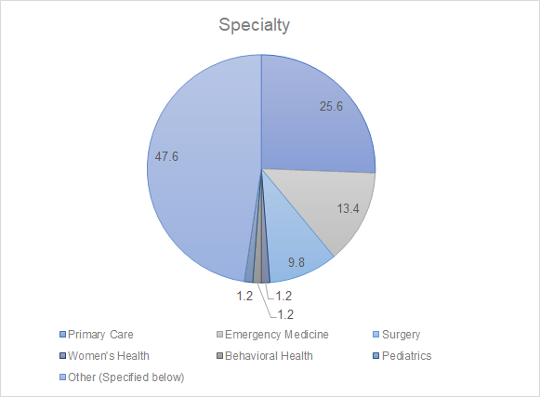
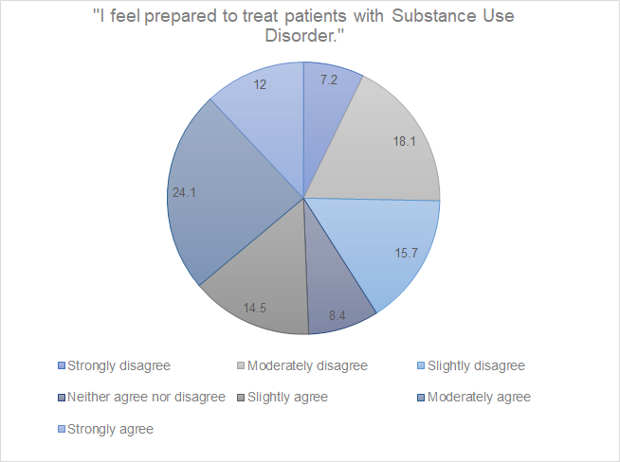
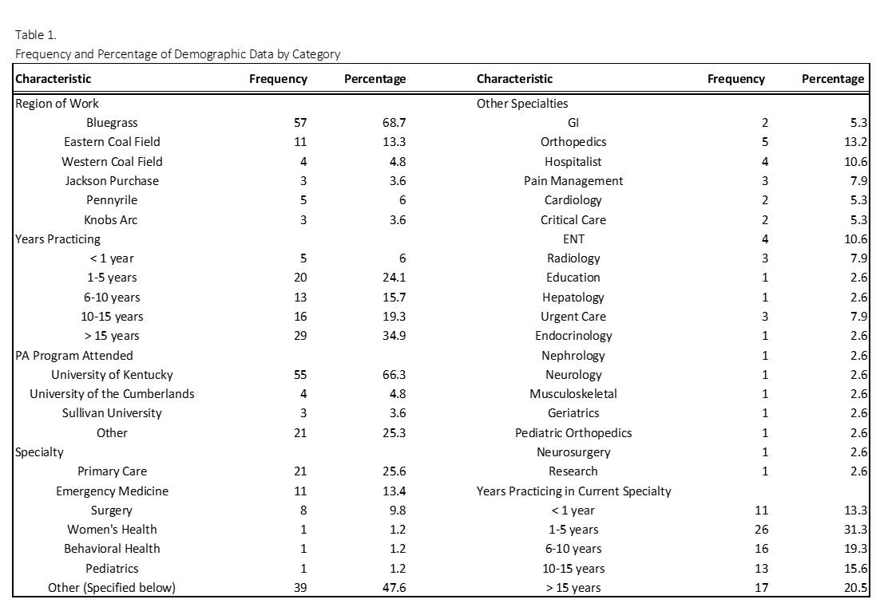
Kentucky Physician Assistant Preparedness
to treat Patients with Substance Use Disorder (KPAP)
C. Fields, D. Greenlee, A. Hoffman, M. Magsig, J. Ross, L. Woltenberg, PhD, MSEd
INTRODUCTION
RESULTS
RESULTS
DISCUSSION
The opioid epidemic has spared no region nor community in the Commonwealth of Kentucky, and few individuals or families in the state remain unaffected in some way by the prevalence of substance use disorder (SUD). With the opioid epidemic ongoing, issues surrounding
the response from health care providers in the state have become critically relevant. The purpose of this study is to perform an assessment of the current level of perceived preparedness of Physician Assistants (PAs) in Kentucky to treat SUD patients. In so doing both the current readiness of the state’s PAs to treat these patients and insights into what did or did not contribute to their preparedness can be assessed.
Figure 1: Percentage Breakdown of Survey Respondents by Specialty
As a central goal of this study was to ascertain the level of perceived preparedness by Kentucky PAs to treat patients with Substance Use Disorder, a keystone question of the survey design was a Likert Scale agreement to the following “I feel prepared to treat patients with Substance Use Disorder.” Results can be seen below:
Figure 2: Percentage Breakdown of PA preparedness to treat SUD
Examining correlations between perceived preparedness to treat SUD patients and how respondents acquired their reported preparedness allow for extrapolations of how future PAs can benefit most. In light of no correlation between PA program attended and preparedness, this study revealed that postgraduate training and experiences may have the most significant impact on making PAs feel more prepared to help patients suffering from Substance Use Disorder. With this in mind, future endeavors to better prepare the next generation of PAs may choose to focus on improving PA education related to SUD, and/or bolstering postgraduate training initiatives.
PURPOSE
Overview of the demographic results of survey respondents revealed PAs from various fields of medicine responded to the survey, with those working in primary care, behavioral health, and emergency medicine being best represented among respondents (Figure 1). The breakdown of respondents identifying as working in “Other” can be seen in Table 1 below. As illustrated below, the Bluegrass region of Kentucky provided the majority of respondents.
The purpose of this study is to objectively assess the current perceived level of preparedness by practicing PAs in Kentucky to treat patients with ongoing SUD.
CONCLUSION
This study provided insight into the influence of post-graduate SUD treatment-related training and job experiences on the perception of preparedness to treat felt by Kentucky Physician Assistants. In identifying a correlation between postgraduate factors and perceived preparedness, PA programs, state-level PA associations, and other PA organizations may be able to identify ways to improve on PA education programs and continuing medical education initiatives in order to better prepare PAs to treat patients suffering from Substance Use Disorder. Adding the results of this study to the literature can guide future research towards better ways to facilitate the future education and training of the next generation of PAs.
As illustrated in Figure 2:
24.1% of participants answered that they “moderately agree” that they feel prepared to treat patients with SUD.
18% answered that they “moderately disagree” to feeling confident in treating this patient population.
METHODS
A 15-question web-based survey was created using Qualtrics and distributed to participants via an electronic mailing list through the Kentucky Academy of Physician Assistants (KAPA) directory, a convenience sample for the purposes of this study. Of the 526 surveys distributed, we had approximately a 16% response rate (total # of participants= 83). The survey included questions about respondent demographics, career experience, modes of SUD training, and perceived preparedness to treat SUD.
Additionally there was an opportunity for participants to provide feedback about the study. The survey format consisted of Likert scales, single-answer multiple-choice selections (used to indicate demographics and work experience), and short answer options (to provide additional information as needed).
SUMMARY OF RESULTS
526 surveys were distributed with a 16% response rate.
When asked to rate how comfortable they felt prescribing schedule III-V drugs for the treatment of SUD, most participants reported feeling “extremely uncomfortable” (28.9%), and only six participants reported feeling “extremely comfortable” (7.2%).
When investigating participants’ response to “I feel prepared to treat patients with SUD”, there was a strong correlation with how they responded that CME requirements (r= 0.434, p< 0.0001) and on-the-job training (r= 0.641, p< 0.0001) prepared them to treat SUD.
There was no correlation between perceived preparedness to treat SUD and the Physician Assistant program the participant attended (r = 0.106, p = 0.339) or their number of years as a practicing Physician Assistant (r = -0.123, p = 0.268).
REFERENCES
1. America's Health Rankings analysis of CDC WONDER Online Database, Underlying Cause of Death, Multiple Cause of Death files, United Health Foundation, AmericasHealthRankings.org, Accessed 2020.
2. Yorkgitis BK, Garbas B, Cole D. Opioid Prescribing Education for Physician Assistant Students: A Physician Assistant Educator Survey. J Physician Assist Educ. 2019;30(1):27‐33. doi:10.1097/JPA.0000000000000238
3. Centers for Disease Control. FastStats - Illegal Drug Use. Centers for Disease Control and Prevention. https://www.cdc.gov/nchs/fastats/drug-use-illicit.htm. Published November 12, 2019. Accessed October 18, 2020.

