Slide 1
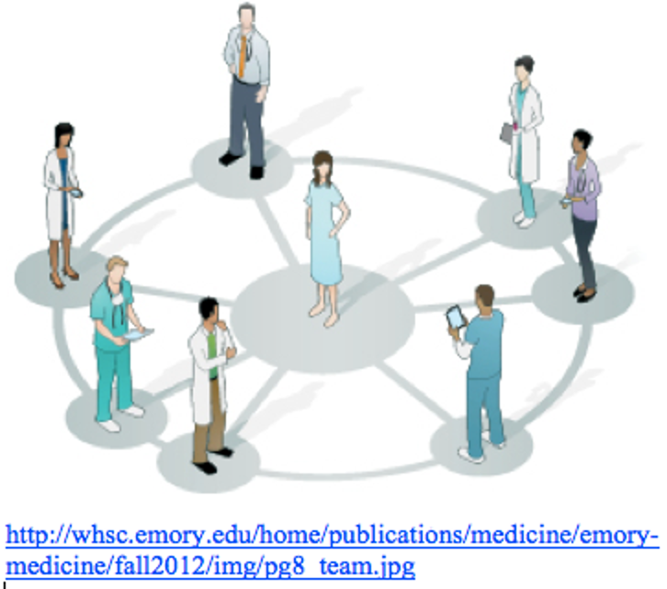
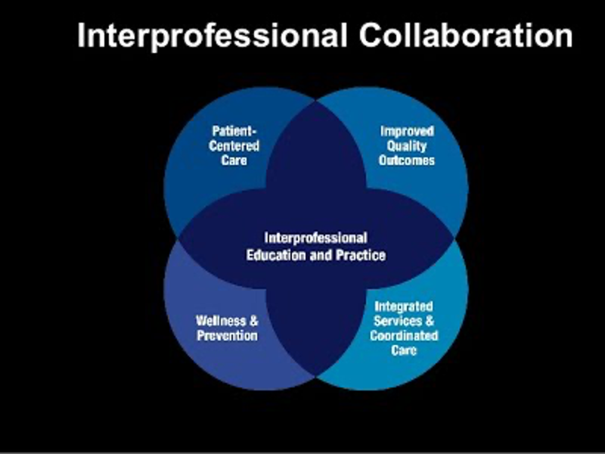
Does Interprofessional Education Identify
Leadership Competencies Among Health Professions Students?
Josh Benner, PA-S, Daniela Fawson, PA-S, Kathryn Hardesty, PA-S, Ron Karcz, PA-S, Jenna Stephens, PA-S, Ndeye Thiaw, PA-S, Kevin Schuer DRPH, PA-C
INTRODUCTION
Healthcare delivery is fragmented by nature, and the bridging of multiple disciplines is essential for optimizing patient care through interprofessional teamwork.¹
Studies suggests that beginning Interprofessional Education (IPE) early in didactic training ultimately prepares students to effectively engage in interprofessional teamwork in a clinical setting.^{1,2}
Based on circumstance, the leader of an interprofessional team can vary; this is referred to as periodic leadership. Periodic leadership within an interprofessional team is critical for effective team performance; therefore, it is imperative that healthcare students develop skills needed to lead in interprofessional teams.
The Interprofessional Collaboration and Team Skills (iCATS) is an IPE program at the University of Kentucky that allows healthcare students, early in their didactic education, the opportunity to “establish a foundation for the collaboration and communication needed in teamwork to facilitate positive patient and population outcomes”. ³
Transformational leadership style has been evaluated as an effective form of leadership in the healthcare setting.
RESULTS
DISCUSSION
PRE-1: The most common response fell within the communication competency (46.6%: 974/2089) [Table 1]
A medical student from 2018 reported, “I hope to contribute my point of view to the different situations we look at, but I would also hope to encourage communication and collaboration. The best part is that we are in a field that allows for this team work”.
PRE-2: The majority of responses (52.4%: 1090/2079) fell within the synergism & teamwork competency [Table 1]
A pharmacy student from 2017 responded with, “Interprofessional teamwork means working with other professionals to develop the best diagnosis regarding a particular situation or a particular patient.”
POST-1: The most frequently reported response (41.9%: 778/1854) fell within the communication competency [Table 1]
A Physician Assistant student from 2019 responded with, “Letting the other students know what my education and scope of practice was. A lot of them were unaware of those things.”
This study found a substantial relationship between participation in IPE and the identification of two leadership competencies -- communication and synergism/teamwork.
Communication and synergism/teamwork are at the core of effective interprofessional collaboration.
Communication is necessary for successful periodic leadership and is a major component of overcoming the fragmented nature of the healthcare system that has been an issue for decades.
Communication between various providers and health professionals improves continuity of care, which is safer for the patients and leads to better outcomes.
Teamwork is a fundamental component of bridging the gap between disciplines and fully adopting a team-based approach to patient care. If students can develop skills necessary for effective teamwork/synergism in an interprofessional setting before going out into practice, they will be more equipped to make meaningful contributions to an interprofessional team and can lead these teams to optimizing patient care.
This study demonstrates that participation in IPE leads to development of some of the most fundamental leadership qualities among health profession students. Participation in IPE will make students more equipped to emerge as leaders within interprofessional teams, which will lead to optimal patient care, improved outcomes, job satisfaction, and decreased burnout.
Table 1: SUMMARY OF FINDINGS
Leadership Competency |  | Number of times Competency found
Synergism/Teamwork |  | 296 | 1090 | 305
Communication |  | 974 | 108 | 778
Emotional Intelligence |  | 406 | 138 | 399
Intellectual Stimulation |  | 10 | 41 | 20
Pragmatism |  | 66 | 688 | 23
Self-Efficacy |  | 315 | 9 | 325
Inspired Motivation |  | 22 | 5 | 4
 |  | PRE-1 | PRE-2 | POST-1
PURPOSE OF STUDY
The purpose of this study was to determine if iCATS can be used to identify leadership competencies among health profession students at the University of Kentucky
METHODS
CONCLUSION
This is a twofold study. The first step consisted of a literature review to identify leadership competencies shown to be effective in the healthcare setting.
After thorough literature research, we identified several transformational leadership competencies, which are synergym/teamwork, communication, emotional intelligence, intellectual stimulation, pragmatism, self efficacy, and inspired motivation.
iCATS data was obtained from the Center of Interprofessional Health Education at UK.
The second part of the study consisted of a qualitative secondary analysis of the 2017-2019 iCATS data.
Certain items (PRE1, PRE2, and POST1) in the iCATS data were analyzed and coded for the leadership competencies identified in the literature search.
Once the data had been coded for their respective leadership competencies, a thematic analysis was completed, specifically to identify how many times each competency was present.
 | Table 2: iCATS STUDY PARTICIPANTS
 | Communication | Nursing | Pharmacy | PT | PA | Social Work | Public Health | TOTAL STUDENTS
2017 | 31 | 224 | 139 | 68 | 38 | 0 | 0 | 698
2018 | 30 | 244 | 140 | 63 | 39 | 4 | 0 | 716
2019 | 29 | 193 | 127 | 67 | 41 | 24 | 1 | 674
TOTAL | 90 | 661 | 406 | 198 | 118 | 28 | 1 | 2088
It was found that communication, synergism and teamwork were the most common competencies present among participants.
Implementation of IPE programs within other universities could improve interprofessional collaboration and identify leaders within interprofessional teams.
Limitations to this study include possible coding bias and unequal healthcare profession representation in the data set.
Implication for future studies include:
1. Studying the benefits of longer IPE programs
2. Analyzing IPE leadership competencies in a population of equally represented health professions.
REFERENCES
Reeves S, Macmillan K, Soeren MV. Leadership of interprofessional health and social care teams: a socio-historical analysis. Journal of Nursing Management. 2010;18(3):258-264. doi:10.1111/j.1365-2834.2010.01077.x
Bridges D, Davidson RA, Odegard PS, Maki IV, Tomkowiak J. Interprofessional collaboration: three best practice models of interprofessional education. Medical Education Online. 2011;16(1):6035. doi:10.3402/meo.v16i0.6035
CANVAS iCATS. Canvas | University of Kentucky. https://uk.instructure.com/courses/1985269. Accessed April 19, 2021.
Krepia, V., Katsaragakis, S., Kaitelidou, D. and Prezerakos, P., 2018. Transformational leadership and its evolution in nursing. Progress in Health Sciences , 8, p.185.
Ross SM, Offermann LR. Transformational Leaders: Measurement of Personality Attributes and Work Group Performance. Personality and Social Psychology Bulletin. 1997;23(10):1078-1086. Doi:10.1177/01461672972310008
Syadina, Khansa Putri, Purnomo, Ratno, and Anggraeni, Ade Irma. "The Impact of Transformational Leadership and Perceived Organizational Support on Organizational Commitment: The Mediating Role of Employee Engagement." JOURNAL OF RESEARCH IN MANAGEMENT 1.4 (2019): JOURNAL OF RESEARCH IN MANAGEMENT, 2019-03-03, Vol.1 (4). Web.
Nielsen, K., Yarker, J., Randall, R. and Munir, F., 2009. The mediating effects of team and self-efficacy on the relationship between transformational leadership, and job satisfaction and psychological well-being in healthcare professionals: A cross-sectional questionnaire survey. International Journal of Nursing Studies , 46(9), pp.1236-1244.
Saravo B, Netzel J, Kiesewetter J. The need for strong clinical leaders - Transformational and transactional leadership as a framework for resident leadership training. PLoS One. 2017;12(8):e0183019. Published 2017 Aug 25. doi:10.1371/journal.pone.0183019
Watters, Colm, Reedy, Gabriel, Ross, Alastair, Morgan, Nicola J, Handslip, Rhodri, and Jaye, Peter. "Does Interprofessional Simulation Increase Self-efficacy: A Comparative Study." BMJ Open 5.1 (2015): E005472. Web.
Notes:
Jo

