Slide 1
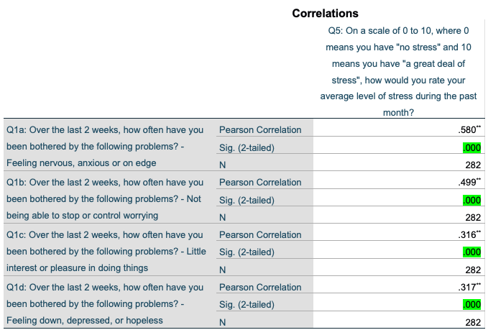
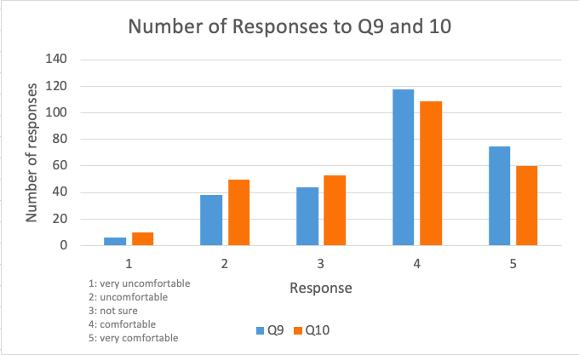
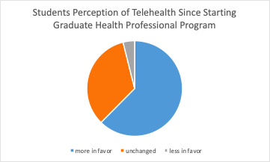
Evaluating the Perceptions and Willingness of University of Kentucky Graduate Health Professional Students with Telehealth Services for Symptoms of Anxiety/Depression
Erika Banta, PA-S; Katie Berryman, PA-S; Darby Harrison, PA-S; Leah Hollander, PA-S; Norella Reyes, PA-S; Micha Short, PA-S; L. Woltenberg, PhD, MSEd
BACKGROUND
RESULTS
DISCUSSION
The prevalence of mental health among young adults has been a rising concern, specifically the diagnosis of depression and anxiety⁹. After conducting some research, it was found that the average age of onset for anxiety is 21.3 years of age, and of that population the majority fail to seek treatment⁴. This is a problem because the failure to seek treatment may eventually lead to exacerbated symptoms that may make it difficult to treat in the future. We wanted to focus our study on graduate-level health science students due to prior research finding out that these students had high levels of depression ⁵. Knowing these results is especially concerning due to the fact that these are the individuals who will be future healthcare providers, which will also put them at risk for professional burnout in healthcare. Due to these findings, it was thought that this population could benefit from early intervention and greater mental health knowledge which we hope can lead to increased health seeking attitudes and intentions.
Furthermore, telehealth medicine (also known as telemedicine) is on the rise now more than ever due to the COVID-19 pandemic. Telemedicine is another way to distribute health-related services via telecommunication technology. We wanted to incorporate telemedicine in our study due to prior research finding that adults with mental illnesses were more willing to seek treatment by utilizing telemedicine¹¹. This is especially important because one study found that students felt embarrassed to seek help and were more willing to disclose information about their mental health through technology¹. Therefore, telehealth medicine should be considered for those who are interested and may feel more comfortable seeking help this way.
PRELIMINARY ANALYSIS:
282 respondents from 11 different health professional programs at University of Kentucky
74% female; 71% aged 18-24
27% Pharmacy students; 27% Medical students; 20% PA students
Average stress 6.8 (SD= 2.133)
41.9% of students reported symptoms of anxiety and/or depression
Stress level showed a positive and significant correlation to all parts of Q1 (p<0.001; Table 1)
The key finding in this study was that while most students would prefer in person therapy, they are willing to participate in telehealth therapy. When comparing specifically telehealth therapy vs. in-person counseling, overall participants responded that they would prefer face-to-face care, however, were not unwilling to participate in telehealth therapy. Respondents did report that since entering graduate school they are more willing to participate in telehealth now compared to before starting school. Because telehealth is still relatively new, the response that individuals would prefer therapy in-person is not surprising, however it is compelling to understand that students are more willing to participate in telehealth therapy since entering school.
Other findings in this study included participants reported they experienced stress currently and over half of respondents had previously seen a mental health profession previously. It is safe to say that these participants might be more apt to seek out mental health resources and have a more positive perception than possibly other fields.
There was not a significant correlation found between age and telehealth. Thus, this means that younger people are not exactly more willing to participate in telehealth versus older students. Cross tabulation studies showed that specific graduate programs were more willing to use telehealth therapy, such as Medical school students and Physical Therapy students, whereas Pharmacy students were not as open to this idea.
Overall, the answer to the main question of this study showed that healthcare focused students, while preferring in person mental health therapy, are open to telehealth therapy since starting in their program.
Table 1: Question 1 was used to screen for anxiety and depression utilizing the Patient Health Questionnaire-4 (PHQ-4). Students responded on a four-point Likert scale (0= not at all, 3= nearly every day). This correlation indicates a significant, positive correlation between the responses to the PHQ-4 and the rating of stress.
CURRENT PRACTICES AND EXPERIENCE WITH MENTAL HEALTH:
Overall, 57.4% of students reported seeking a mental health professional previously
Out of those who had seen a mental health professional previously, 84.7% found it helpful
Of those reporting feeling down, depressed, or hopeless in the past two weeks (123 students), 39% have never been to a mental health professional before
49.6% have been to a mental health professional and found it helpful
Figure 1: The responses to Q9 (How comfortable would you be talking to a counselor or therapist face-to-face in real life?) and Q10 (How comfortable would you be talking to a counselor or therapist using technology, such as video chat or online messaging?) are recorded and compared. Responses for both questions were given on a Likert scale (1=very uncomfortable; 5=very comfortable) as seen in the key.
CONCLUSION
This study demonstrates that it is worth investing additional mental health resources into graduate healthcare programs due to the significant amount of stress students experience. Allocating more resources to in-person therapy may be more widely accepted and effective, though, it would be beneficial providing telehealth therapy as an alternative option where resources for in-person therapy are not available. Since healthcare students are typically more educated and experienced with telehealth services, their trust and willingness to try telehealth could make it a successful resource in providing a pathway to care that fills current gaps in mental health treatment. Limitations included a low response rate, in addition to being conducted during the COVID pandemic and Christmas break.
PURPOSE OF STUDY
WILLINGNESS AND PERCEPTIONS BETWEEN TELEHEALTH AND IN PERSON:
When asked if students felt uncomfortable seeking mental health services, the average answer was neutral (M=2.63, SD=1.20)
Students level of comfort seeking mental health services and willingness to speak to a counselor had both significant correlation (p<0.001) and regression (p<0.001)
Students preferred to speak to a counselor face-to-face in person (Q12, M=3.45, SD=0,.86)
On average, students felt “comfortable”(Q9 and 10, value of 4) when asked how comfortable they would be talking to a counselor in person (Q9, M=3.77, SD=1.08) and through telehealth (Q10, M=3.56, SD=1.12). (Figure 1)
62.4% of students said their perception of telehealth has become more in favor since starting their professional program while 33.7% said their perception is unchanged (Figure 2)
This research team aimed to evaluate the mental health perceptions of University of Kentucky graduate health professional students and their willingness to seek treatment via telemedicine services by assessing the stigma of mental health and any change in perception of mental health since starting a graduate health professional program. In addition, this study will compare stress, mental health symptoms and perceptions of mental health between different graduate health professional programs.
REFERENCES
Ebert DD, Mortier P, Kaehlke F, et al. Barriers of mental health treatment utilization among first-year college students: First cross-national results from the WHO World Mental Health International College Student Initiative [published correction appears in Int J Methods Psychiatr Res. 2019 Dec;28(4):e1800]. Int J Methods Psychiatr Res. 2019;28(2):e1782. doi:10.1002/mpr.1782
Kroenke K, Spitzer RL, Williams JB, Lo¨we B. An ultra-brief screening scale for anxiety and depression: The PHQ-4. Psychosomatics 2009;50:613–621.
Langbecker D, Caffery LJ, Gillespie N, Smith AC. Using survey methods in telehealth research: A practical guide. J Telemed Telecare. 2017;23(9):770-779. doi:10.1177/1357633X17721814
Lijster JMD, Dierckx B, Utens EM, et al. The Age of Onset of Anxiety Disorders. The Canadian Journal of Psychiatry. 2016;62(4):237-246. doi:10.1177/0706743716640757
Melnyk, Bernadette Mazurek; Slevin, Caitlin; et al. Physical health, lifestyle beliefs and behaviors, and mental health of entering graduate health professional students: Evidence to support screening and early intervention, Journal of the American Association of Nurse Practitioners: April 2016 - Volume 28 - Issue 4 - p 204-211
doi: 10.1002/2327-6924.12350
Rathbone AL, Prescott J. The Use of Mobile Apps and SMS Messaging as Physical and Mental Health Interventions: Systematic Review. J Med Internet Res. 2017;19(8):e295. Published 2017 Aug 24. doi:10.2196/jmir.7740
Shigekawa E, Fix M, Corbett G, Roby DH, Coffman J. The Current State Of Telehealth Evidence: A Rapid Review. Health Aff (Millwood). 2018;37(12):1975-1982. doi:10.1377/hlthaff.2018.05132
Stress in America. Are teens adopting adults’ stress habits. American Psychological Association. 2014. Available at www.apa.org/news/press/ releases/stress/2013/stress-report.pdf (last accessed August 8, 2017).
Suvisaari, J., et al. “Mental Disorders in Young Adulthood.” Psychological Medicine, vol. 39, no. 2, 2008, pp. 287–299., doi:10.1017/s0033291708003632.
Taylor-Rodgers E, Batterham PJ. Evaluation of an online psychoeducation intervention to promote mental health help seeking attitudes and intentions among young adults: Randomised controlled trial. Journal of Affective Disorders. 2014;168:65-71. doi:10.1016/j.jad.2014.06.047
Toscos T, Carpenter M, Drouin M, Roebuck A, Kerrigan C, Mirro M. College Students' Experiences with, and Willingness to Use, Different Types of Telemental Health Resources: Do Gender, Depression/Anxiety, or Stress Levels Matter?. Telemed J E Health. 2018;24(12):998-1005. doi:10.1089/tmj.2017.0243
Younes N, Chollet A, Menard E, Melchior M. E-mental health care among young adults and help-seeking behaviors: a transversal study in a community sample. J Med Internet Res. 2015;17(5):e123. Published 2015 May 15. doi:10.2196/jmir.4254
Youth Risk Behavior Surveillance System (YRBSS). Centers for Disease Control. 2016. Available at www.cdc.gov/yrbss. (last accessed August 8, 2017).
Salyers, M. P., Bonfils, K. A., Luther, L., Firmin, R. L., White, D. A., Adams, E. L., &amp; Rollins, A. L. (2016). The relationship between Professional burnout and quality and safety in Healthcare: A meta-analysis. Journal of General Internal Medicine, 32(4), 475-482. doi:10.1007/s11606-016-3886-9
METHODS
Using a voluntary online survey we analyzed graduate students' stress level, recent signs/symptoms of anxiety and depression, as well as perceptions towards and willingness to seek mental health via face-to-face and telehealth services. After distributing the survey, 282 graduate students in healthcare programs from the University of Kentucky voluntarily took part in the survey.
Figure 2 displays the distribution on answer choices when students were asked about their perception of telehealth since beginning their perspective graduate health professional programs.

