Slide 1
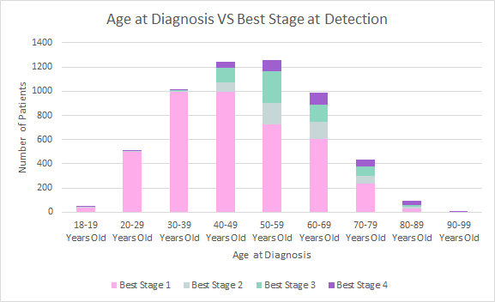
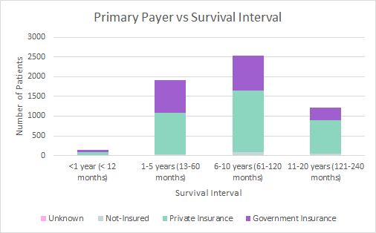
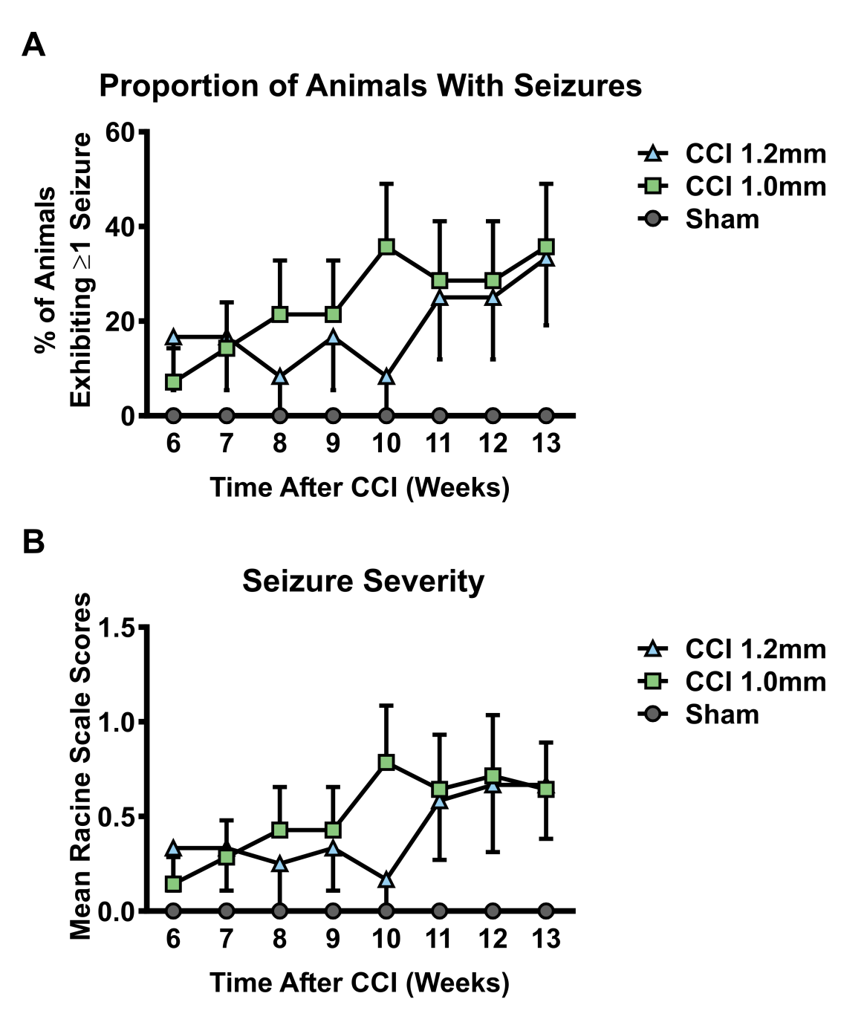
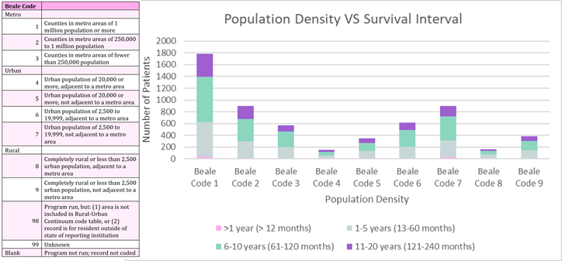
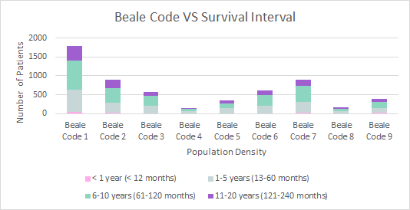
An Investigation of Socioeconomic Status and Thyroid Cancer in KY
Elle Eggleston, Harrison Free, Zachary Gregory, Stephanie Moore,
Sriyanshi Suryadevara, Colyn Wright, Cheryl Vanderford MPAS, PA-C
University of Kentucky Physician Assistant Studies
sdgsdsdgnnknhhihih
Introduction
Data & Results
Discussion
Thyroid Cancer is considered the most common endocrine malignancy worldwide, representing 3.8% of all new cancer diagnoses in the United States (Aschebrook-Kilfoy et. al 2008) Thyroid cancer is caused by an overproliferation of cancer cells in the thyroid gland
United States has seen thyroid cancer incidence to increase by 5.5% annually with an annual rising death rate of 0.8% (Nguyen et al. 2015). Markers for higher levels of healthcare access were associated with higher thyroid cancer incidence (Li et al., 2013)
Descriptive Statistics
Mean Age | 49.79 +/- 14.92 years
Age Range | 76 years
% of patients in Appalachia | 33%
Average Tumor Size Code | 19.58 +/- 2.86
Average Best Stage Group | 1.5 +/- .917
Average Income | $42,496 +/- 10,415.31
Fig. 1 (Left) Figure 1 provides the descriptive statistics concerning the data collected. The following table provides the basic results of out data.
Our research indicates SES has a negligible effect on thyroid cancer diagnosis in Kentucky.
Patients with government insurance are proportionally more likely to have a shorter survival interval indicating a possible lapse in healthcare access that needs to be addressed.
Patients in rural areas have shorter survival intervals. This may be due to fewer hospitals and increasingly skewed patient to provider ratios.
An additional correlation between age at diagnosis and BEST stage group was found. The severity of BEST stage value at diagnosis increased with age. Specifically, Stage 3 and Stage 4 rise significantly after the age of 40. This may be indicative of a gap in healthcare for geriatric populations.
Fig. 2 (Bottom Left) Figure 2 provides the comparison between primary payer of healthcare and the survival interval of diagnosed patients. The Pearson Chi-Square value was significant at .000 with a significant systemic measurement of a Cramer’s V value of .085
Purpose and Hypothesis
This research project utilized the KCR registry and 2010 Census for information on thyroid cancer incidence and SES in Kentucky.
Part I compared Primary Payer and Survival Interval. It was hypothesized that patients who possess private insurance, presumably with higher SES, would have a longer survival interval than those who possess government insurance.
Part II compared Beale Code and Survival Interval. It was hypothesized for this portion of the study that patients in metro areas with higher populations (lower-coded Beale codes) would have a higher survival interval and greater number of cases than more rural areas with lower population density (higher-coded Beale codes)
Conclusion & Future Directions
Socioeconomic status including primary payer status, median county income, and Appalachian status did not have statistically significant correlations with thyroid cancer stage at detection.
Beale code and primary payer status both did have a statistically significant relationship to survival interval with a small effect size.
Further research is needed to determine causative factors of the results gathered to explore potential impact of overdiagnosis on thyroid cancer incidence, to understand how/why thyroid cancer is being overdiagnosed, and to examine the impact of this phenomenon on patient health.
Fig. 3 (Top Right) Figure 3 provides the comparison between the age of the diagnosed patient and their BEST stage at detection. The Pearson Chi-Square value was significant at .000 with a significant systemic measurement of a Cramer’s V value of .250
Fig. 4 (Below) Figure 4 provides the comparison between the Beale Code and survival interval of the patient. The Beale code represents the population density of the patient’s location and allows for distinction between metro, urban and rural areas. The Pearson Chi-Square value was significant at .021 with a significant systemic measurement of a Cramer’s V value of .048
Methods
Data Sources. In this approved IRB-exempt retrospective secondary data analysis, data regarding thyroid cancer was obtained from the Kentucky Cancer Registry (KCR), the population-based central registry for cancer in the Commonwealth of Kentucky. Inclusion criteria for this study were primary thyroid cancer diagnosis between the years 2007 and 2017, residency within Kentucky and age 18 years or older at the time of diagnosis. The data yielded 5,827 cases to examine. The variables utilized for this study include: Kentucky county of residence at diagnosis and related population density and Appalachian status, age, insurance status, size and stage of tumor at diagnosis, and survival interval. Median county income from the US Census American Community Survey was assigned to each cancer case and utilized as a marker of socioeconomic status.
Statistics. Descriptive statistics were calculated to understand basic indications of the data collected. Chi-squared tests were utilized to determine Pearson correlation between variables with P = 0.05 indicating statistical significance. Cramer’s V was calculated to indicate effect size and cross tabulations were examined to better understand relationships found.
Select References
Aschebrook-Kilfoy B, James B, Nagar S, Kaplan S, Seng V, Ahsan H, Angelos P, Kaplan EL, Guerrero MA, Kuo JH, Lee JA, Mitmaker EJ, Moalem J, Ruan DT, Shen WT, Grogan RH. (2015). Risk Factors for Decreased Quality of Life in Thyroid Cancer Survivors: Initial Findings from the North American Thyroid Cancer Survivorship Study. Thyroid. 2015: 25(12): 1313–21. doi: 10.1089/thy.2015.0098.
Cabanillas ME, McFadden DG, Durante C. Thyroid Cancer. The Lancet (British Edition). 2016; 388(10061): 2783-95.
Cooper DS, Doherty GM, Haugen BR, Kloos RT, Lee SL, Mandel SJ, Mazzaferri EL, McIver B, Pacini F, Schlumberger M, Sherman SI, Steward DL, Tuttle RM. American Thyroid Association (ATA) Guidelines Taskforce on Thyroid Nodules and Differentiated Thyroid Cancer. Thyroid. 2009 Nov; 19(11):1167-214.
Grogan RH, Kaplan SP, Cao H, Weiss RE, Degroot LJ, Simon CA, Embia OM, Angelos P, Kaplan EL, Schechter RB. Surgery. 2013 Dec; 154(6):1436-46; discussion 1446-7.
Guay B, Johnson-Obaseki S, McDonald JT, Connell C, Corsten M. Incidence of Differentiated Thyroid Cancer by Socioeconomic Status and Urban Residence: Canada 1991–2006. Thyroid. 2014; 24(3):552-55. doi: 10.1089/thy.2013.0308.
Husson O, Mols F, Oranje WA, Haak HR, Nieuwlaat WA, Netea-Maier RT, Smit JW, van de Poll-Franse LV. Psycho-oncology. 2014 Aug; 23(8):946-52.
Nguyen QT, Lee EJ, Huang MG, Park YI, Khullar A, Plodkowski RA. Diagnosis and Treatment of Patients with Thyroid Cancer. American Health & Drug Benefits. 2015; 8(1): 30–40.
Acknowledgments
We would like to acknowledge Dr. Leslie Woltenberg, PhD and Jaclyn K. McDowell, DrPH for their support.

