Slide 1
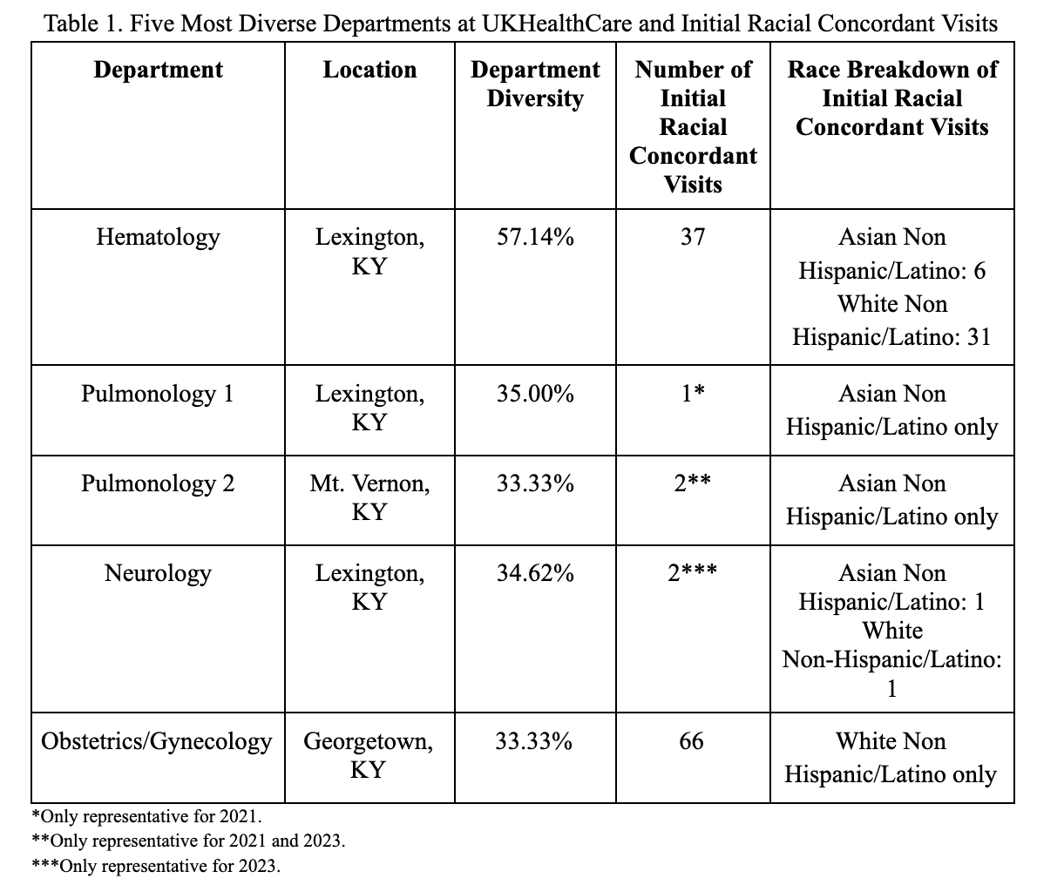
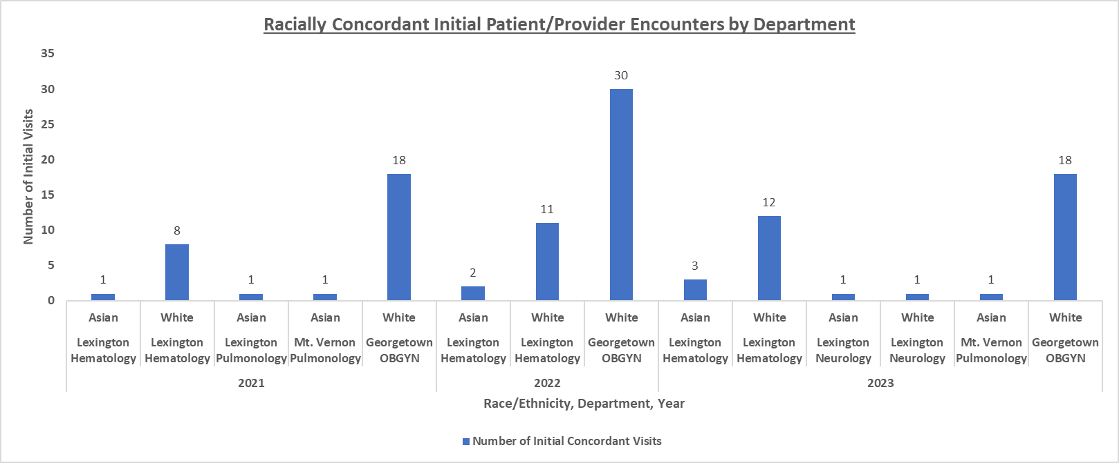
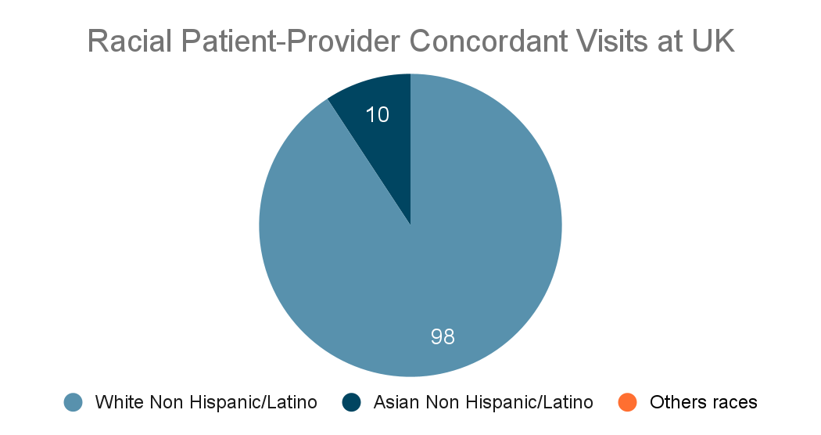
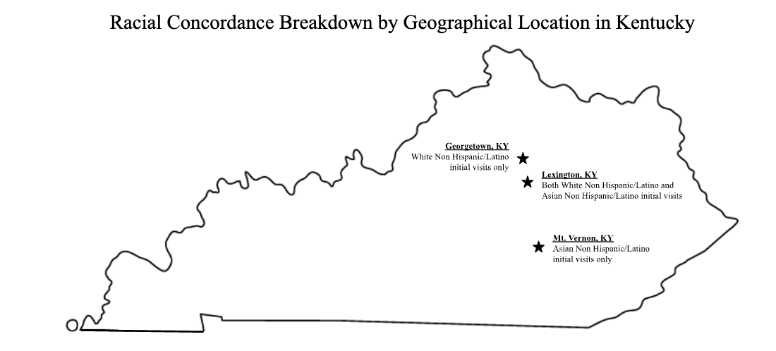
Exploring Diversity in UK Healthcare: A Descriptive Analysis of Patient-Provider Racial Concordance in UK Healthcare Departments
Ayanna Adaniel, Elena Botsford, Presley Chirico, Emma Li Mathews, Alexis Thompson, Allie Trusty
Faculty Mentor: Joshua Burkhart, MSPAS, PA-C
INTRODUCTION
RESULTS
DISCUSSION
Patient-provider concordance is defined as the shared identity between a patient and the provider they seek care from [8]. There are many contributing factors to concordance, including race, ethnicity, age, gender, values, and language. This exploration focuses on racial concordance at UK HealthCare by merging their data with Human Resources’, which has never been investigated here before. The goal of this research is to foster a deeper understanding of diversity amongst UK Healthcare medical departments by examining racial concordance between patients and providers.
The five most diverse departments in UK HealthCare:
Hematology (57.14%),
Pulmonology 1 (35.00%),
Neurology (34.62%),
Pulmonology 2 (33.33%),
Obstetrics/Gynecology (33.33%)
Only Asian Non Hispanic/Latino and White Non Hispanic/Latino racially concordant relationships are identified.
Obstetrics/Gynecology has the greatest number of White Non Hispanic/Latino concordant visits, and is the least diverse of the five specialties.
Hematology has the greatest number of Asian Non Hispanic/Latino concordant visits.
Only White and Asian populations are represented in the reported data.
The greatest number of initially concordant visits were between White Non-Hispanic Latinos from 2021-2023
The most diverse specialties include hematology, pulmonology, neurology, and obstetrics/gynecology.
Investigated specialties are operated by UK Healthcare from geographically rural to urban locations including Lexington, Georgetown, and Mount Vernon.
The findings in this descriptive analysis can facilitate future investigations in order to clarify the impact a concordant relationship has on patients, what their preferences are, and serves to underscore the degree of diversity in Kentucky healthcare as a whole.
PURPOSE OF STUDY
This exploratory analysis appraises UK HealthCare data to foster a deeper understanding of diversity amongst UK Healthcare medical departments by examining racial concordance between patients and providers. The diversity of the medical providers within a race matched patient population are evaluated to gain a deeper understanding of the diverse population, or lack thereof, in UK HealthCare disciplines.
CONCLUSION
This analysis contextualizes the relationship between patients and providers in UK Healthcare and reveals a discrepancy of racial concordance between initial encounters between Asian Non-Hispanic Latinos and emphasizes the prevalence of concordance between Non-Hispanic/Latino White encounters.
Further investigation is needed to inquest the implications of these findings such as patient predilection for providers, and to extend the analysis beyond UK Healthcare.
METHODS
Data analysts at the Center for Clinical and Translational Science (CCTS) office at University of Kentucky (UK) amassed provider and patient demographics.
Inclusion criteria consist of patients aged 18+ and the most diverse departments/specialties by percentage from 01/01/2021-12/31/2023. Inpatient specialities, dental services, social services, emergency departments, and follow-up visits were excluded.
REFERENCES
QR CODE:
Link to REFERENCES
https://docs.google.com/document/d/1WQdso-7Fp4oMLkFnC8-beUST73Jcc2mU3LU24wVy3Tc/edit?usp=sharing
The most diverse departments were determined by the number of racially self-identified providers in a given facility.
Figure 1: This column chart shows the number of racially concordant initial visits among White and Asian populations in the five most diverse UK Healthcare departments from 2021-2023.
Data was gathered for the following; racial diversity in a department per year, total number of initial patient visits in a department per year, total initial patient-provider racial concordant visits in a department per year, total initial patient visits by year identified using provider ID number, and the provider race/ethnicity.
ACKNOWLEDGMENTS
Special thanks to collaborating database analyst Kristen Gray. The project described was supported by the NIH National Center for Advancing Translational Sciences through grant number UL1TR001998. The content is solely the responsibility of the authors and does not necessarily represent the official views of the NIH.

