Slide 1
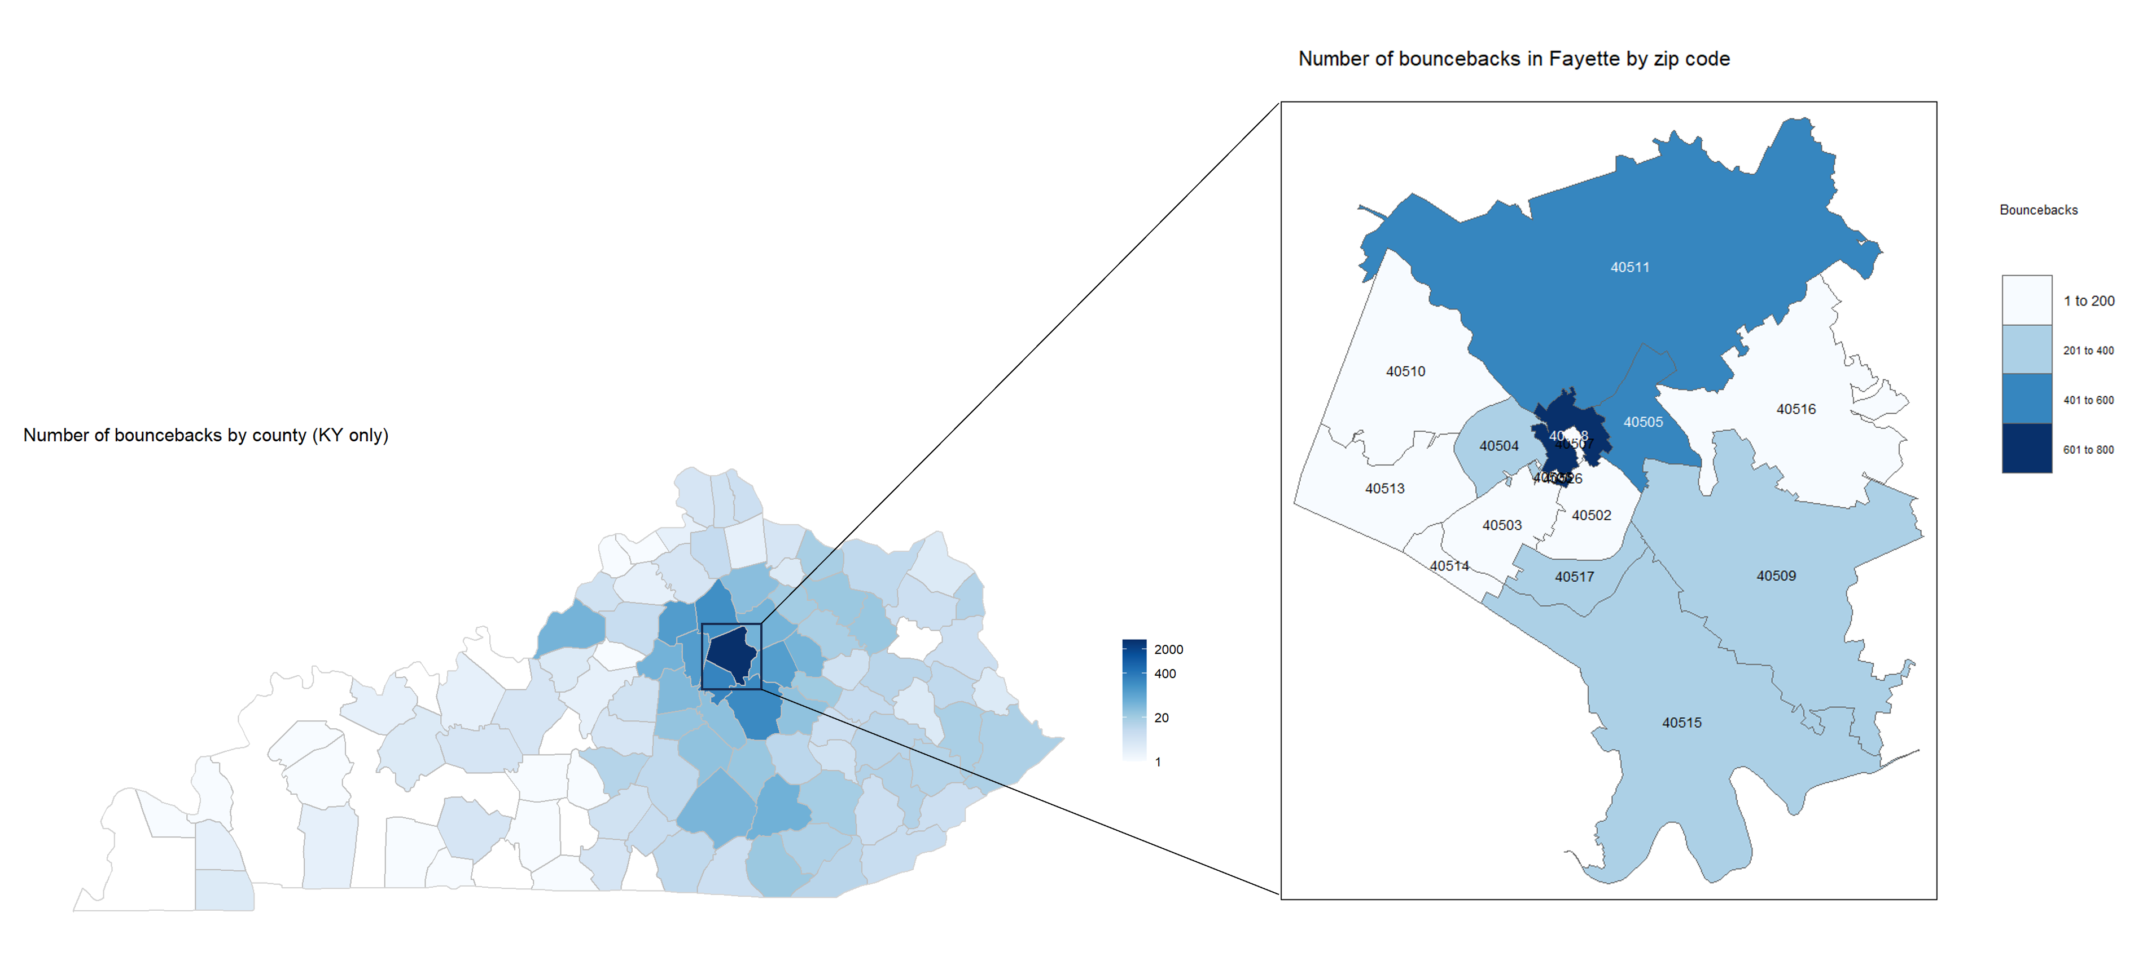
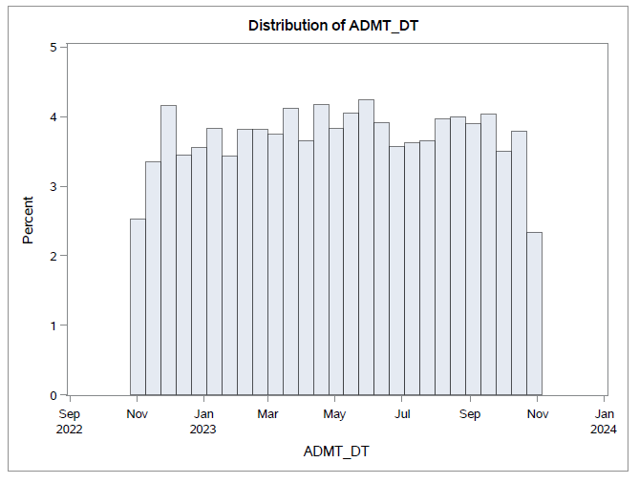
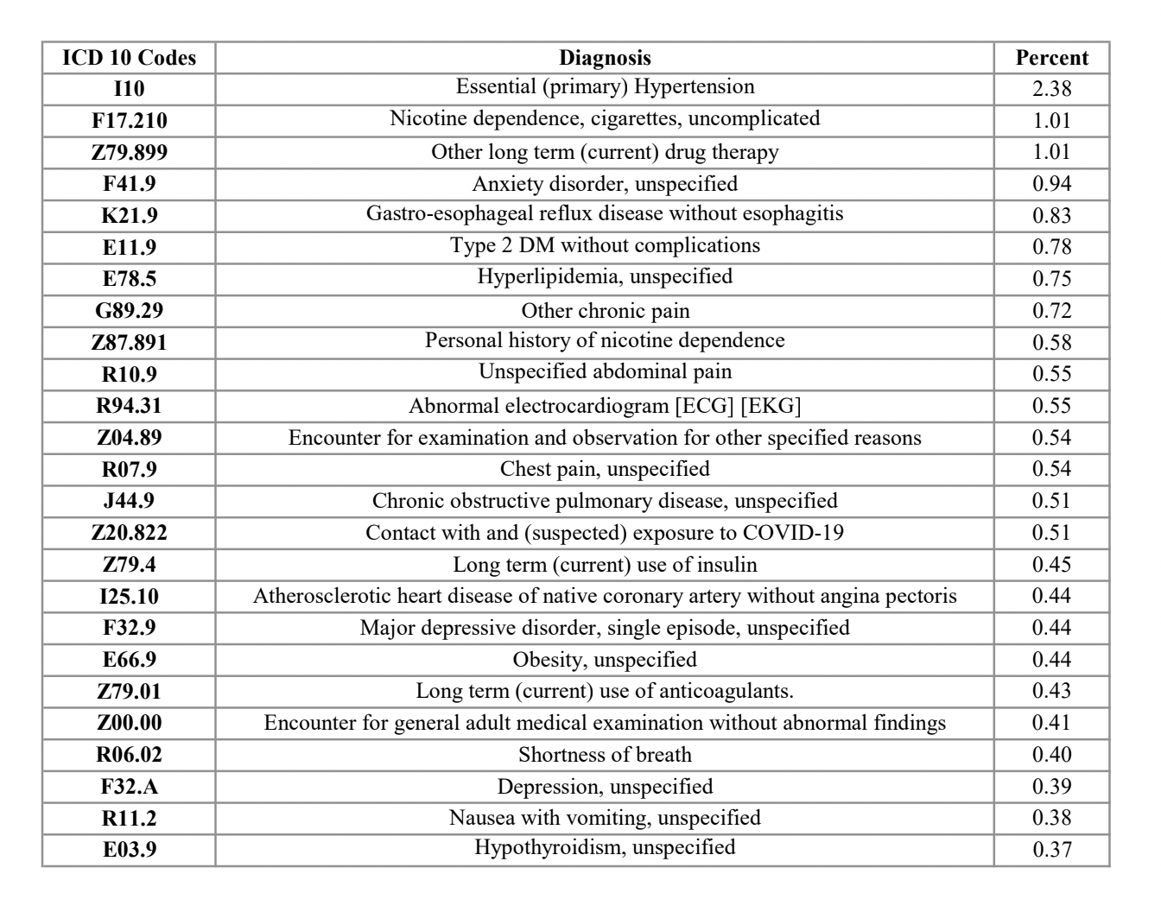
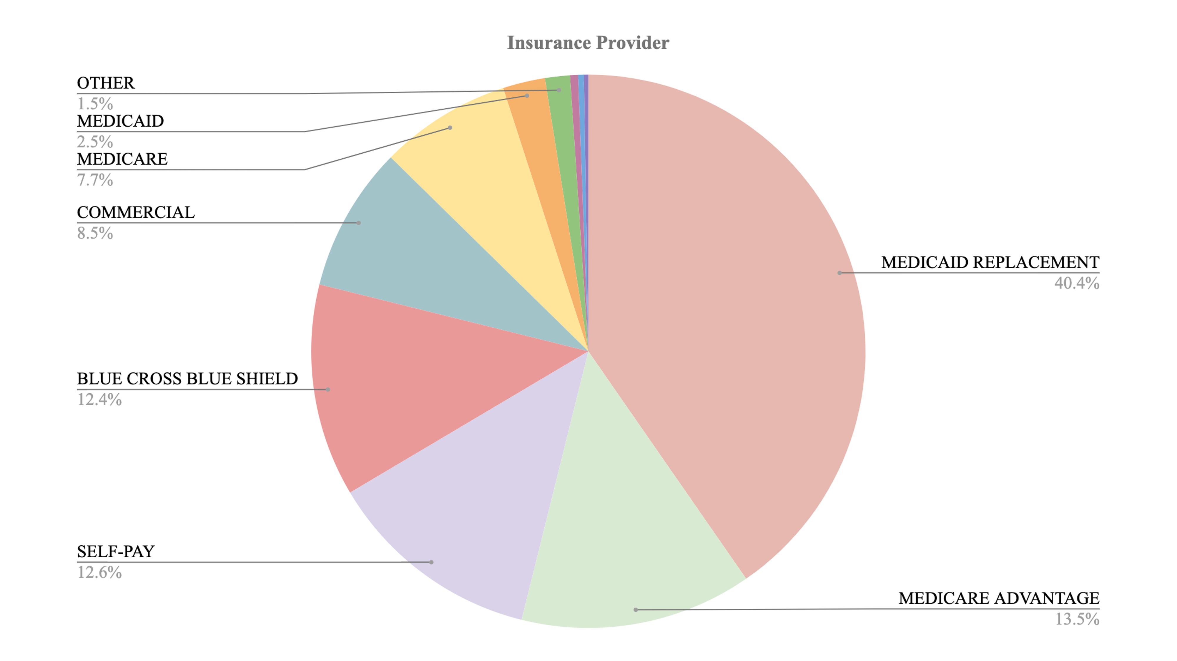
Demographics and Characteristics of Patients Who Bounced-Back to the University of Kentucky Emergency Department
Cailynn Bales, PA-S; James Caston, PA-S; Alexandria Coffin, PA-S; Brendon Daunhauer, PA-S; Rachel Durborow MS, CCC-SLP, PA-S; Annie Neiheisel, PA-S; Zella Christensen, BFA; Ryan Hunton, DHSc, PA-C; and Kevin Schuer, DrPH, PA-C
INTRODUCTION
RESULTS
Table 1. Frequency of bounce-backs among race, gender, and ethnicity combined
Emergency department (ED) bounce-backs, defined as a patient returning to the ED within 72 hours of their initial visit, remain a burden to the healthcare system. There are many reasons for bounce-backs which can contribute to overuse of the ED for first line health access. Although patient revisit to the ED can be related to a change in a patient’s acute medical condition, it is often related to patient factors such as exacerbations of poorly managed chronic disease and lack of access to primary care. These factors affect the efficiency of patient care, contribute to the unnecessary use of medical resources, and increase overall healthcare costs.
The most common demographics of patients that bounced-back to the UK ED were white non-Hispanic women (see Table 1). Most patients resided within Fayette County, and nearly half of those patients (48.09 percent) resided in the cluster of zip codes 40508, 40505, and 40511 (see Figure 1). The mean and median age of the cohort revealed that most of the patients were in their 40s. The number of bounce-backs remained relatively consistent throughout the year with frequencies ranging from 450-532 bounce-backs per month (see Figure 2). Out of this cohort, most (97.53 percent) reported having access to a primary care provider. Medicaid Replacement was the most used insurance provider among the cohort (see Figure 3). During subsequent visits, most patients were discharged home (87.33 percent); rarely (0.33 percent) were patients admitted inpatient (see Table 2). The top category of diagnosis codes was ICD-10 Category Z “Factors influencing health status and contact with health services” and the top listed diagnosis overall was ICD-10 Code I10 “Essential (primary) hypertension” (see Table 3).
DISCUSSION
Although this study found that a majority of bounce-backs occurred in white patients, the black or African American patients still made up approximately 20% of the cohort. In comparison with the black population of Kentucky, and Fayette County specifically, this is a significantly higher representation for this group.
The zip code with the highest frequency of bounce back to UK EDs is 40508. This is defined as a food desert according to the Food Access Research Atlas (FARA). Food insecurity has been linked to obesity, hypertension, diabetes, coronary heart disease, cerebral vascular accident, congestive heart failure, and chronic kidney disease.
Medicaid Replacement was the most used insurance provider in the cohort. Studies show that a lack of insurance or reliance on Medicaid increases patient risk for ED bounce-back.
The management of chronic diseases could be a potential target for disease-specific clinics in underserved areas, also known as access clinics, to provide patients with treatment options and an alternative to the ED.
Mental and behavioral health issues emerged as a prominent patient finding in this study. A notable proportion of these patients presented with conditions such as nicotine/cigarette dependence, unspecified anxiety disorder, and unspecified depression. These findings highlight the critical need for comprehensive mental health services and underscore the importance of addressing underlying psychiatric comorbidities to reduce bounce-back rates and improve patient outcomes.
PURPOSE OF STUDY
The purpose of this study was to describe the demographics and characteristics of patients who bounced-back to the University of Kentucky Albert B. Chandler and Good Samaritan EDs in Lexington, KY over the course of one year.
Figure 1. Number of patients who bounced-back to UK’s ED by Kentucky county and by Fayette county zip codes
METHODS
A retrospective cohort study using a de-identified limited dataset was collected from the University of Kentucky (UK) Center for Clinical and Translational Sciences database (CCTS) and is covered under UK's IRB protocol number 45668. Data was collected over a year-long period (November 1, 2022 – October 31, 2023). This included 4,543 adult patients who had visited UK’s Albert B. Chandler ED or UK’s Good Samaritan ED in Lexington, KY with a subsequent return to the ED within 72 hours of the initial visit. Data collection included patient demographics like age, gender, and ethnicity, insurance provider, whether the patient had a primary care provider (PCP), acute and chronic conditions, number of prior visits to the ED within the last year, and number of visits within 72 hours. For the initial and return visits, data also included disposition type, disposition date, and length of stay.
Figure 2. Distribution of bounce-backs per month by percent
Table 3. Top 25 most frequently used ICD-10 Codes
Figure 3. Insurance provider among patients who bounced back
CONCLUSION
Table 2. Discharge disposition in subsequent visit
Recognizing bounce-back factors assists in identifying the patient populations that require the most support. In order to combat ED bounce-backs, access clinics could be a valuable asset to underserved communities where chronic illnesses play a major part in contributing to return visits. Patient demographic information can be used to reduce bounce-backs and facilitate clinic placement. Future studies should be done to determine associations between patient factors and ED return visits.
Discharge disposition | Frequency | Percent
Home or self-care | 1144 | 87.33
Left against medical advice | 91 | 6.95
Elopement | 24 | 1.83
Left without being seen | 16 | 1.22
Home-health care service | 9 | 0.69
Skilled nursing facility | 8 | 0.61
Long-term care | 4 | 0.31
Psychiatric hospital | 4 | 0.31
Another healthcare institution | 3 | 0.23
Court/law enforcement | 3 | 0.23
Admitted as inpatient | 1 | 0.08
ED dismissed – diverted elsewhere | 1 | 0.08
Rehab facility | 1 | 0.08
Still a patient | 1 | 0.08
REFERENCES

