Slide 1
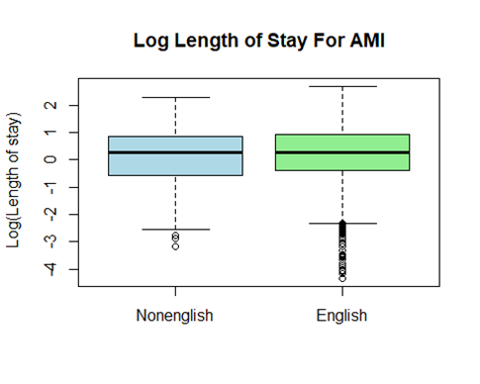
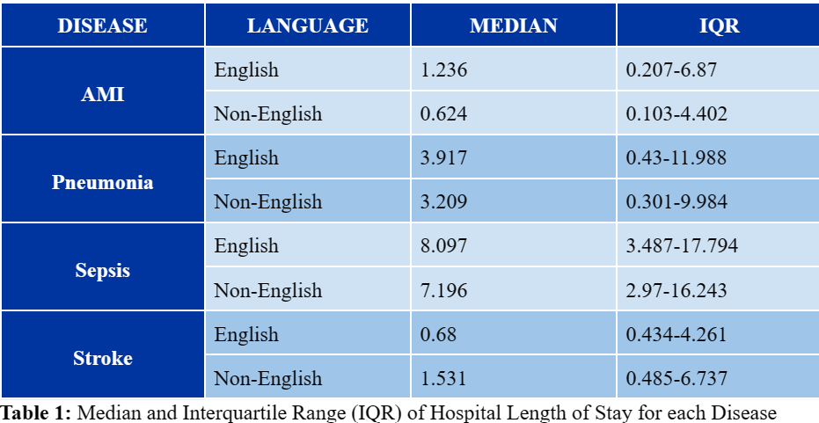
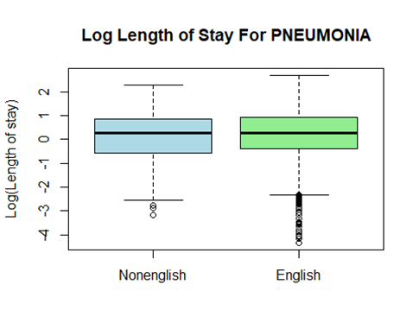
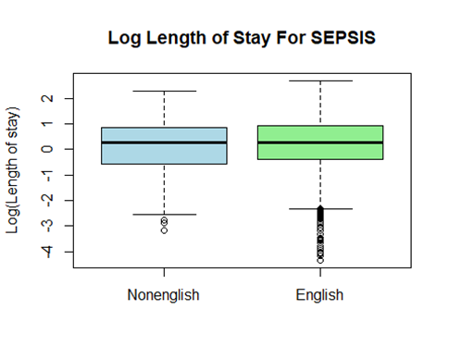
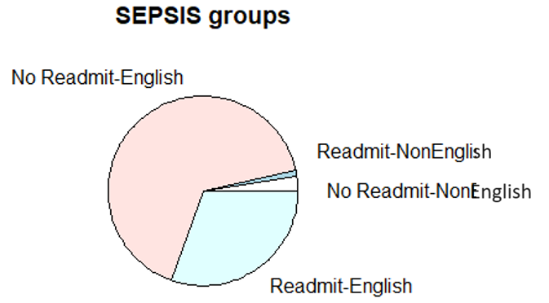
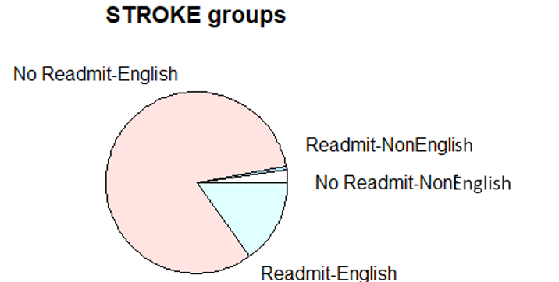
Examining the Relationship Between Length of Stay and Readmission Rates of English-Speaking and Non-English Speaking Patients Diagnosed with Stroke, Sepsis, Pneumonia, and Myocardial Infarction
Colby Dupin, Emma Gruper, Samantha Ingram, Hunter Leathers, Austin Stephenson
Faculty Mentor: Ashley Quinlan, PA-C
Statistician: Bridget Carroll
PURPOSE OF STUDY
RESULTS
DISCUSSION
The purpose of this study is to identify and compare the differences in length of stay and readmission rates between English speaking and non-English speaking patients by examining stroke, sepsis, pneumonia, and myocardial infarction at the University of Kentucky.
Non-English-speaking patients experience longer LOS times and higher readmission rates than English speaking patients. Our research findings are congruent with the findings of other, similar research findings.
How can providers mitigate these inequalities?
Utilize professional translation services with EVERY patient with a primary language other than English
Provide thorough and quality patient education; utilize the teach-back method to ensure patient understanding
Advocate for investments into healthcare resources for non-English-speaking patients
Points of Future Research:
Expand this research to include other hospital systems throughout the country
Examine the efficacy of different translation modalities to determine which is most effective
Identify the language groups who are most at risk of adverse health outcomes
Analyze the interventions that are most useful in mitigating negative health outcomes in non-English-speaking patients
BACKGROUND
Diversity, equity, and inclusion are vital in publicly serving institutions, demanding critical examination to ensure marginalized groups are not dismissed in discussions regarding healthcare access and quality.
Preliminary research has shown significant outcome disparities experienced by non-English speakers across a variety of settings and diseases throughout the United States, emphasizing the need for interventions to address these discrepancies^{1,2}.
Limited English proficiency intensifies challenges in accessing and comprehending healthcare services, making the experience virtually unfathomable for individuals who seek out quality services^{3,4}.
The University of Kentucky's unique healthcare ecosystem may reflect certain struggles seen across the United States in providing equitable care by examining shortcomings.
Local data analysis is important for understanding the unique needs of diverse populations to develop specific interventions to promote health equity, particularly in regions such as central Kentucky⁵.
This research is aimed at identifying disparities in length of stay and readmission rates among non-English speaking patients compared to English speaking patients across a spectrum of disease states.
Table 1: Log median and IQR of hospital length of stay for each disease.
Length of Stay (LOS) Analysis
T-tests revealed statistically significant differences in LOS between English and non-English speaking patients with AMI (p< 0.0001), stroke (p< 0.0001), and sepsis (p=0.04008). Observed a marginally significant difference in patients with pneumonia (p= 0.07566).
AMI: Non-English speakers had longer LOS (test statistic= -4.9054)
Stroke: Non-English speakers had longer LOS (test statistic= 4.6765)
Sepsis: Non-English speakers had longer LOS (test statistic= -2.056)
Pneumonia: English speakers tending to have shorter LOS (test statistic= -1.7779)
Table 1 presents median and interquartile range (IQR) for LOS, addressing any outliers
CONCLUSION
Non-English-speaking patients experience longer length of stays across all four examined disease states
Readmission rates are higher for non-English speaking patients who experience stroke or sepsis
Geographic specificity and a singular healthcare system limit generalizability, thus further research is required.
Method of translation services used in practice should be examined to explore which is most beneficial in reducing LOS and readmission rates
METHODS
This retrospective study used de-identified data from the University of Kentucky Center for Clinical Translation Services (CCTS). IRB approval was received for the study.
Two groups were included in the study: English and non-English speaking patient populations.
Data parameters for the two groups included length of stay and readmission rates over the past 5 years (2018-2023) for the following medical conditions: stroke, sepsis, pneumonia, and myocardial infarction.
Across all analyses, a p-value of less that 0.05 was considered statistically significant.
REFERENCES
Readmission Rates Analysis
Chi-square tests revealed:
AMI: No significant differences in readmission rates (p= 0.2092)
Pneumonia: No significant differences in readmission rates (p= 0.3001)
Sepsis: Significant difference indicated (p= 0.01096), requiring intervention
Stroke: Slight difference indicated (p= 0.08496), warranting further investigation
Acknowledgement:
The project described was supported by the NIH National Center for Advancing Translational Sciences through grant number UL1TR001998. The content is solely the responsibility of the authors and does not necessarily represent the official views of the NIH.

