Slide 1
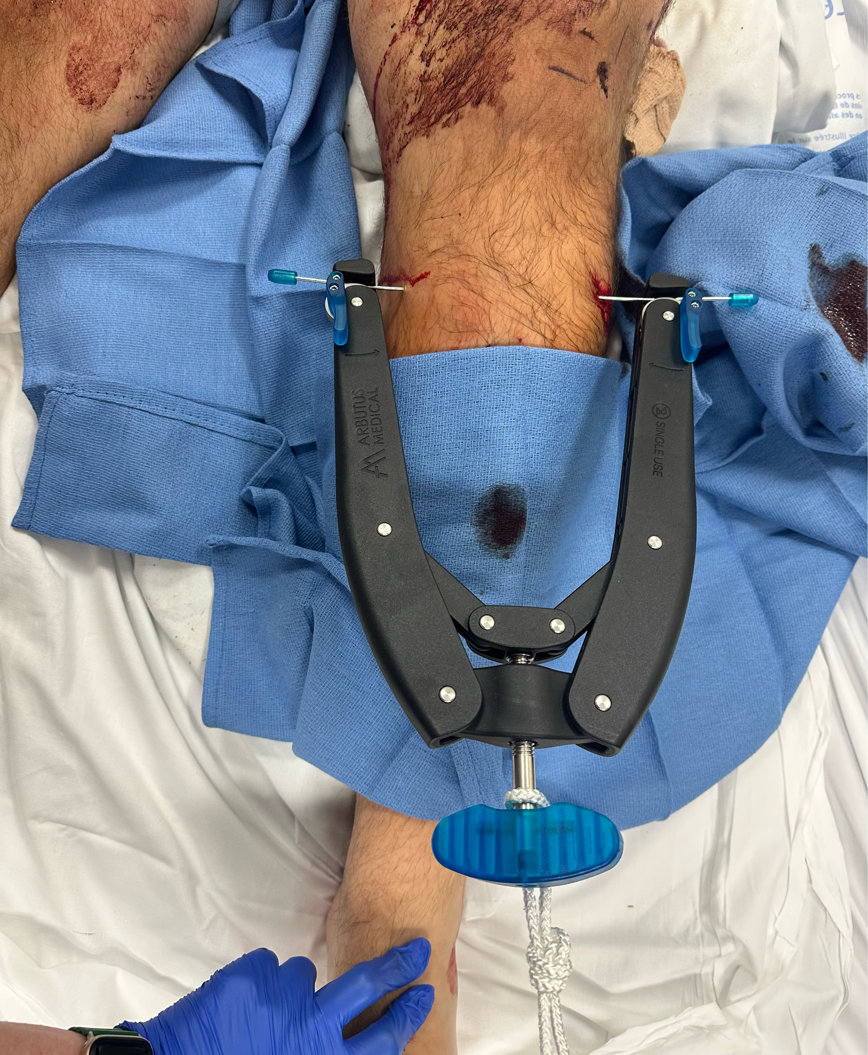
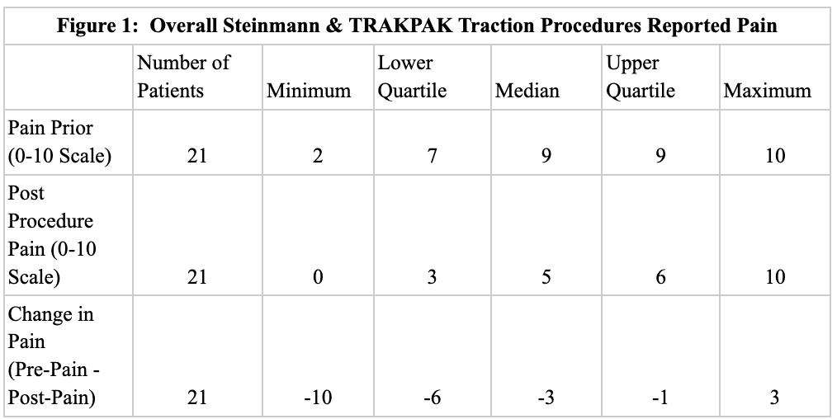
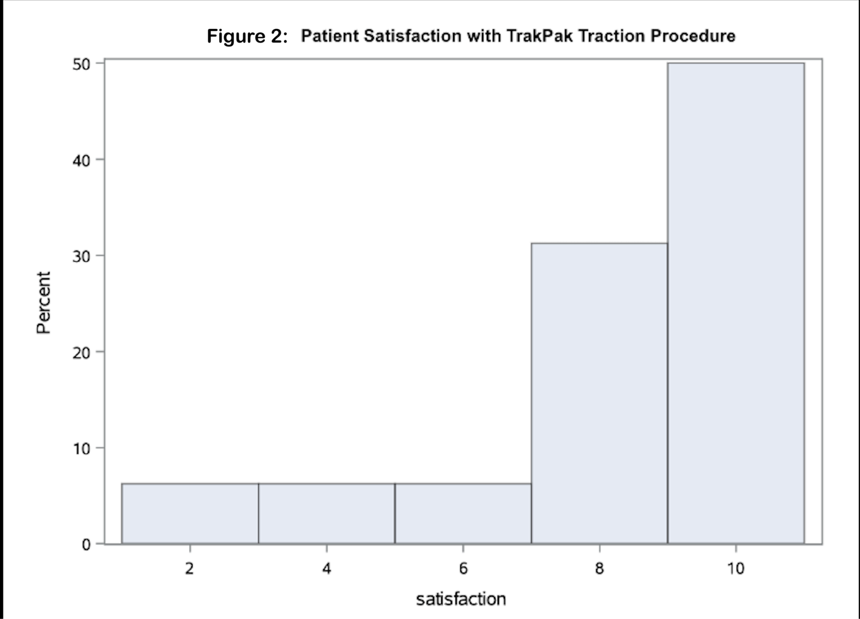
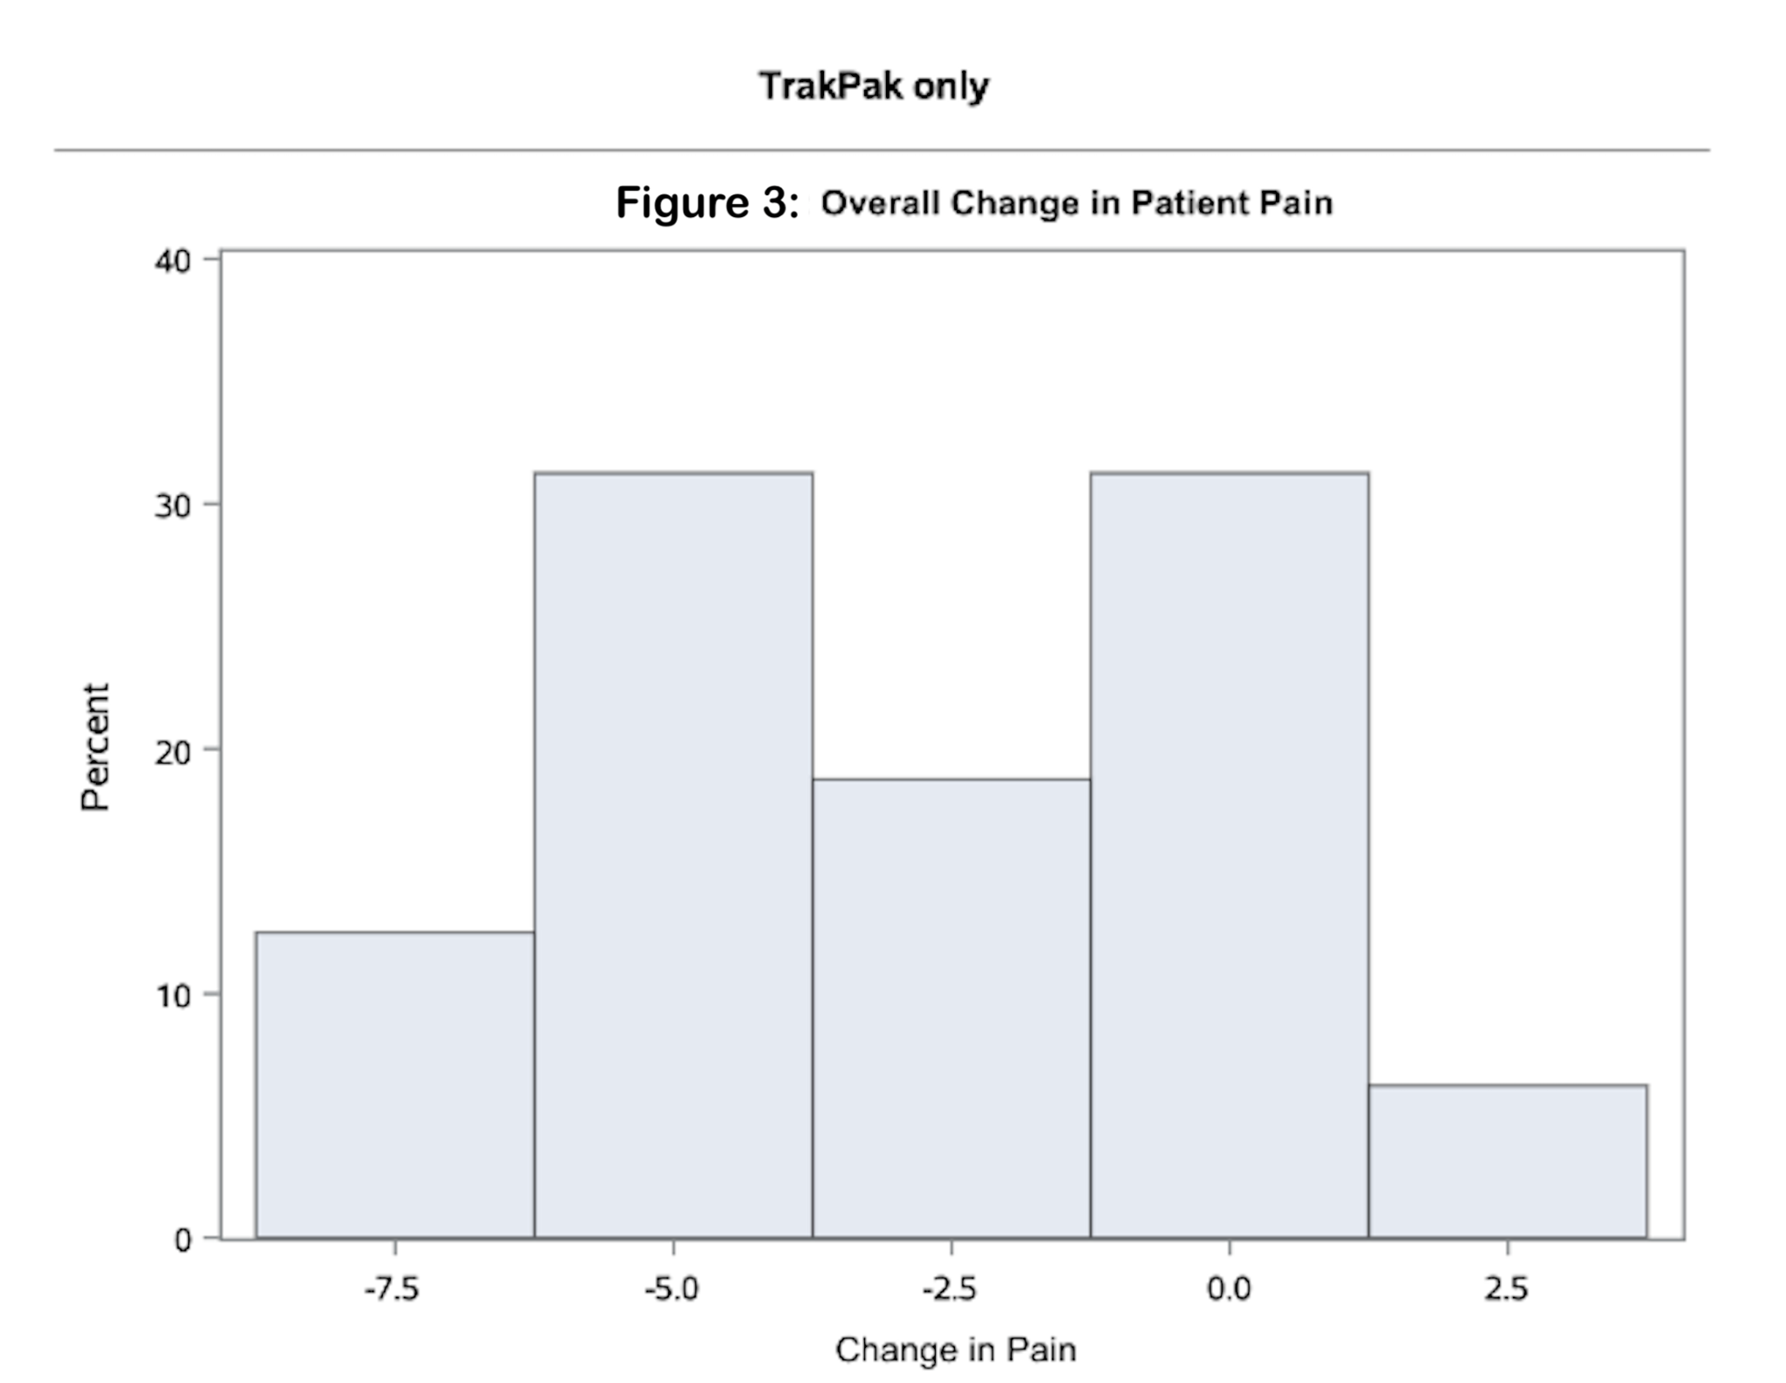
Psychosocial Factors and Pain in Patients with Lower Extremity Traction Pins
Lindsay E. Baechtold, Alan J. Bearnson, Lucy C. Bowers, Trevor M. Fields, Logan A. Greco, Anne W. Shand
William M. Charlton, Zella Christensen, Paul E. Matuszewski MD, Phillip A. Williford PA-C
INTRODUCTION
RESULTS
DISCUSSION
There are approximately 700,000 lower extremity fractures each year.
Traction is an option for orthopaedic patients and is used to stabilize various injuries before definitive fixation.
Traction allows the insertion of a pin where weight is added to allow the re-alignment of the fracture.
Complications, however, can be highly associated with traction. A foreign object can cause a high risk of infection, along with the procedure being completed outside the OR.
Steinmann pins, typically 4mm, are typically used at the current institution. The drill and proper sterility is not maintained throughout the procedure.
TRAKPAK is a newly developed kit that uses 2mm pins and uses sterile tools for the procedure. This device comes with a cost advantage for hospitals.
Scan to see the set up and procedure of the TRAKPAK device
Prior investigations have found a relationship between patient centered care and improvements in procedural quality and efficiency. Nevertheless, there has been little research on how patient satisfaction can impact skeletal traction procedures.
This study revealed a 30% decrease in pain post procedure between both the Steinmann and TRAKPAK pins. Factors that led to this decrease may be attributed to pain medication used, patients individual pain tolerances, mechanism of the patient’s injury, and the differences between the diameter sizes of the Steinmann and TRAKPAK pins.
The average length of the procedure was 8.14 minutes with the average satisfaction score of 8.38/10. Based on the current body of evidence, these results show that quicker procedure times were correlated with increased satisfaction ratings and increased efficiency of the procedure.
Image 1: TRAKPAK 2 mm kit by Arbutus Medical
Image 2: TRAKPAK by Arbutus Medical placed on a patient
PURPOSE OF STUDY
Figure 1 reveals a median reduction in patient pain by 3 points on a 10-point scale, translating to a substantial 30% decrease in patient pain following both Steinmann and TRAKPAK traction procedures.
This observed effect was found to be statistically significant, with a p-value of 0.0002.
The study explored patient satisfaction throughout the process including pain, sterility concerns, and length of procedure with the TRAKPAK and Steinmann pins.
CONCLUSION
Patient-pain levels following traction procedure improved by 30% from their pre-procedural levels.
Participating patients reported an average of 8.38/10 for procedure satisfaction.
This study was limited by a small sample size, a homogenous demographic, potential human error regarding timing of the procedures, and the lack of previous research on this topic.
Implications for future study include:
Increased sample sizes to generalize data to a larger population.
Further exploration of the impact of TRAKPAK vs. Steinmann pins on pain and satisfaction.
How the time from diagnosis to traction intervention affects patient outcomes.
METHODS
This was an observational cohort study of 21 patients where all patients underwent lower extremity traction at a Level I Trauma Center.
Approval was received by the local IRB (#91133)
Inclusion Criteria: LEF requiring surgical fixation, Glasgow Coma Score of 15 upon hospital admission, age ≥18.
Exclusion: Medical diagnosis of Alzheimer’s or Dementia, CVA, moderate to severe traumatic brain injury (TBI) diagnosed via a CT, pregnant, spinal cord injury, self-inflicted injury, incarcerated, medical diagnosis of schizophrenia or other psychiatric disorder, or require a legal authorized representative.
Surveys were collected prior to traction procedure and 30-minutes after via REDCap.
Statistical tests were generated using SAS statistical software (version #9.4)
REFERENCES
While the data for the TRAKPAK only participants showed efficient procedure times and high patient satisfaction (Figure 2), those outcomes did not alter the overall observed post-procedure pain, with an identical median decrease of 30% (Figure 3). This observed effect was statistically significant, with a p-value of 0.0024.

