Slide 1
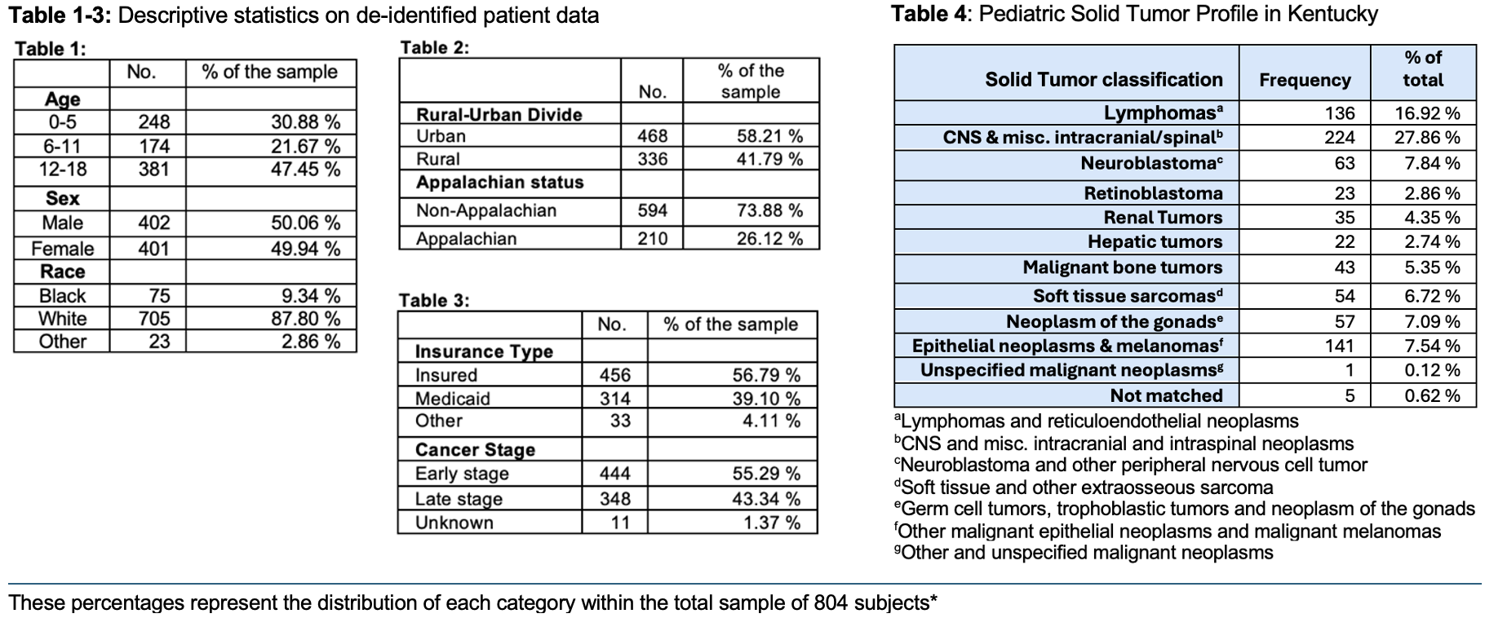
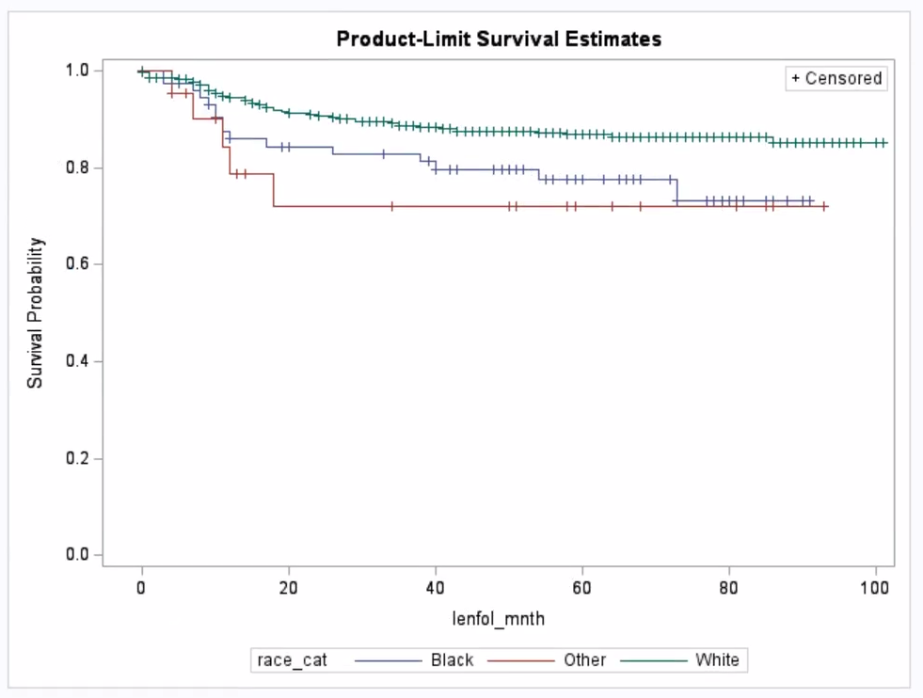
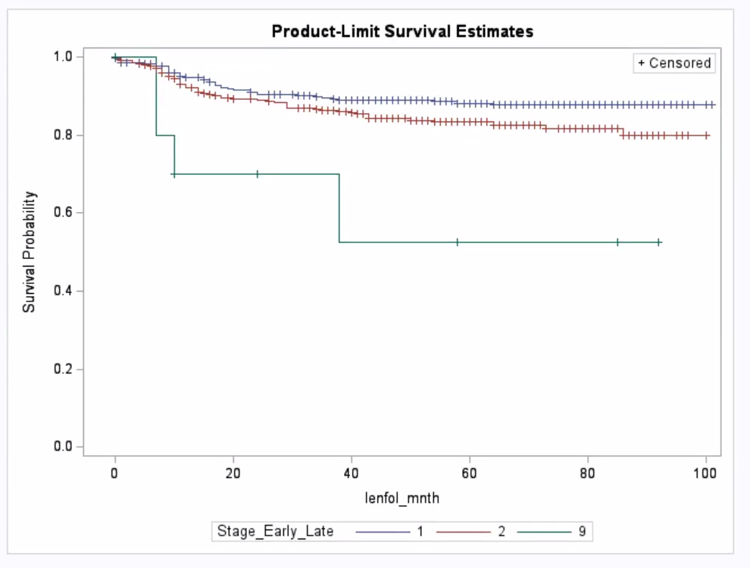
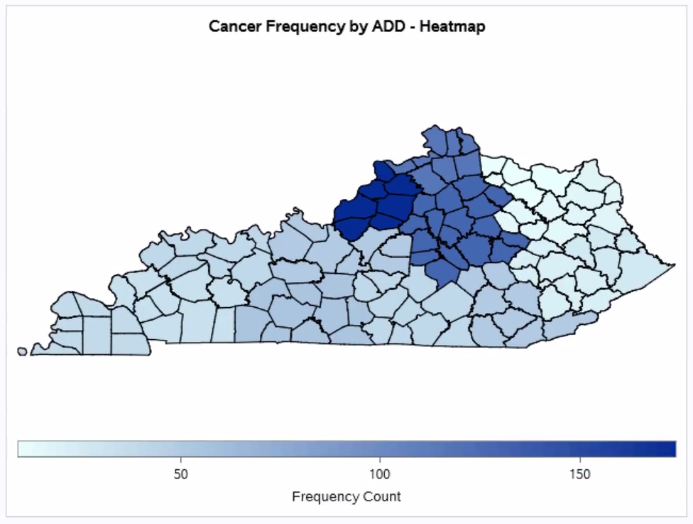
Impact of Social Determinants of Health on Pediatric Solid Tumors in KY
Abby Ayers, Kyle Davis, Kaylin Edwards, Chad Fishman, Mattie Klein, Calisse Burand; Leslie Woltenberg, PhD, MS Ed
INTRODUCTION
RESULTS
DISCUSSION
Malignant neoplasms are the 3rd leading cause of death in children and adolescents in the United States. The incidence of cancer has been rising, particularly in Kentucky (KY). Considerable data reveal that disparities exist between rural and urban, and Appalachian and non-Appalachian KY communities. According to the CDC, cancer death rates between the years of 2011-2015 were substantially higher in rural counties than in metropolitan counties. The idea of social determinants of health (SDoH) is an innovative approach to examine disparities on multiple levels. This study partnered with the Pediatric Oncology DanceBlue Clinic at the University of Kentucky (UK) in an effort to support their foundation and begin analyzing the potential link between solid tumor cancer diagnoses in the pediatric population in KY and the prognosis dependent upon the SDoH of those individuals.
Survival Probability: Overall, 84% of pediatric patients with solid tumor cancer diagnoses are likely to survive more than 8 years post-diagnosis, offering reassurance to patients and families.
Geographic Disparities: Despite expectations, no statistically significant differences were found in survival rates between residents of Appalachian vs non-Appalachian regions and rural vs urban counties, suggesting equitable access to care for patients across KY.
Insurance: Insurance status did not significantly impact survival outcomes, challenging common beliefs that insurance status is a predictor in survival.
Race: Race was found to be statistically significant, with a difference of about 9% in mortality rates emphasizing the common belief that racial disparities impact health outcomes. This result may be attributed to a small and localized representation of KY, highlighting the need for further studies.
PURPOSE OF STUDY
The purpose of this research is to evaluate the impact of social determinants of health on mortality and incidence of malignant pediatric solid tumors in KY through examining Kentucky Cancer Registry (KCR) data at the University of Kentucky.
CONCLUSION
Although it was hypothesized that more SDoH than only race and stage at diagnosis would have statistically significant impacts on mortality of pediatric solid tumors in KY, these results can be utilized to give hope to patients coming from medically underserved communities such as those in Appalachia. This research reassures patients and families that sex, insurance status, or geographic location do not put them at a disadvantage. Additionally, this research serves to educate clinicians on how SDoH may or may not affect mortality in pediatric solid tumors in KY. Clinicians can use this data to more appropriately screen patients for early signs of cancer coming from all areas in KY, regardless of many SDoH, as these results illuminate the importance of early diagnosis on mortality.
Further studies should be pursued with a larger, more diverse, sample size, on individual cancer types, and about SDoH specifically related to patient’s parents or caregiver
METHODS
This retrospective study analyzes de-identified pediatric solid tumor cases using the KCR database from 2015 to 2019. Solid tumors were chosen due to its ability to be staged and use for further differentiation between early and late stage. The impacts of SDoH on overall survival were performed using Kaplan Meier survival curves and log-rank tests for comparison between groups.
Additionally, geographic analysis was done to portray cancer incidence across area development districts in KY and Appalachian versus non-Appalachian designated counties. Notably, geographic analysis per capita was unable to be performed for the choropleth maps developed. Moreover, histology codes were condensed into 11 comprehensive categories to effectively represent the cancer profile in KY, along with their corresponding frequencies.
This study was approved by the Institutional Review Board (IRB) at the University of Kentucky, IRB protocol #92211.
SUMMARY OF RESULTS
Overall, 84% of patients aged 0-18 with solid tumors survived more than 8 years.
White patients did have a significantly higher survival rate than patients classified as Black or Other.
Solid tumors classified as early stage did have a significantly higher survival rate than late stage tumors.
There was no significant difference in survival rates found between: sex, insurance status, Appalachian status, or rural status.
REFERENCES
Scan the QR code for an external list of references, commentaries on the tables/ figures, and acknowledgements.

