Slide 1
Compliance Requirements for Clinical Leadership and Management Majors
For compliance questions:
Email: CHS-Compliance@uky.edu
https://chs.uky.edu/current-students/compliance
C.T. Wethington Building Room 111

Slide 2
Clinical Requirements
Full Background Check
10 Panel Drug Screening
Clinical Requirements:
Health Insurance (annual renewal)
Influenza Shot (annual renewal)
Commitment to Behavioral Standard in Patient Care
OLE Guide (annual renewal) Link below
https://www.uky.edu/chs/sites/chs.uky.edu/files/ole_orientation_guide.pdf
HIPAA Education and Consent Form (annual renewal) Link below
https://www.uky.edu/chs/sites/chs.uky.edu/files/2021_hipaa_education_and_c onsent.pdf
Immunizations: Hepatitis B, MMR, Varicella and Tdap documentation
Tuberculosis Two-Step Skin Test (2 separate TB test given at least 1 week apart) or IGRA Blood Test
An annual one-step skin test or IGRA Blood Test is required each year after for renewal.

Slide 3
Due Dates
The full background check and drug screening are due BY August 1st.
Incoming freshman do not need to open their CastleBranch account until start of the 2nd year in the program.
The clinical requirements are due by first day of class. Please be aware that some requirements are annual updates.
Flu Immunization is due November 1st each year.
It is highly recommended that you do not wait until close to the deadline to complete these requirements. Get them done as early as possible in case problems arise!

Slide 5
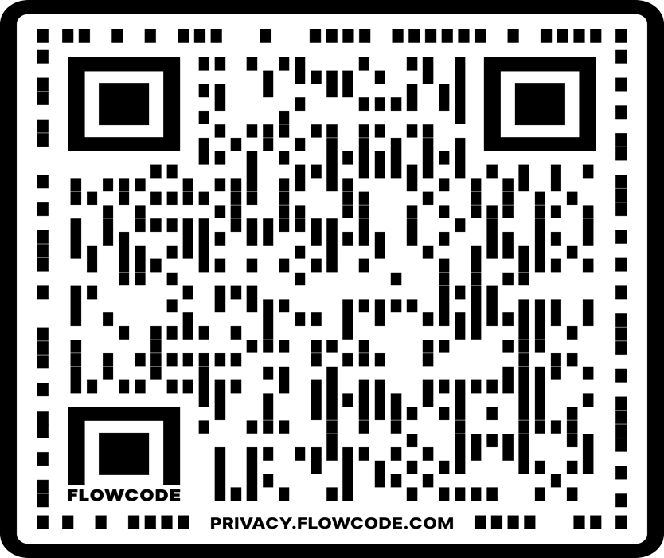
How to get started: Create an account on Castle Branch
Step 1: Go to https://uky-health.castlebranch.com/UK33 (copy and paste this link) or scan the QR Code
Step 2: Select “Place Order”
Step 3: Select Clinical Leadership and Management
Step 4: Select “UK34” “I need to order my initial Background Check, Drug Test, and Medical Document Manager”
Step 5: Review and place your order
You will need your personal information including SSN for this portion
For designation: undergraduate
Degree/certification: BHS Clinical Leadership and Management
Cost is $103 and includes Background Check, Drug Testing and Medical Document Manager

Slide 6
Background Check and Drug Screen
Your background check will begin immediately upon purchasing.
Instructions for your Drug Screening will be provided within your Castle Branch “To Do List” within three business days.
Download the registration form and locate a LabCorp near you to process the specimen (must be done at LabCorp). It is your responsibility to make sure that you allow enough time for us to receive the result prior to the start of the semester.
For issues processing a drug screen, please call CastleBranch directly at (888) 723-4263

Slide 7
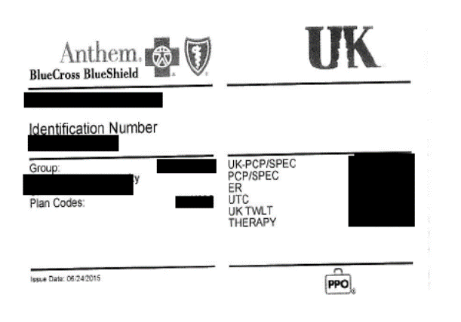
Health Insurance
You must provide a copy of your current health insurance card or proof of coverage.
Please make sure your name is on card. If your name is different than the name listed on the card, you will need to upload documentation showing you are covered under the name listed on the card, along with a copy of the front and back of your insurance card.
Make sure that you upload a copy of the front AND the back of the insurance card and any other proof of insurance documents needed as 1 upload/submission.
Example of uploaded card:

Slide 8
Influenza Vaccination
You will need to get a flu shot for the CURRENT FLU SEASON SEPT 1 – MARCH 31.
Please follow these instructions below for finding vaccines done through UK Healthcare:
Login to your My Chart:
https://mychart.uky.edu/MyChart/Authentication/Login
Go to Menu
Health summary
Immunization tab
Click the printer icon
Under destination, save as a PDF on you laptop
Upload to your CastleBranch account.
Any flu shot administered outside of this window for the current flu season will be rejected.
If flu immunization is completed on UK Campus, your document will automatically be uploaded in your MyChart in your myUK
This requirement has a different deadline than the others. You must complete this by November 1st.

Slide 9
Required Immunizations
Required Vaccines : please obtain documentation from your healthcare provider.
TB - TB skin test or IGRA Blood test) Annual renewal is 1 step TB skin test or IGRA Blood test.
Hepatitis B
MMR
Varicella
Tdap
Vaccines can be administered by University Health Services (UHS)
Appointments may be made by calling 859-323-2778.

Slide 10
Tuberculosis Test
New CHS students are required to complete an initial 2 step TB skin test or equivalent IGRA Blood test.
A 2 step TB test is 2 different TB skin tests given at least 1 week apart.
Annual renewal of 1 step TB skin test or TB blood test.
TB skin tests can be completed at University Health Services and are free with student ID.
If you have had a TB test within the last year, please bring a copy of the results with you to your appointment.
If completed at UHS, your document will be automatically uploaded to your MyChart in your MyUK.

Slide 11
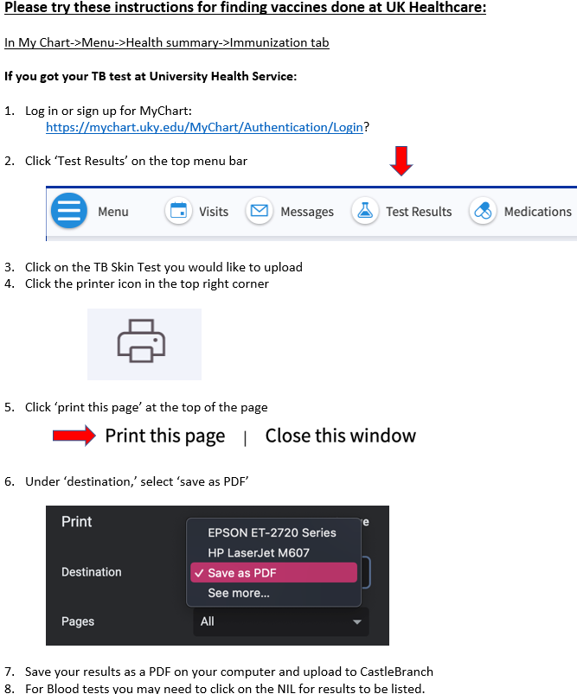
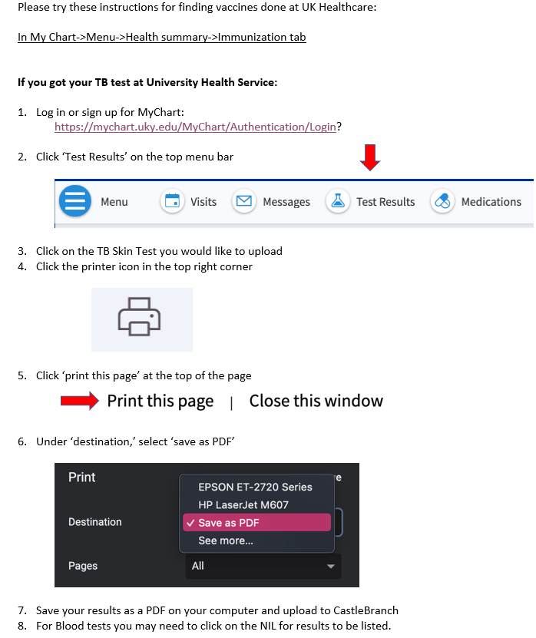

Slide 12
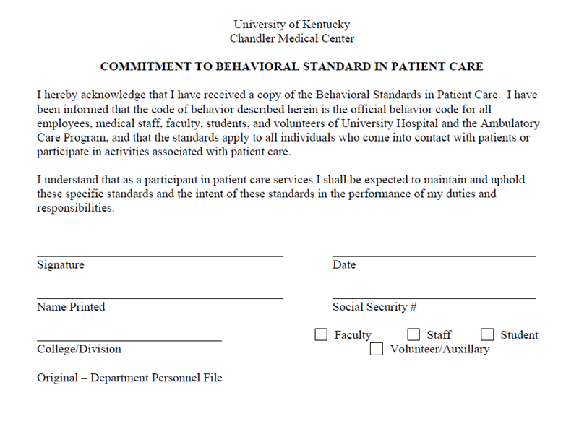
Commitment to Behavioral Standard in Patient Care
You will receive a copy of the Behavioral Standards in Patient Care at orientation.
Here is the link for Behavioral Standards in Patient Care: https://chs.uky.edu/current-students/compliance/forms
You will need to complete the last page of the document and upload this page to your CastleBranch account.
Scan the signed document or take a clear photo and upload it to CastleBranch (there are scanner apps you can download for free on your phone.)

Slide 13
Important Notes
Pay attention to due dates! If you do not complete the requirements in time, a hold will be placed on your UK account.
If CastleBranch rejects one of your submissions, promptly address this. Castlebranch will provide a reason for the rejection in an email to you. If you still do not understand why a document is not being accepted, you can contact:
CHS-Compliance@uky.edu
Occasionally, flu shots get rejected if the flu season is not explicitly stated on the document. Make sure your name, birthdate and date given is also listed on the document prior to uploading. Check your CB account to see what reason your flu shot is rejected.
Note that the flu shot has a different deadline than the other requirements and is due November 1st.

