Slide 1
Compliance Requirements for the Communication Sciences and Disorders Undergraduate Program and Pre-Req Students
For compliance questions:
Email: CHS-Compliance@uky.edu
https://chs.uky.edu/current-students/compliance

Slide 2
Requirements
Full Background Check
10 Panel Drug Screening
Clinical Requirements:
Health Insurance (annual)
Influenza Shot (annual)
Tuberculosis Two-Step Skin Test (2 separate TB test given at least 1 week apart) or IGRA Blood Test
An annual one-step skin test or IGRA Blood Test is required the each year for renewal.
Hepatitis B, MMR, Varicella and Tdap documents
Commitment to Behavioral Standard in Patient Care
https://www.uky.edu/chs/sites/chs.uky.edu/files/commitment_to_behavioral_standard_in_patient_care_manual_and_signature_form.pdf
Discrimination and Harassment Training
HIPAA training
OLE Guide (annual renewal)
https://www.uky.edu/chs/sites/chs.uky.edu/files/ole_orientation_guide.pdf
HIPAA Education and Consent Form (annual renewal)
https://www.uky.edu/chs/sites/chs.uky.edu/files/2021_hipaa_education_and_consent.pdf

Slide 3
Due Dates
The full background check and drug screening are due BY August 1st before start of program.
The clinical requirements are due by September 15th each year you are in the program.
Flu Immunization is due November 1st each year.
It is highly recommended that you do not wait until close to the deadline to complete these requirements. Get them done as early as possible in case problems arise!

Slide 4
How to get started: Create an account on CastleBranch

Slide 5
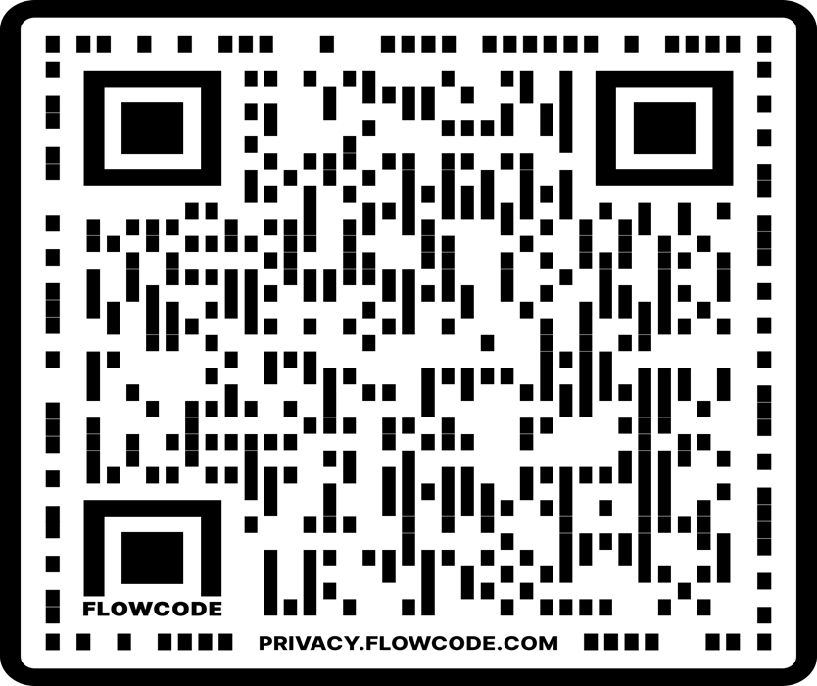
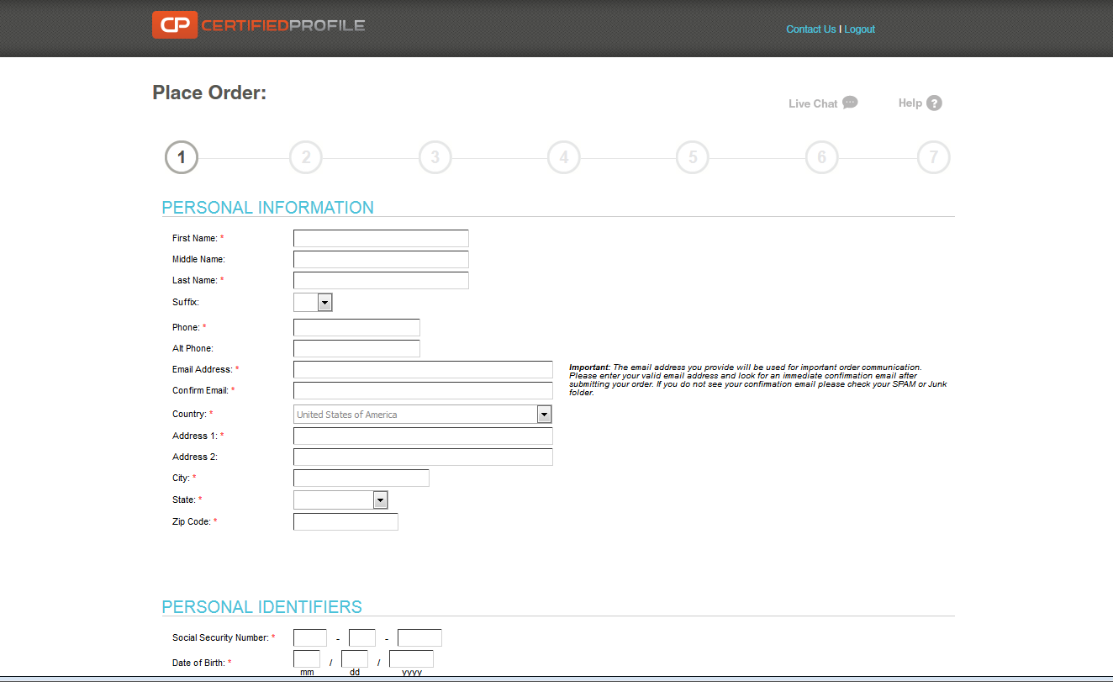
http://uky-health.castlebranch.com or scan QR code
Select “Place Order”
Select “College of Health Sciences”
Select “Communication Science and Disorders – Undergraduate”
Select UK35: “I need to order my initial Background Check, Drug Test, and Medical Document Manager”
You will then be directed to review your order, and then enter your personal details
Cost is $103

Slide 6
Background Check and Drug Screen
Your background check will begin immediately upon purchasing.
Instructions for your Drug Screening will be provided within your “To Do List” within three business days. You must use a LabCorp location for your drug screening.
You will be able to download the registration form and locate a LabCorp near you to process the specimen. It is your responsibility to make sure that you allow enough time for us to receive the result prior to the start of courses.
For issues processing a drug screen, please call CastleBranch directly at (888)723-4263

Slide 7
Clinical Requirements
Health Insurance (annual)
Commitment to Behavioral Standard in Patient Care
Influenza Shot (annual)
Hepatitis B, MMR, Varicella and Tdap documentation
2 step TB test (2 different TB skin tests given at least 1 week apart) or IGRA Blood Test
An annual one-step skin test or IGRA Blood test is required after the initial two-step test or IGRA Blood test.

Slide 8
Required Immunizations
Required Vaccines : please obtain documentation from your healthcare provider.
2 step TB test (2 different TB skin tests given at least 1 week apart)
or IGRA Blood Test
Hepatitis B
MMR
Varicella
Tdap
Vaccines can be administered by University Health Services (UHS)
Appointments may be made by calling 859-323-2778.

Slide 9
Health Insurance
You must provide a copy of your current health insurance card (front and back). .Please make sure your name is on the card.
If your name is different than the name listed on the card, you will need to upload documentation confirming your coverage along with a picture of the front and back of your insurance card. All documents must be uploaded as 1 upload.
Make sure that you upload a copy of the front AND back of the insurance card and any other proof of insurance documents needed as 1 upload
Example of uploaded card:

Slide 10
Influenza Vaccination
You will need to get a flu shot for the CURRENT FLU SEASON SEPT 1 – MARCH 31.
Please follow these instructions below for finding vaccines done through UK Healthcare:
Login to your My Chart:
https://mychart.uky.edu/MyChart/Authentication/Login
Go to Menu
Health summary
Immunization tab
Click the printer icon
Under destination, save as a PDF on you laptop
Upload to your CastleBranch account.
Any flu shot administered outside of this window for the current flu season will be rejected.
If flu immunization is completed on UK Campus, your document will automatically be uploaded in your MyChart in your myUK
This requirement has a different deadline than the others. You must complete this by November 1st

Slide 11
Tuberculosis Test
New Communication Sciences and Disorders students are required to complete an initial two-step TB skin test or equivalent IGRA Blood test.
A 2 step TB test is 2 different TB skin tests given at least 1 week apart.
Annual renewal of 1 step TB skin test or TB blood test.
TB skin tests can be completed at University Health Services and are free with student ID.
If you have had a TB test within the last year, please bring a copy of the results with you to your appointment.
If completed at UHS, your document will be automatically uploaded to your MyChart in your MyUK.

Slide 12
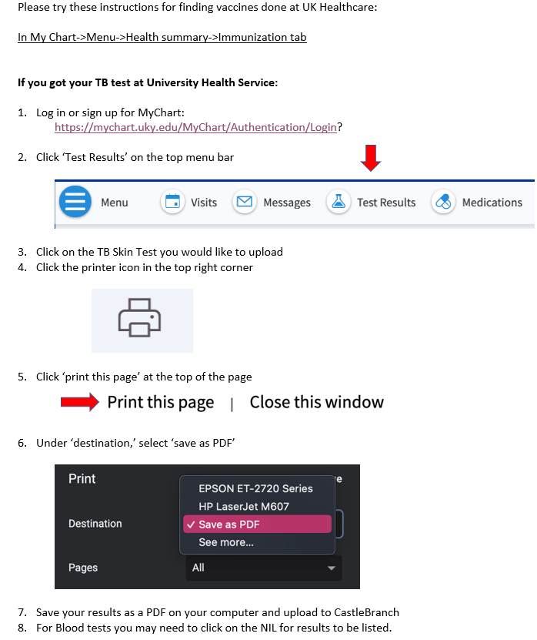
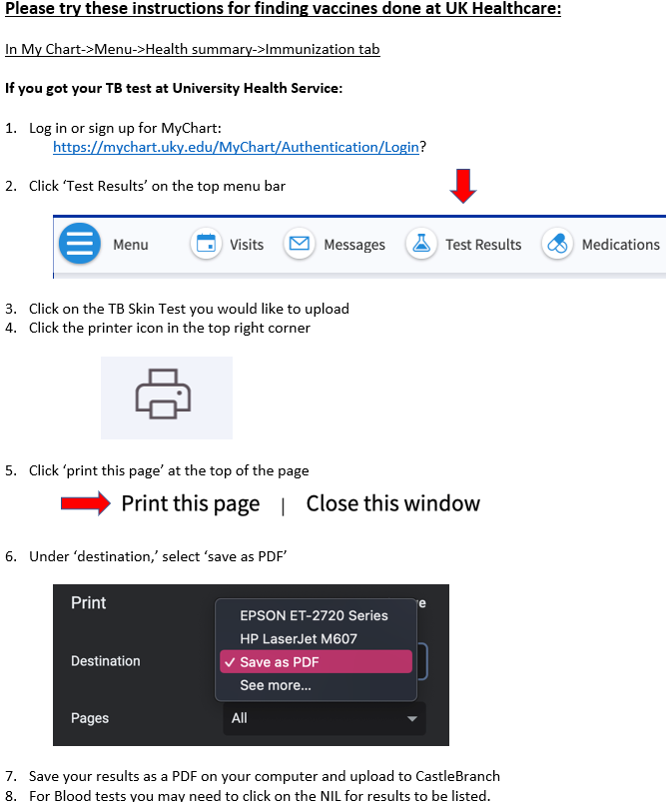

Slide 13
Commitment to Behavioral Standard in Patient Care
In Castle Branch, there is a link to this document. Follow this link to go to the document:
https://chs.uky.edu/current-students/compliance/forms
You will need to print, read, and sign this document.
Then, scan it and upload it to Castle Branch (there are scanner apps you can download for free on your phone.)

Slide 14
HIPAA and Discrimination and Harassment Trainings
Go to this link and enroll in the Canvas course. (NOTE: You will need your Link Blue ID and password to do so. If you do not yet have it, you will have to wait until you do.)
Go to “Assignments.” You will find the HIPAA training presentation and quiz. Before beginning the quiz, carefully read and review all the information in the presentation. When you are familiar with the material, take the quiz. You will have multiple attempts, but you MUST receive a 100% in order to get credit.
Follow the same instructions for the Discrimination training.
When both are complete, go to the “Grades” tab. You will then select the “Print Grades” option. Save the document as a PDF (you only need the first page that displays the two grades and your name).
Upload this PDF for BOTH the HIPAA and Discrimination training requirements in Castle Branch.

Slide 15
The document you upload for the HIPAA and Discrimination training should look like this:

Slide 16
Important Notes
Pay attention to due dates! If you do not complete the requirements in time, a hold will be placed on your UK account.
If CastleBranch rejects one of your submissions, promptly address this. Castlebranch will provide a reason for the rejection in an email to you. If you still do not understand why a document is not being accepted, you can contact:
CHS-Compliance@uky.edu
Occasionally, flu shots get rejected if the flu season is not explicitly stated on the document. Make sure your name, birthdate and date given is also listed on the document prior to uploading. Check your CB account to see what reason your flu shot is rejected.
Note that the flu shot has a different deadline than the other requirements and is due November 1st.

