Slide 1
Compliance Requirements for Athletic Training Graduate Program
For compliance questions, Email:
CHS-Compliance@uky.edu
https://chs.uky.edu/current-students/compliance
C.T. Wethington Building Room 111

Slide 2
Requirements
Full Background Check
10 Panel Drug Screening
Clinical Requirements:
MMR (Measles, Mumps, Rubella
Varicella (Chicken Pox)
Tetanus, Diphtheria, Pertussis (Tdap)
Hepatitis B
TB IGRA Blood test (2nd year renewal)
Flu Immunization (annual renewal)
CPR Certification (Basic Life Support for healthcare workers is required)
Physical Examination
Health Insurance (annual renewal)
Professional Liability Insurance (annual renewal)
Commitment to Behavioral Standard in Patient Care (annual renewal)
HIPAA Certification (annual renewal)
Discrimination & Harassment Training (annual renewal)
OLE Guide (annual renewal)
HIPAA Education and Consent form (annual renewal)
Bloodborne Pathogens Training (annual renewal)
FERPA Training (annual renewal)
Health Care Colleges Code of Student Acknowledgement (annual renewal)
CHS Student Technical and Behavioral Standards (annual renewal)

Slide 3
Due Dates
The full background check and drug screening are due BY April 1st before class registration and start of program.
The clinical requirements are due by May 1st each year you are in the program.
Flu Immunization is due November 1st, each year.
It is highly recommended that you begin gathering these materials as early as possible, especially if you are an out-of-state student or you are far from your primary health care provider. Get them done as early as possible in case problems arise!

Slide 4
How to get started: Create an Account on CastleBranch

Slide 5
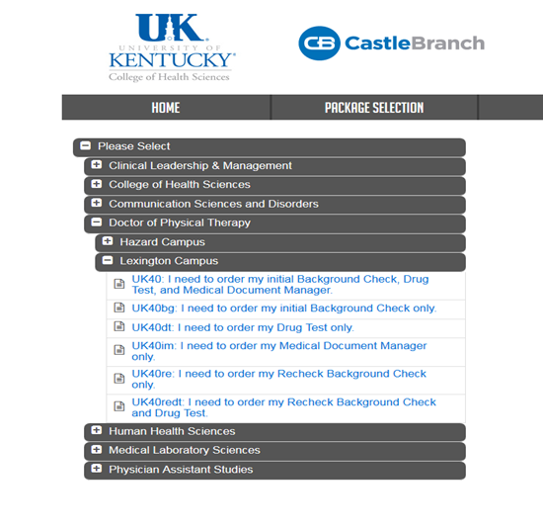
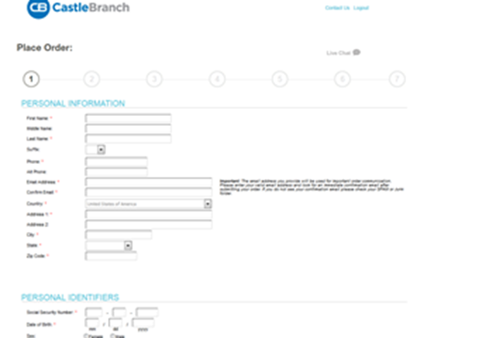
http://uky-health.castlebranch.com/
Select “Place Order”
Select “College of Health Sciences”
Select “University of Kentucky Athletic Training”
Select “I need to order my initial Background Check, Drug Test, and Medical Document Manager”
You will then be directed to review your order, and then enter your personal details
The cost is $103.

Slide 6
Background Check and Drug Screen
Your background check will begin immediately upon purchasing.
Instructions for your Drug Screening will be provided within your CastleBranch “To Do List” within three business days. You must use a LabCorp location for your drug screening.
You will be able to download the registration form and locate a LabCorp near you to process the specimen. It is your responsibility to make sure that you allow enough time for us to receive the result prior to the start of courses.
For issues processing a drug screen, please call CastleBranch directly at (888) 723-4263

Slide 7
Clinical Requirements
MMR (Measles, Mumps, Rubella
Varicella (Chicken Pox)
Tetanus, Diphtheria, Pertussis (Tdap)
Hepatitis B
TB IGRA Blood Test (first year)
TB IGRA Blood test (annual renewal)
Flu Immunization (annual renewal)
BLS/CPR Certification (BLS for Healthcare providers)
Physical Examination
Health Insurance (annual renewal)
Professional Liability Insurance (annual renewal)
Commitment to Behavioral Standard in Patient Care (annual renewal)
HIPAA Certification (annual renewal)
Discrimination & Harassment Training (annual renewal)
OLE Guide (annual renewal)
HIPAA Education and Consent form (annual renewal)
Bloodborne Pathogens Training (annual renewal)
FERPA Training (annual renewal)
Health Care Colleges Code of Student Acknowledgement (annual renewal)
CHS Student Technical and Behavioral Standards (annual renewal)
NATA Membership Card (annual renewal)

Slide 8
Health Insurance
You must provide a copy of your current health insurance card or proof of coverage. Please make sure your name is on the card.
If your name is different than the name listed on the card, you will need to upload documentation confirming your coverage.
Make sure that you upload a copy of the front AND back of the insurance card.

Slide 9
Professional Liability Insurance
Students are responsible for obtaining their own liability insurance. Popular insurers include Mercer and HPSO.
The “Per Incident” amount should be at least 1 million and the “annual aggregate” should be at least 3 million. 2 million per incident and 4 million annual aggregate is also acceptable.
Typically costs $30-$50 per year.
Must be renewed annually.

Slide 11
Required Immunizations
Required vaccines: please obtain documentation from your healthcare provider.
TB IGRA Blood Test
Hep B
MMR
Varicella
Tdap
Vaccines can be administered by University Health Services (UHS).
Appointments may be made by calling 859-323-2778.

Slide 12
MEASLES, MUMPS AND RUBELLA (MMR) vaccine Compliance can be obtained by providing: 1. Two MMR vaccines with first dose given at 1 year of age or older AND second dose given at age four or older; OR 2. Documentation of positive antibody titers showing proof of immunity for each of the three diseases: [measles (rubeola), mumps AND rubella] Note: If a student submits documentation of negative or indeterminate titers, but they have also submitted proof of two MMR vaccines as listed above, this is acceptable. Documentation must include: Student’s Name Student’s date of birth If series is completed, dates of each shot OR If titers are provided, dates of positive titers are required and information will include: “immune,” “positive” or number that when compared to range given on record indicates the student is positive/immune; AND Name of the healthcare provider OR UHS compliance form OR Employee compliance form OR state immunization certificate or registry.
MMR Vaccine

Slide 13
Evidence of one dose of TDaP. Documentation must include: -Student’s Name -Student’s date of birth -Date of TDaP shot; AND -Name of the healthcare provider OR UHS compliance form OR Employee compliance form OR state immunization certificate or registry.
TDaP
(Tetanus-Diphtheria Acceular Pertussis)

Slide 14
VARICELLA (Please note that oral history of disease or an X on immunization record is not accepted.) Compliance may be obtained by providing: 1. Evidence of varicella two-dose series after one year of age; OR 2. Positive antibody titer showing proof of immunity; OR 3. Medically documented history of disease (chicken pox/varicella or shingles/zoster) from a healthcare provider (Doctor, APRN, or PA) with date of disease. An X on the immunization form by varicella is NOT acceptable proof of disease. Note: If a student submits documentation of negative or indeterminate titers, but they have also submitted proof of two varicella vaccines as listed above, this is acceptable
Documentation must include:
Student’s Name
Student’s date of birth
If series is completed, dates of each shot; OR
If titer is provided, date of positive titer is required and information will include: “immune,” “positive” or number that when compared to range given on record indicates the student is positive/immune; OR
If providing medical history, submit a medical record from healthcare provider (Physician, APRN or PA) stating patient diagnosed with Chicken pox (Varicella) or Shingles (Herpes zoster); AND
Name of the healthcare provider OR UHS compliance form OR Employee compliance form OR state immunization certificate or registry.

Slide 15
Compliance may be obtained by providing: 1. Evidence of three Hepatitis B vaccines; OR 2. If series is in process or historical documentation of vaccines could not be obtained, 2 vaccines are required upon initial submission to this requirement. You will be able to submit record of the third shot when it is due. Documentation must include: -Student’s Name -Student’s date of birth -Dates of HEP B shots; AND -Name of the healthcare provider OR UHS compliance form OR Employee compliance form OR state immunization certificate or registry. Subsequent Requirement: If only two initial vaccines obtained, Hepatitis B third dose due 6 months after the 1st dose.
HEPATITIS B
(Positive Titer not accepted)

Slide 17
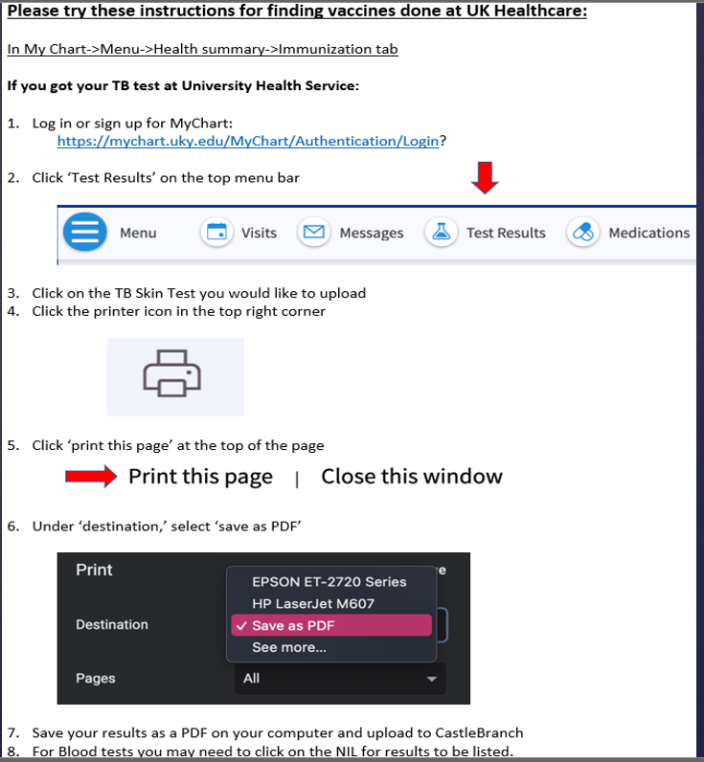

Slide 18
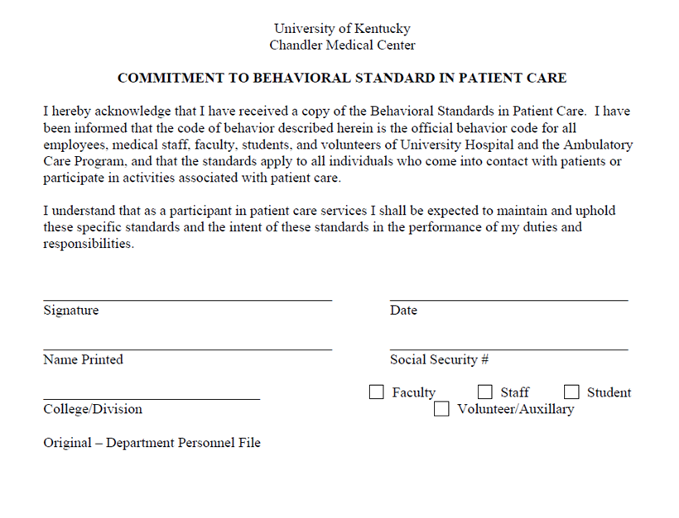
Commitment to Behavioral Standard in Patient Care
In Castle Branch, there is a link to this document. Follow this link https://chs.uky.edu/current-students/compliance/forms to go to the document.
You will need to print, read, and sign this document.
Then, scan it and upload it to Castle Branch (there are scanner apps you can download for free on your phone.)

Slide 19
BLS/CPR Certification
Acceptable documents:
American Heart Association Basic Life Support or
American Red Cross BLS/CPR for Healthcare Providers
Skills portion must be an in-person course (not online)
A copy of BOTH the front and the back of your card is required and the card MUST be signed.
More information can be found at the following links:
http://www.redcross.org/take-a-class/bls
http://cpr.heart.org/AHAECC/CPRAndECC/Training/HealthcareProfessional/BasicLifeSupportBLS/UCM_473189_Basic-Life-Support-BLS.jsp

Slide 20
Physical Examination
Upload documentation of your completed physical examination. The form must be completed and signed by a medical professional, be completed within the past 12 months, AND must be completed on the 2 page form available for download from the following link.
https://www.uky.edu/chs/sites/chs.uky.edu/files/AT/professional_master_of_science_in_athletic_training_ppe_form.pdf

Slide 21
Bloodborne Pathogens Training Certification
When you complete the Bloodborne Pathogens training, upload a copy of your UK certificate to this requirement. Student name must be included. This will need to be updated annually by 5/1 in CastleBranch.
https://ehs.uky.edu/classes/classes_ohs_0001.php#bloodborne_pathogens_general

Slide 22
HIPAA and Discrimination and Harassment Trainings
Go to this link and enroll in the Canvas course. (NOTE: You will need your LinkBlue ID and password to do so. If you do not yet, have it, you will have to wait until you do.)
Go to “Assignments.” You will find the HIPAA training presentation and quiz. Before beginning the quiz, carefully read and review all the information in the presentation. When you are familiar with the material, take the quiz. You will have multiple attempts, but you MUST receive a 100% to get credit.
Follow the same instructions for the Discrimination training.
When both are complete, go to the “Grades” tab. You will then select the “Print Grades” option. Save the document as a PDF (you only need the first page that displays the two grades and your name).
Upload this PDF for BOTH the HIPAA and Discrimination training requirements in Castle Branch.
This will be updated annually by 5/1 each year in CastleBranch.

Slide 23
FERPA TRAINING
FAMILY EDUCATION RIGHTS & PRIVACY ACT (FERPA)
A Federal Law designed to protect the privacy of education records, to establish the right of students to inspect and review their education records.
FERPA Training: https://www.uky.edu/chs/current-students/compliance-background-checks-and-drug-screens
Confidentiality agreement to complete and upload to CastleBranch: https://www.uky.edu/chs/current-students/compliance-background-checks-and-drug-screens (Go to CHS Student Polices, Rules & Regulations for agreement). Updated annually by 5/1 each year.

Slide 24
CHS Student Technical and Behavioral Standards
Please use this link to read the College of Health Sciences Student Technical and Behavioral Standards. https://www.uky.edu/chs/current-students/compliance-background-checks-and-drug-screens
After reading, complete and upload the Technical and Behavioral Standards Acknowledgement form to your CastleBranch account. The Acknowledgement Form is found under the same link above, under the Program Specific instructions “Athletic Training”.

Slide 25
Important Notes
Pay attention to due dates! If you do not complete the requirements in time, a hold will be placed on your UK account.
If CastleBranch rejects one of your submissions, promptly address this. Castlebranch will provide a reason for the rejection in an email to you. If you still do not understand why a document is not being accepted, you can contact:
CHS-Compliance@uky.edu
Occasionally, flu shots get rejected if the flu season is not explicitly stated on the document. Make sure your name, birthdate and date given is also listed on the document prior to uploading. Check your CB account to see what reason your flu shot is rejected.
Note that the flu shot has a different deadline than the other requirements and is due November 1st.

