Slide 1
Compliance Requirements for Physician Assistant Students
Do not place order until after Sept. 15th
For compliance questions
Email: CHS-Compliance@uky.edu
https://chs.uky.edu/current-students/compliance
C.T. Wethington Building Room 111

Slide 2
Requirements
Full Background Check
10 Panel Drug Screening
Clinical Requirements:
  Health Insurance (annual renewal)
  Influenza Shot (annual renewal)
  Required immunization records
  Commitment to Behavioral Standard in Patient Care
  Tuberculosis: IGRA Blood test (annual renewal)
  BLS/CPR Certification (Basic Life Support for Healthcare providers from AHA)
  Discrimination and Harassment Training
  HIPAA training
  HIPAA Acknowledgement Form
  Blood Borne Pathogens Training
  ACLS Certification
  CPI/NCI Certification

Slide 3
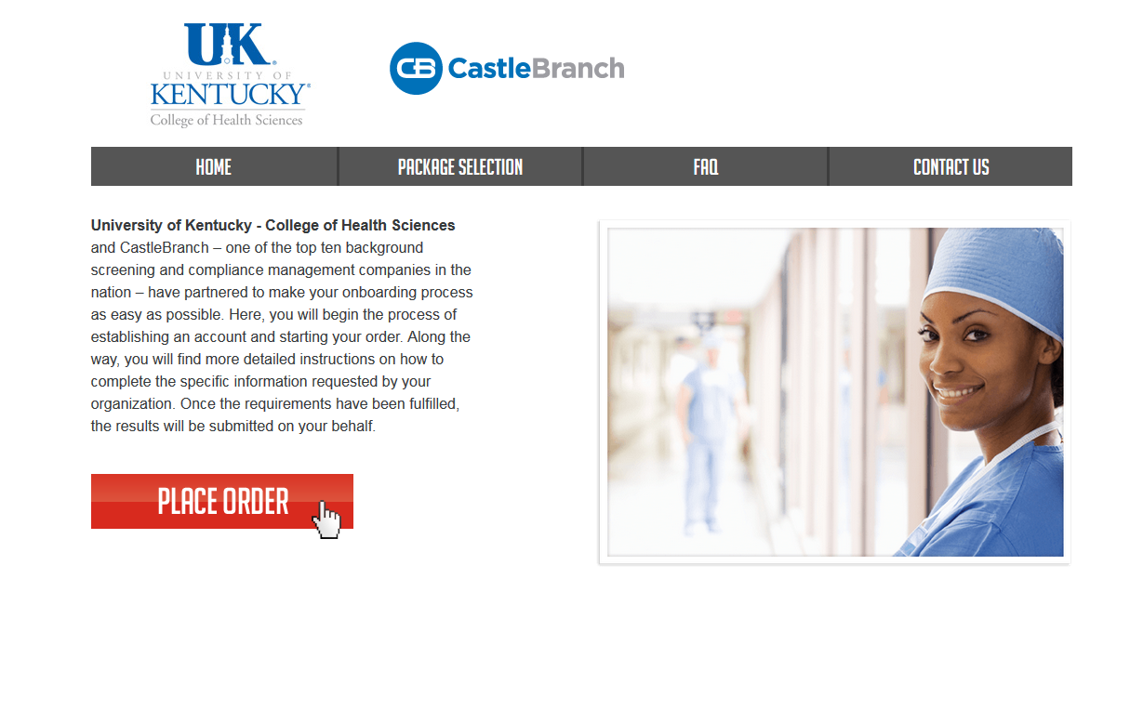
How to get started:
Create an account on Castle Branch

Slide 4
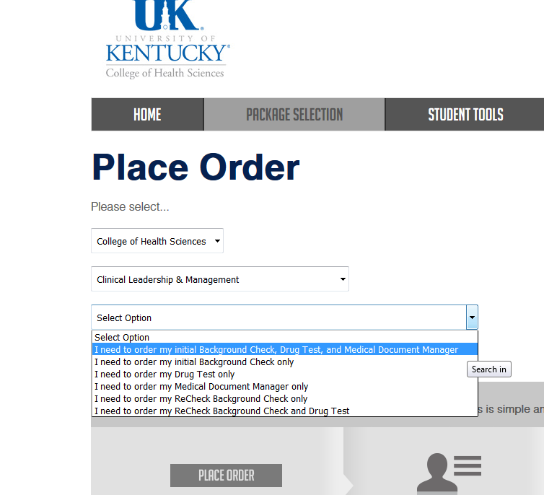
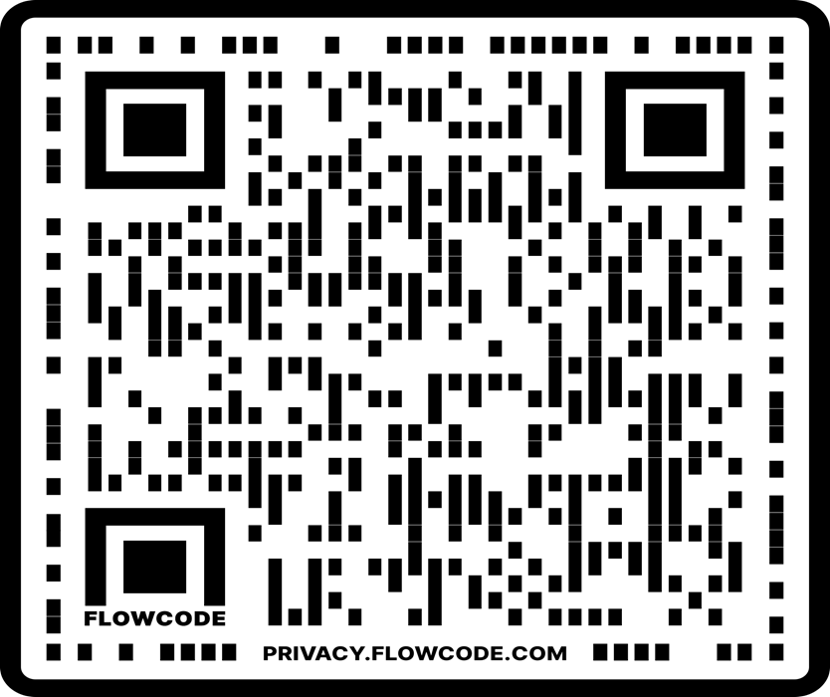
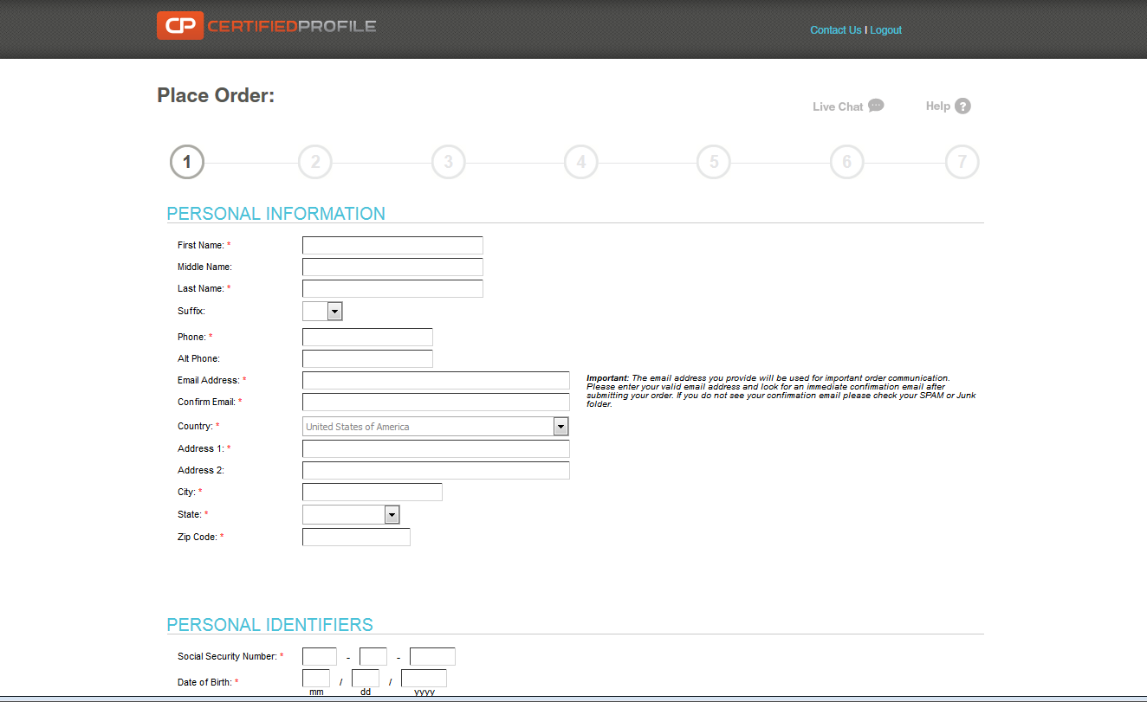
New Incoming students to UK
Go to: http://uky-health.castlebranch.com/
Or scan QR code
Select “Place Order”
Select “College of Health Sciences”
Select “Physician Assistant Studies”
Select “UK42: I need to order my initial Background Check, Drug Test, and Medical Document Manager”
You will then be directed to review your order, and then enter your personal details
The cost is $103.00

Slide 5
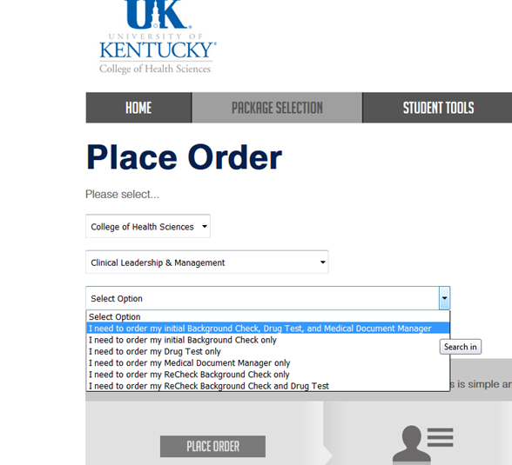
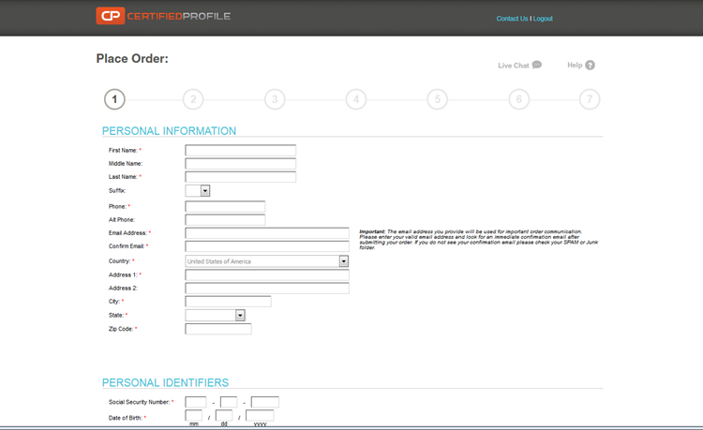
If you are a current UK CHS Undergraduate Student and already have a CastleBranch account, follow the instructions below:
Go to: http://uky-health.castlebranch.com/
Select: “Place Order”
Select: “College of Health Sciences”
Select: “Physician Assistant Studies”
Select: “UK42redt: I need to order my Recheck Background Check and Drug Test.”
You will then be directed to view your order and enter personal details.
The cost is $58.00
Reach out to chs-compliance@uky.edu to make sure that you are moved to the PAS cohort in CastleBranch

Slide 6
Background Check and Drug Screen
Your background check will begin immediately upon purchasing.
Instructions for your Drug Screening will be provided within your Certified Profile “To Do List” within three business days.
  You will be able to download the registration form and locate a LabCorp near you to process the specimen. It is your responsibility to make sure that you allow enough time for us to receive the result prior to the start of courses.
  For issues processing a drug screen, please call CastleBranch directly at (888) 723-4263

Slide 7
Due Dates
The full background check and drug screening are due BY November 1st before class registration and start of program.
Make sure that you have enough time to get the results before this time. It can take a few days to process.
The clinical requirements are due by January 1st each year you are in the program with exception of ACLS and CPI/NCI (due 6/1)
It is highly recommended that you begin gathering these materials as early as possible, especially if you are an out-of-state student or you are far from your primary health care provider.

Slide 8
Clinical Requirements
  Health Insurance (annual)
  Influenza Shot (annual)
  Immunizations: MMR, Varicella, Hep B and Tdap
  Commitment to Behavioral Standard in Patient Care
  Tuberculosis: IGRA, QuantiFERON or T-Spot Blood test (annual)
  BLS/CPR Certification (America Heart Association BLS for Healthcare Provider)
  ACLS -American Heart Association Advanced Cardiac Life Support Certification
  CPI/NCI – Crisis Prevention Institute’s Nonviolent Crisis Intervention Training.
  Discrimination and Harassment Training
  HIPAA training
  HIPAA Acknowledgement Form
  Blood Borne Pathogens Training

Slide 9
Required Immunizations
Required vaccines: please obtain documentation from your healthcare provider.
  Tuberculosis IGRA, QuantiFERON, or T-Spot Blood test
  Hep B
  MMR
  Varicella
  Tdap
  Flu
Vaccines can be administered by University Health Services (UHS).
Appointments may be made by calling 859-323-2778.

Slide 10
Health Insurance
You must provide a copy of your current health insurance card or proof of coverage.
Please make sure your name is on card. If your name is different than the name listed on the card, you will need to upload documentation showing you are covered under the name listed on the card, along with a copy of the front and back of your insurance card.
Make sure that you upload a copy of the front AND the back of the insurance card and any other documents needed as 1 upload.
Example of uploaded card:

Slide 11
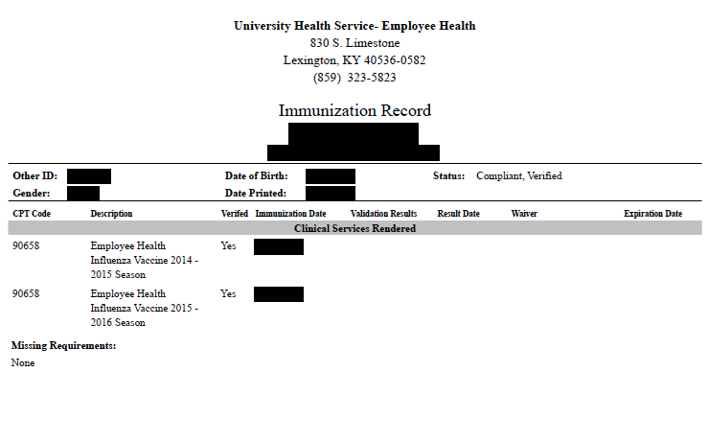
Influenza Vaccination
You will need to get a flu shot for the CURRENT FLU SEASON SEPT 1 – MARCH 31.
  Any flu shot administered outside of the current flu season will be rejected.
  Note that this document will look a little different depending on where you get your flu shot.
This requirement has a different deadline than the others. This document is due no later than November 1st.

Slide 12
MMR Vaccine
MEASLES, MUMPS AND RUBELLA (MMR) vaccine Compliance can be obtained by providing: 1. Two MMR vaccines with first dose given at 1 year of age or older AND second dose given at age four or older; OR 2. Documentation of positive antibody titers showing proof of immunity for each of the three diseases: [measles (rubeola), mumps AND rubella] Note: If a student submits documentation of negative or indeterminate titers, but they have also submitted proof of two MMR vaccines as listed above, this is acceptable. Documentation must include: Student’s Name Student’s date of birth If series is completed, dates of each shot OR If titers are provided, dates of positive titers are required and information will include: “immune,” “positive” or number that when compared to range given on record indicates the student is positive/immune; AND Name of the healthcare provider OR UHS compliance form OR Employee compliance form OR state immunization certificate or registry.

Slide 13
Note: TDaP is a different vaccine than the tetanus (Td) vaccine, which is recommended every 10 years. TDaP is also different than the childhood DTaP vaccine
Evidence of one dose of TDaP given at any time. Documentation must include: Student’s Name Student’s date of birth Date of TDaP shot; AND Name of the healthcare provider OR UHS compliance form OR Employee compliance form OR state immunization certificate or registry.
TDaP
(Tetanus-Diphtheria Acceular Pertussis)

Slide 14
VARICELLA (Please note that oral history of disease or an X on immunization record is not accepted.) Compliance may be obtained by providing: 1. Evidence of varicella two-dose series after one year of age; OR 2. Positive antibody titer showing proof of immunity; OR 3. Medically documented history of disease (chicken pox/varicella or shingles/zoster) from a healthcare provider (Doctor, APRN, or PA) with date of disease. An X on the immunization form by varicella is NOT acceptable proof of disease. Note: If a student submits documentation of negative or indeterminate titers, but they have also submitted proof of two varicella vaccines as listed above, this is acceptable
Documentation must include: Student’s Name Student’s date of birth If series is completed, dates of each shot; OR If titer is provided, date of positive titer is required and information will include: “immune,” “positive” or number that when compared to range given on record indicates the student is positive/immune; OR
If providing medical history, submit a medical record from healthcare provider (Physician, APRN or PA) stating patient diagnosed with Chicken pox (Varicella) or Shingles (Herpes zoster); AND Name of the healthcare provider OR UHS compliance form OR Employee compliance form OR state immunization certificate or registry.

Slide 15
HEPATITIS B
(Positive titer not accepted)
Compliance may be obtained by providing: 1. Evidence of three Hepatitis B vaccines; OR 2. If series is in process or historical documentation of vaccines could not be obtained, 2 vaccines are required upon initial submission to this requirement. You will be able to submit record of the third shot when it is due. Documentation must include: Student’s Name Student’s date of birth Dates of HEP B shots; AND Name of the healthcare provider OR UHS compliance form OR Employee compliance form OR state immunization certificate or registry. Subsequent Requirement: If only two initial vaccines obtained, Hepatitis B third dose due 6 months after the 1st dose.

Slide 16
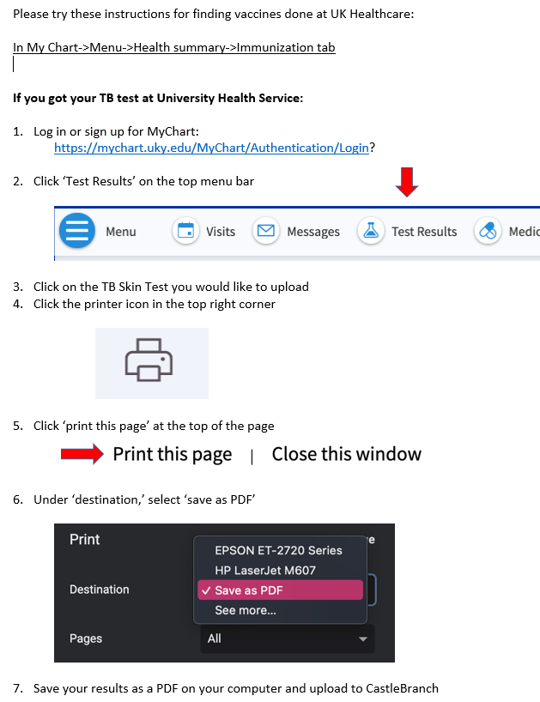
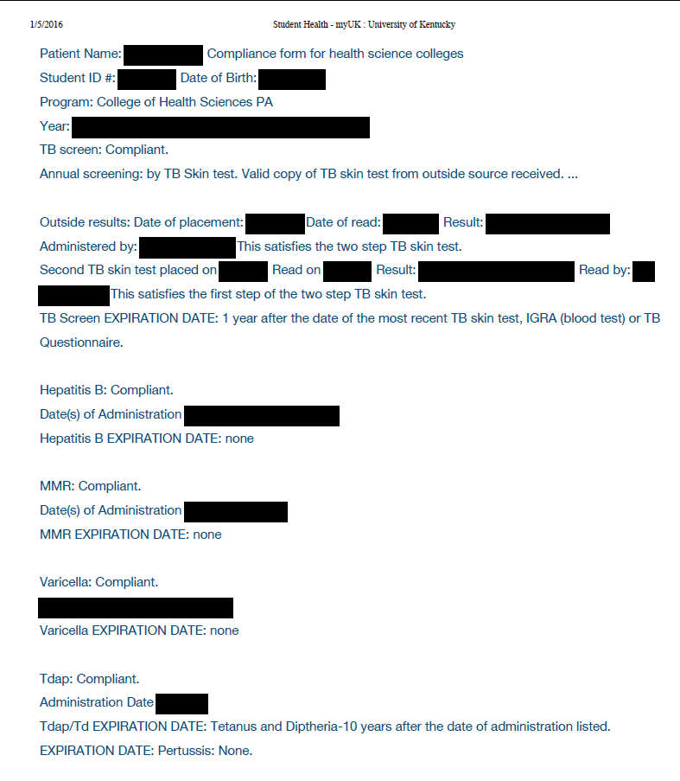
Tuberculosis Test
You must obtain one of the following to complete your TB requirement: IGRA, QuantiFERON, or T-Spot Blood test.
Each year you will have to renew your TB blood test.
Instructions for downloading documents from your MyChart in your myUK.

Slide 17
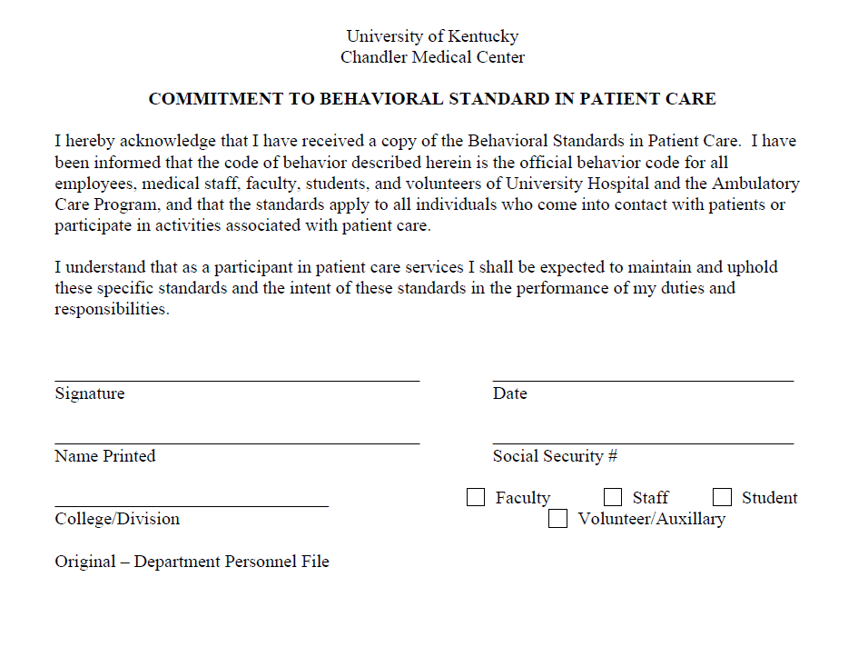
Commitment to Behavioral Standard in Patient Care
In Castle Branch, there is a link to this document. Follow this link to go to the document.
https://chs.uky.edu/current-students/compliance/forms
You will need to complete the last page of the document and upload to your CastleBranch account.
Then, take a picture with your phone or scan and upload it to Castle Branch (there are scanner apps you can download for free on your phone.)

Slide 18
CPR Certification
Acceptable document:
  American Heart Association BLS (Basic Life Support) /CPR Certification (Instructor led) for healthcare providers.
  Skills portion must be an in-person course (not completely online)
A copy of BOTH the front and the back of your card is required and the card MUST be signed.
More information can be found at the following link:
  https://cpr.heart.org/

Slide 19
HIPAA and Discrimination and Harassment Trainings
Go to this link and enroll in the Canvas course. (NOTE: You will need your LinkBlue ID and password to do so. If you do not yet have it, you will have to wait until you do.)
Go to “Assignments.” You will find the HIPAA training presentation and quiz. Before beginning the quiz, carefully read and review all the information in the presentation. When you are familiar with the material, take the quiz. You will have multiple attempts, but you MUST receive a 100% in order to get credit.
Follow the same instructions for the Discrimination training.
When both are complete, go to the “Grades” tab. You will then select the “Print Grades” option. Save the document as a PDF (you only need the first page that displays the two grades and your name).
Upload this PDF for BOTH the HIPAA and Discrimination training requirements in Castle Branch.

Slide 20
HIPAA Acknowledgement Form
In your CastleBranch account please download, complete, and re-upload the attached HIPAA Acknowledgement Form. Only the signature page is required, and it must be completed in its entirety.

Slide 21
The document you upload for the HIPAA and Discrimination training should look like this:

Slide 22
IPAC Questionnaire/
Behavioral Standard in Patient Care
Download the IPAC Questionnaire Form from this link: https://chs.uky.edu/current-students/compliance/forms
Print the form, read and fill it out completely. If you have traveled out of the country and experienced any of the symptoms listed on the form, you are required to contact your program director to discuss this issue and receive further instruction.
This requirement must be renewed annually.

Slide 23
Bloodborne Pathogens Training
Provided is the link on EHS Safety Training webpage for your online training. After completing the training and quiz you can download your quiz (100 out of 100) and upload to CastleBranch.
https://ehs.uky.edu/classes/classes_ohs_0001.php#bloodborne_pathogens_general

Slide 24
ACLS Certification
ACLS - American Heart Association Advanced Cardiac Life Support. There is a teaching component, skill check component and an examination. The examination must be passed to receive certification. The program has trainers that we use annually to provide this training. The students pay the trainers for the course. Proof of certification is a card (very similar to the BLS card) and it is good for 2 years.
This training is required before a student can go on clinical rotations. Training is completed in the Spring/Summer prior to the start of the clinical year so that it will last for the entire year. American Heart Association Basic Life Support training needs to be completed prior to completing ACLS training.

Slide 25
CPI/NCI Training
Crisis Prevention Institute's Nonviolent Crisis Intervention Training. This is workplace violence prevention training. The program has trainers that we use annually to provide this training. The students pay the trainers for the course. Proof of certification is a card (very similar to the BLS card) and it is good for 2 years.
This training is required before a student can go on clinical rotations. Training is completed in the Spring/Summer prior to the start of the clinical year so that it will last for the entire year.

Slide 26
Important Notes
Pay attention to due dates! If you do not complete the requirements in time, a hold could be placed on your UK account.
If Castle Branch rejects one of your submissions, promptly address this. They will provide a reason for the rejection. If you still do not understand why a document is not being accepted, you can contact CHS-Compliance at CHS-Compliance@uky.edu
Occasionally, flu shots get rejected if the flu season is not explicitly stated on the document. It is preferable for the date to be written on the document prior to uploading, but this can be overridden by CHS-Compliance if necessary. CHECK FIRST to see if this is the reason a flu shot is rejected.

Slide 27
CastleBranch QR code to place an order
Follow Instructions below:
Click on Place an order
Select “Physician Assistant Studies”
Select UK42dt: I need to order my Drug Test only ($30)
Or
Select UK42re: I need to order my Recheck Background Check only ($28)
Or
Select UK42redt: I need to order my Recheck Background Check and Drug Test ($58)

